Slide 1

Lightning talk: Space maths school visits
CETL-MSOR 2025
Liverpool University
MESH Research Group
Dr Nick Sharples
Dr Alison Megeney
Dr Brendan Masterson
Dr Zainab Kazim Ali
Dr Matthew Jones
Dr Snezana Lawrence

Slide 2

2000 + 1 A Space Maths Odyssey
STFC Public Engagement Spark Award
Aim: produce a publicly accessible digital game that challenges players to perform astronautical manoeuvres through completing relevant Key Stage 2 to Key Stage 3 (ages 8-14) mathematics questions.
Co-designed with target audience at outreach events.
Including school visits.
Our offer for schools:
We will design a maths session that builds on your most recent curriculum topic.
This session will have a design element to contribute to the game.

Slide 3
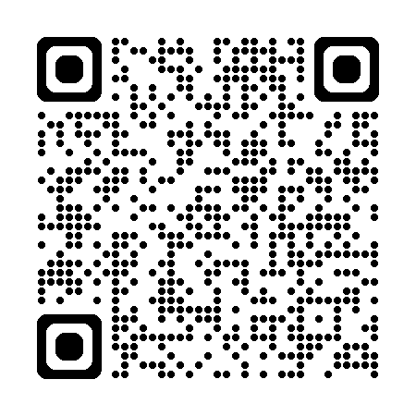
Resources:
Slides and Handouts
2000 + 1: A Space Maths Odyssey – MESH Research

Slide 4
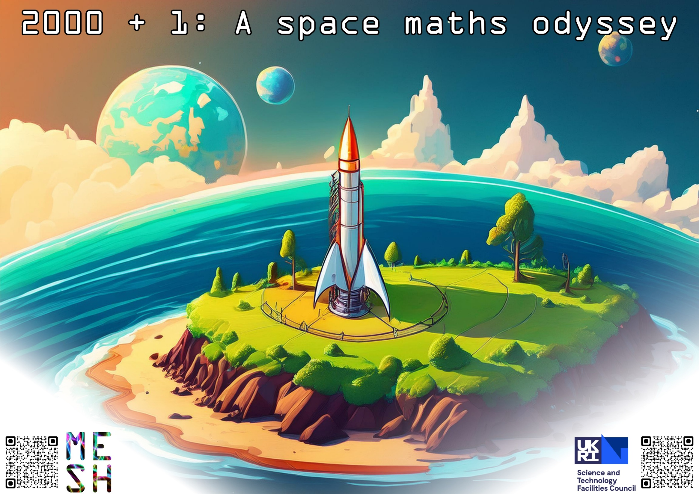
Landing page
Wren Academy
7&8 July 2025

Slide 5










Maths in space: mapping out the universe
How far away is the star?
$$d$$
$$89.9997°$$
$$p$$
$$30,000,000,000,000,000 \text{m}=1 \text{parsec}$$
What kind of triangle is this?
Right angled, scalene triangle.
What is the distance $d$?
$$≈150,000,000,000 \text{m}$$
What is the angle $p$?
$$0.0003°$$

Slide 6
Handouts

Slide 7
Results
4 schools over 5 days: around 600 Y7 and Y8 pupils.
State funded secondary schools (academies/maintained schools).
16:30 Pre/post data for attendee attitudes at outreach events (LT5)

Slide 8
“[activities like school visits] with Middlesex really build in me the sense of a community, that I belong somewhere and it feels like a home.”
RESULTS
“I wanted to experience a classroom setting in a totally different part of the world, which is much more developed compared to where I come from.
I was looking for things that I can bring back [to my home country].”
“learning… how we can adjust our communication and how we present material to gain audience interest and involvement.”
“the communication bit was very important and at the same time I feel like I also gained confidence”
“I don't really speak much. I'm not really open unless if it is very necessary... [the school visits] helped actually, and especially in domains like maths it is very hard.”
“I’m looking forward to becoming something like a curriculum developer or [part of a team to] reform the whole education system.”
“I love teaching in general… but my recent experience just showed me that maybe not secondary school.”

Slide 9
Summary
Open offer (“we’ll write something for your recent syllabus”) was very successful.
Involve students: they value
  Confidence building
  Experience of school environment
  Sense of wider mathematics community
  Staff development:
    Writing for a different audience (for whom engagement and application is critical!)
    Experience our students’ recent educational environment.

