Slide 1

Reflecting on two years of generative AI in assessment.
CETL-MSOR 2025
Liverpool University
MESH Research Group
Dr Alison Megeney
Dr Nick Sharples
Dr Brendan Masterson
Dr Zainab Kazim Ali
Dr Matthew Jones
Dr Snezana Lawrence

Slide 2
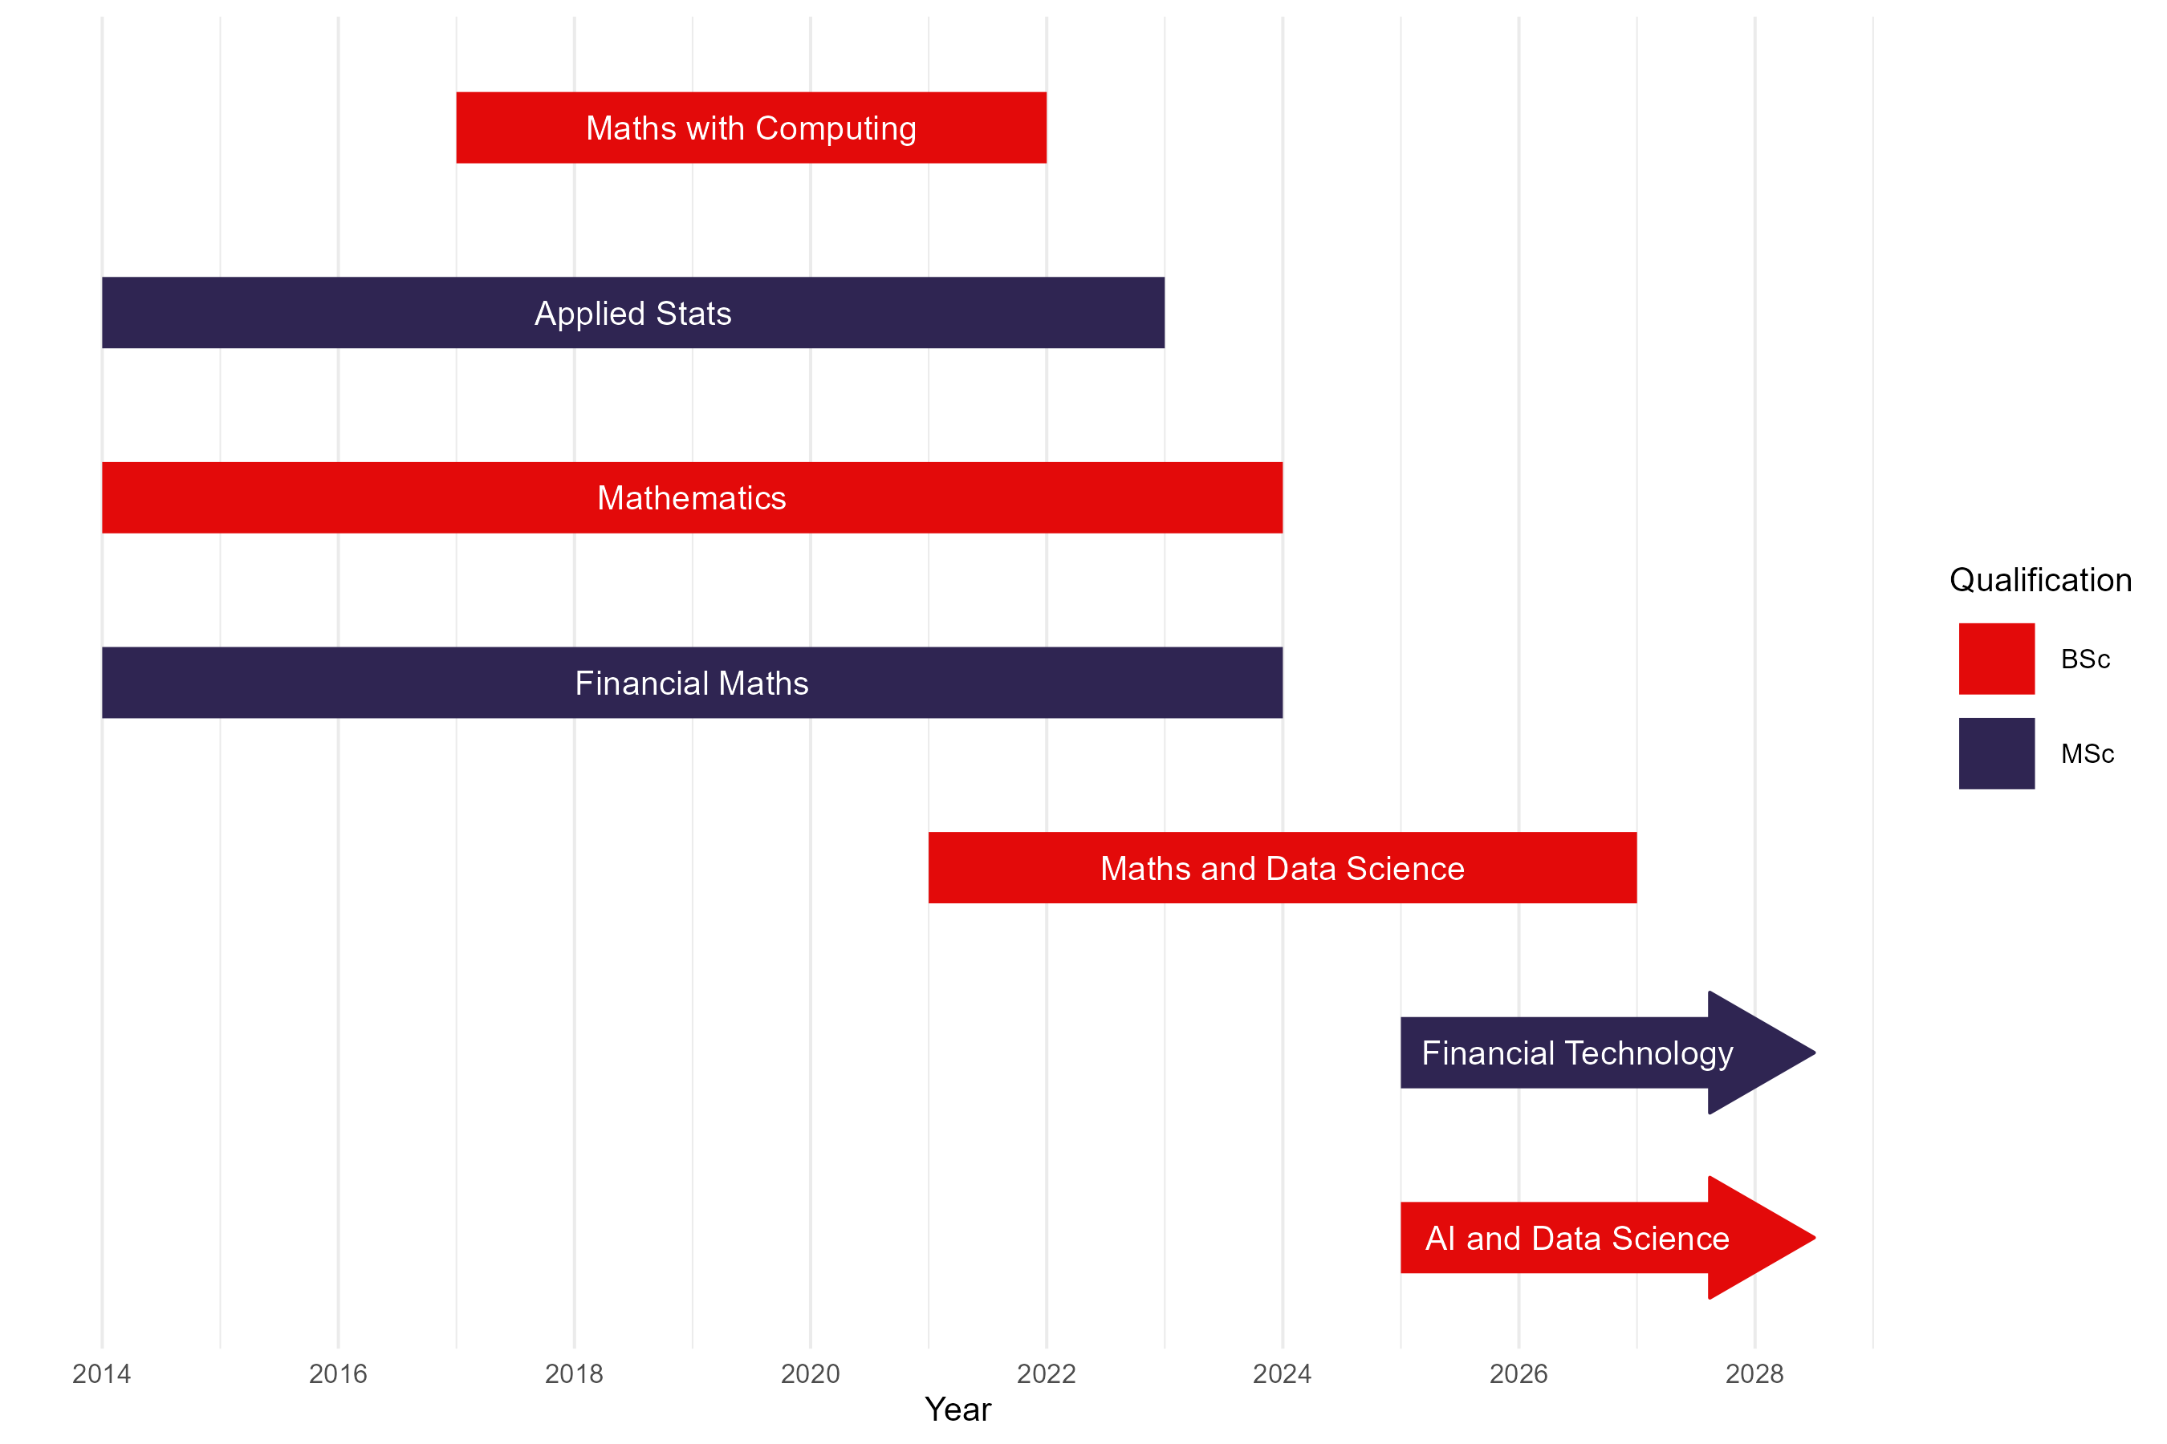
Maths at
Middlesex
Maths exams removed
University exams removed
GenAI elements included in maths assessment

Slide 3
Our students
The demographics of the MDX students have particular challenges:
    59% of Full-Time Undergraduates are from IMD quintile 1 or 2* (45% sector average)
    38.5% were eligible for free school meals (17.7% sector average)
    There is a digital divide between IMD quintiles (IPSOS Mori 2018) in whether technology is used for learning.
    Perhaps this also applies to GenAI.
*latest OFS 2022-23 access and participation data

Slide 4
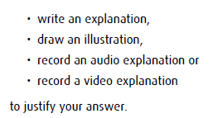


Before GEN-AI: Authentic assessment
Student agency: choice of subject matter and submission format.
Employability skills:
Communication
Creativity
Problem-solving
Collaboration
Reflection
Industry tools
Authentic assessment:
output appropriate for professional roles
Authentic problems:
input appropriate for professional roles
No exams

Slide 5
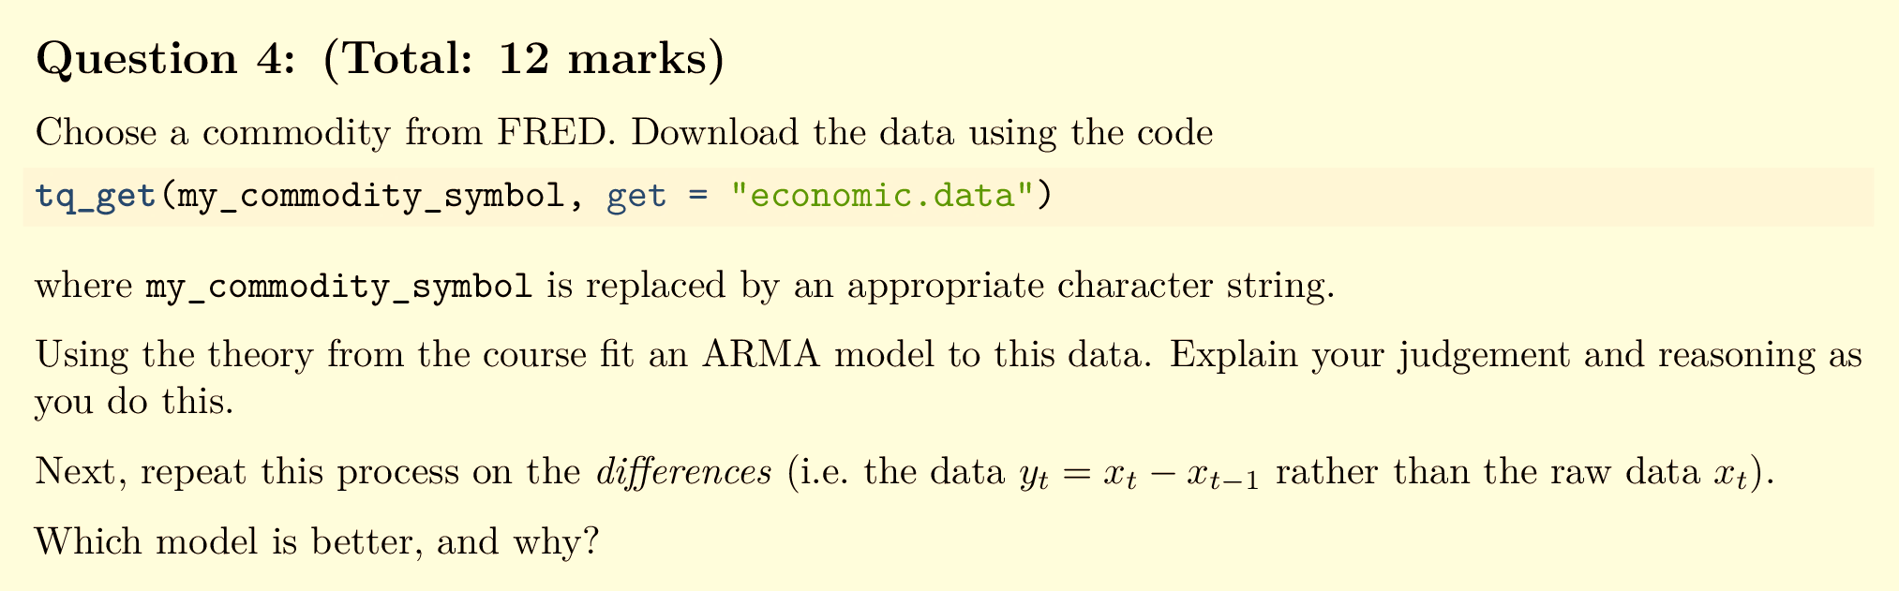
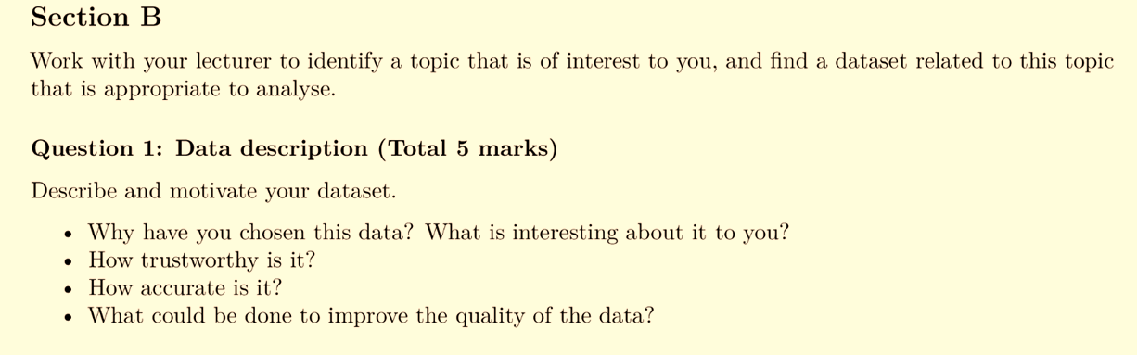
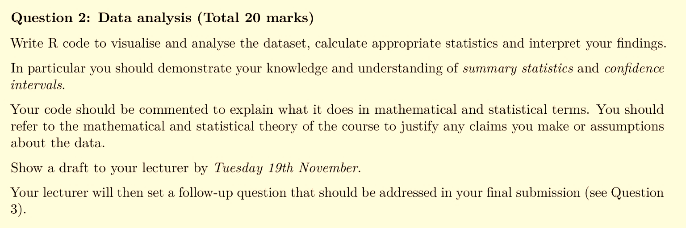
Examples:
Stochastic Processes for Finance
15 credits, level 6.
This question: 6% of grade.
Mathematical Statistics
30 credits, level 5.
This question: about 30% of grade.

Slide 6
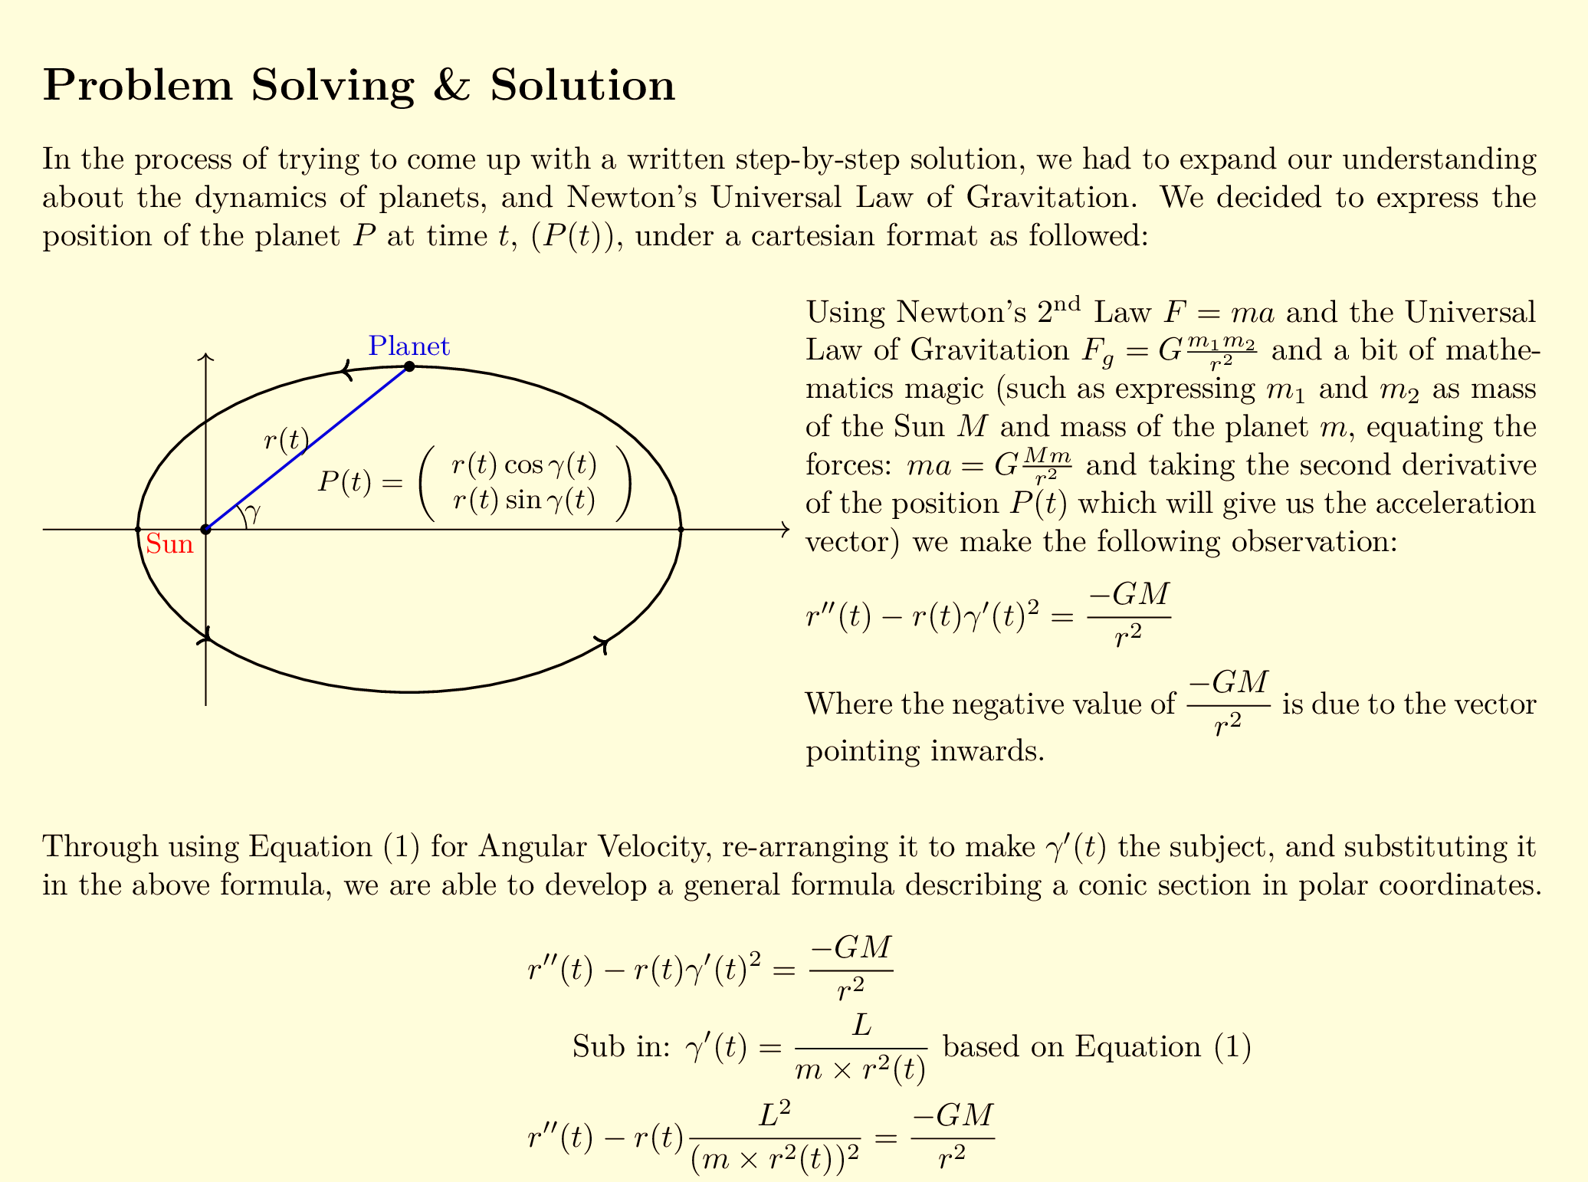
Example:
“A gravitational slingshot is a technique for speeding up a spacecraft without using fuel by “bouncing’” it off a planet…
Explore this manoeuvre. How much of a boost can the spacecraft be given?”
Problem Solving and Communication
30 credits, level 5.
Group assignment: worth 50% of grade.
Report
Introduction formulation and strategy: 10 marks
Problem solving: 30 marks
Solution: 10 marks
Conclusion, reflection and further work: 5 marks
Report written presentation: 5 marks
Presentation
Oral presentation: 20 marks
Slide deck: 20 marks
Worked on in timetabled workshops with guidance and support from lecturers.
Brief requirement: 1500 - 2500 words
(This submission: 7000 words)

Slide 7

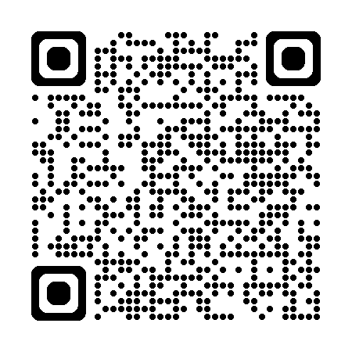
Reflections: TEAPOTS project
I just wanted to let you know that I've gotten my graduate job as a data analyst! Specifically, they were impressed with my communicating mathematics project.
[Choice of assessment format] can be overwhelming because we don't have those skills.
I’m afraid that I will plagiarise [from] the Internet… when I try to articulate my thoughts.
Most challenging part: Anxiety of starting
Workshop on Assessment and Wellbeing.
Greenwich, July 2024
What assessment would work best for you?
Emergent theme: In-class Oral Assessment
Ask questions like an interview… encourages you to think in the moment.

Slide 8
Current Assessment:
Authentic
AI-aware

Slide 9
Reflective ASSESSMENT
Problem Solving and Communication
30 credits, level 5.
“You are primarily being assessed on the approach you take to solving problems, rather than the actual solution”
Worked on in timetabled workshops with guidance and support from lecturers.
Report (60 marks, group)
Introduction Formulation and Strategy (10 marks)
Problem Solving (30 marks)
Solution (10 marks)
Conclusion, Reflection and Further Work (5 marks)
Presentation (5 marks)
“You give a thorough description of how you’ve approached the problem.
You explain what you have tried (that did and didn’t work), and identify which activities helped you progress.”
Most challenging part: Anxiety of starting
Reports can be validated as they include shared experiences:
Moments of realisation in workshops.
External resources/books they’ve found, then shared.
Failed attempts.
Sanctioned use of GenAI in exploring solutions.
I’m afraid that I will plagiarise [from] the Internet… when I try to articulate my thoughts.

Slide 10
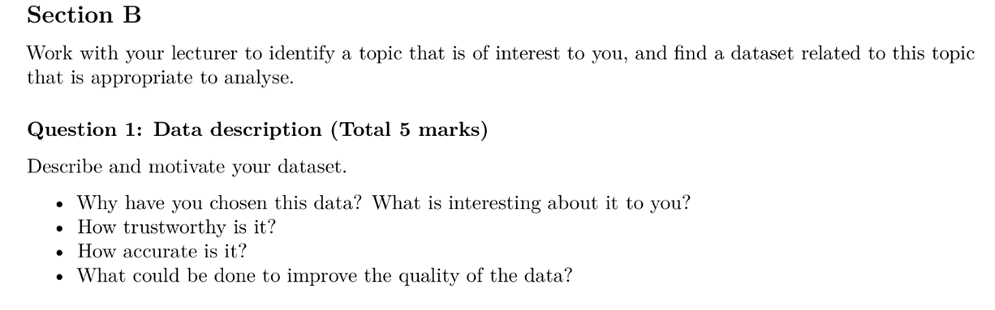
Personalised Assessment
Mathematical Statistics
30 credits, level 5.
Gentle opening question for a viva.
“As an aspiring financial trader, I spent 2018 to 2023 trying to better understand the system we all live under. It was particularly interesting to see how, why, and when the big financial institutions buy or sell assets, and how money circulates in the world…”
Ask questions like an interview… encourages you to think in the moment.

Slide 11
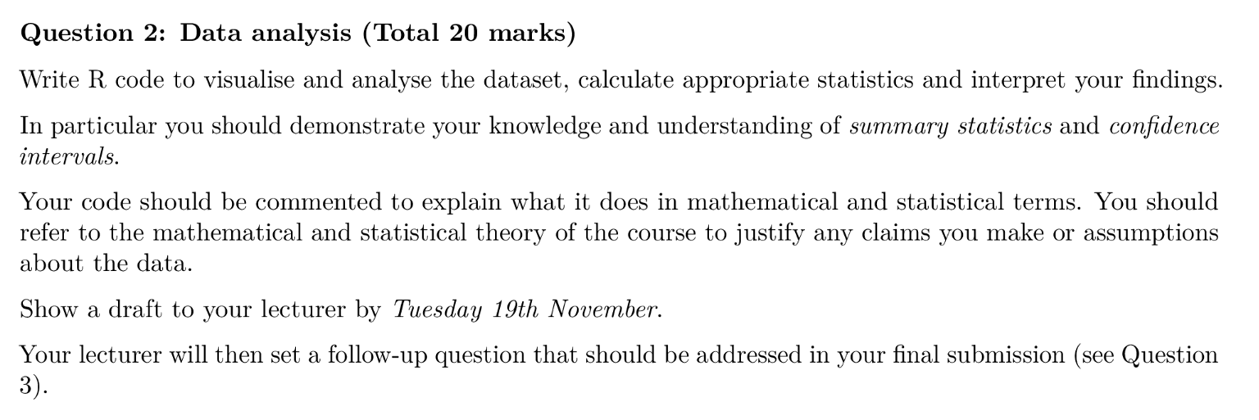
“The first step was to load the data onto R-Studio, and use the Tidyverse, Janitor, and Lubridate libraries to clean the data and only keep the information we were interested in…
The “year” column will store information about the year we are looking at, and it searches for that information by focusing on “Time Period” column, and the code "^\\d{4}" will search from the first input in that column, looking for any digits, specifying looking for 4 digits, and stores them as a number.
More significant question for a viva.
gold_monthly <- gold_data %>%
filter(str_detect(`Time Period`, "M")) %>%
mutate(
year = as.numeric(str_extract(`Time Period`, "^\\d{4}")))

Slide 12
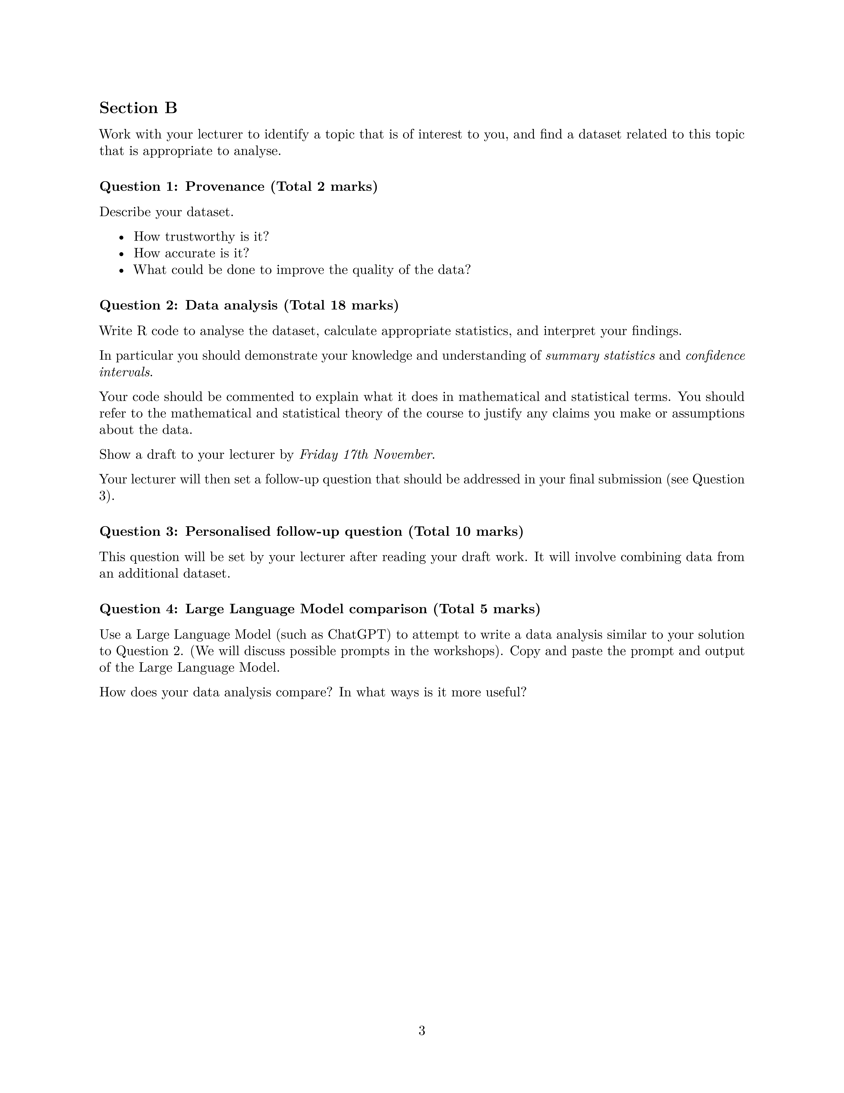
Continuous assessment
Multiple contact points while completing assignment
Bespoke follow-up question (Authentic! Graduate work is iterative and involves dialogue.)
Make opportunities to redirect inappropriate use of GenAI.
Monitor student progress through version control:
Photoshop history
Git
Microsoft OneDrive
“Your first version can be a skeleton produced by GenAI.”
“Your last version can use GenAI to correct grammar or restructure”.
“Include prompts and comment on any significant changes by GenAI”.
Assessment strategies:
review history on submission, or
review throughout assessment period, or
actively engage through comments/opening issues.
Most challenging part: Anxiety of starting

Slide 13
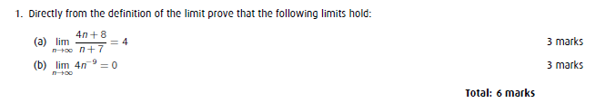
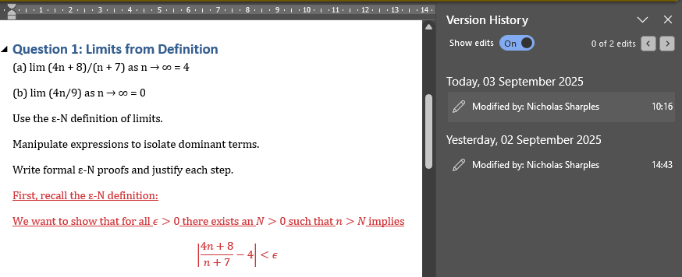
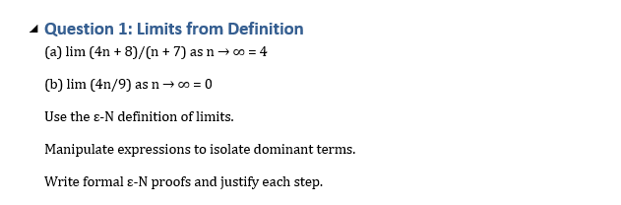

Example: WORD
Coursework1.pdf I've been set this piece of coursework. I don't want you to complete the assignment for me, as I need to learn this material and be able to defend my work in a viva voce.
However, I'm struggling to get started and I'm staring at a blank sheet of paper.
Could you produce a skeletal solution document, with some concrete next steps for me?
Here's a skeletal solution document to help you get started, along with concrete next steps for each question.

Slide 14

Student-Led Assessment
Problem Solving and Communication
30 credits, level 5.
Week 12 – Manim workshop
(Learn to animate like Grant Sanderson - 3Blue1Brown – YouTube)
Manim is a free, open source, Python-based animation engine.
It’s brilliant but has a steep learning curve. (I’m not proficient).
3 hour workshop:
Introduction.
Minimal working example
Use Copilot to build an animation of students’ choice of mathematical idea.
Neither Manim nor animation were on the syllabus.
There was no requirement that students use this for assessment.
[Choice of assessment format] can be overwhelming because we don't have those skills.

Slide 15
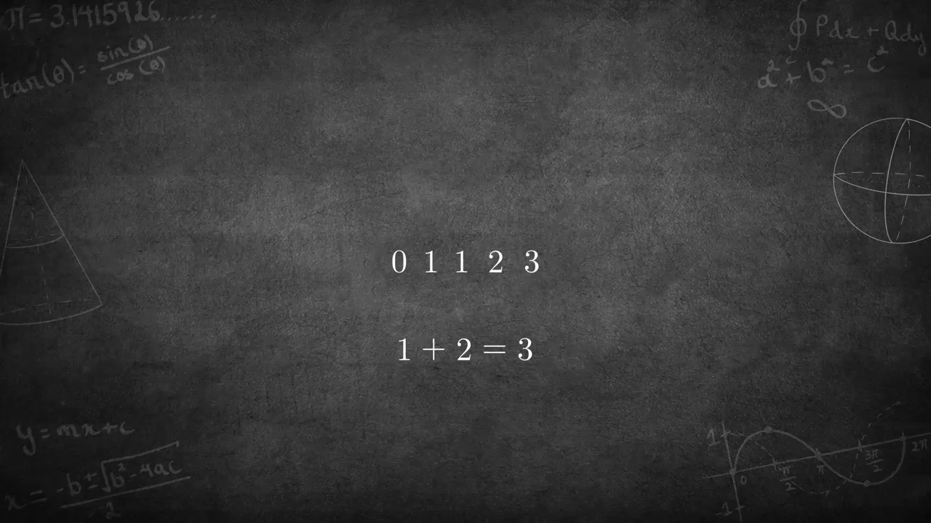

Slide 16
Comparative Assessment
Mathematical Statistics
30 credits, level 5.
Compare with ChatGPT output.
Authentic! Interviewees will need to demonstrate what they can offer over genAI.

Slide 17
Comparative Assessment
Mathematical Statistics
30 credits, level 5.
April 2025
April 2024
“I believe that the coding done by the large language model is clearer, particularly because each step is explained through comments.
Moving forward, I want to adopt this practice of providing clear explanations in my coding…
My analysis is better when it comes to a more
focused analysis (team or match-level analysis).
“[chatGPT] doesn’t determine what interesting variables could be for us. It just does every variable.”
“OpenAI was not able to produce short data analysis with sensible code.”
Some submissions had an “over-reliance” on GenAI.
These students didn’t attempt the comparison question.
“The explanation after the code is fantastic. DeepSeek is listing the concepts used and then the justification of those concepts.
It is true that LLM answer is very generic and, my explanation was more specific to one topic ‘Total Revenue’ .”
Students miss some negative features of GenAI:
data cleaning in a black box,
no justification of some techniques.

Slide 18
INSTITUTIONAL PICTURE

Slide 19
Return to Exams?
  “Authentic” assessment is now a core tenet of Middlesex’s New Learning Framework.
  This framework was adopted over 2023-25.
  Exams are not regarded as authentic.
  Exams are only permitted for modules with PSRB requirements.

Slide 20
Plagiarism 2023-24
  Metric: “Grade Amendment Forms”
  Used to add/update a student’s grade after an assessment board closes.
  One use: to action the outcome of (some) Academic Misconduct investigations.

Slide 21

Assessment Economics
Does any of this work in a class of 200 students?
Middlesex has a maximum seminar/workshop size of 30 students.
Received wisdom: exams are 10 times faster to mark than to sit.
180 minute exam
120 minute exam + 6 minute viva
60 minute exam + 12 minute viva
3 times 6 minute vivas
12 minute review of final submission + 6 minute viva
18 minutes per student
Draft submission is familiar from timetabled sessions.
Version history: have previous comments been actioned?

Slide 22
Summary and REcommendations

Slide 23
Recommendations for GENAI
Summative assessment time during scheduled sessions.
  Support students with appropriate use of GenAI during sessions.
  Flip: homework is to write-up, check understanding and bring questions.
  Mark scheme can emphasise the process (through reflection).
Summative conversations (viva voces).
  Naturally implemented with personalised assessment (student choice).
  Authentic output: write a document then defend it in a meeting.
  Students must understand their written submissions (even if authored by GenAI).
  Consider an analogue of Confidence-Based Marking.
Document (and assess) the process, sanction specific use of GenAI.
  Consider monitoring through version control.
Support and assess “learn a new skill using GenAI”.
Include critical comparison to GenAI output.

Slide 24
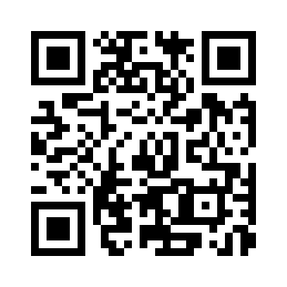
Questions?
meshresearch.org
MESH Research Group
Dr Alison Megeney a.megeney@mdx.ac.uk @DrAliMegs
Dr Nick Sharples n.sharples@mdx.ac.uk @nick_Sharples
Dr Matthew Jones matthew.m.jones@ucl.ac.uk @doc_jones1
Dr Zainab Kazim Ali z.kazim@mdx.ac.uk
Dr Snezana Lawrence s.lawrence@mdx.ac.uk @snezanalawrence
Dr Brendan Masterson b.masterson@mdx.ac.uk @BrendanMasters4

Slide 25
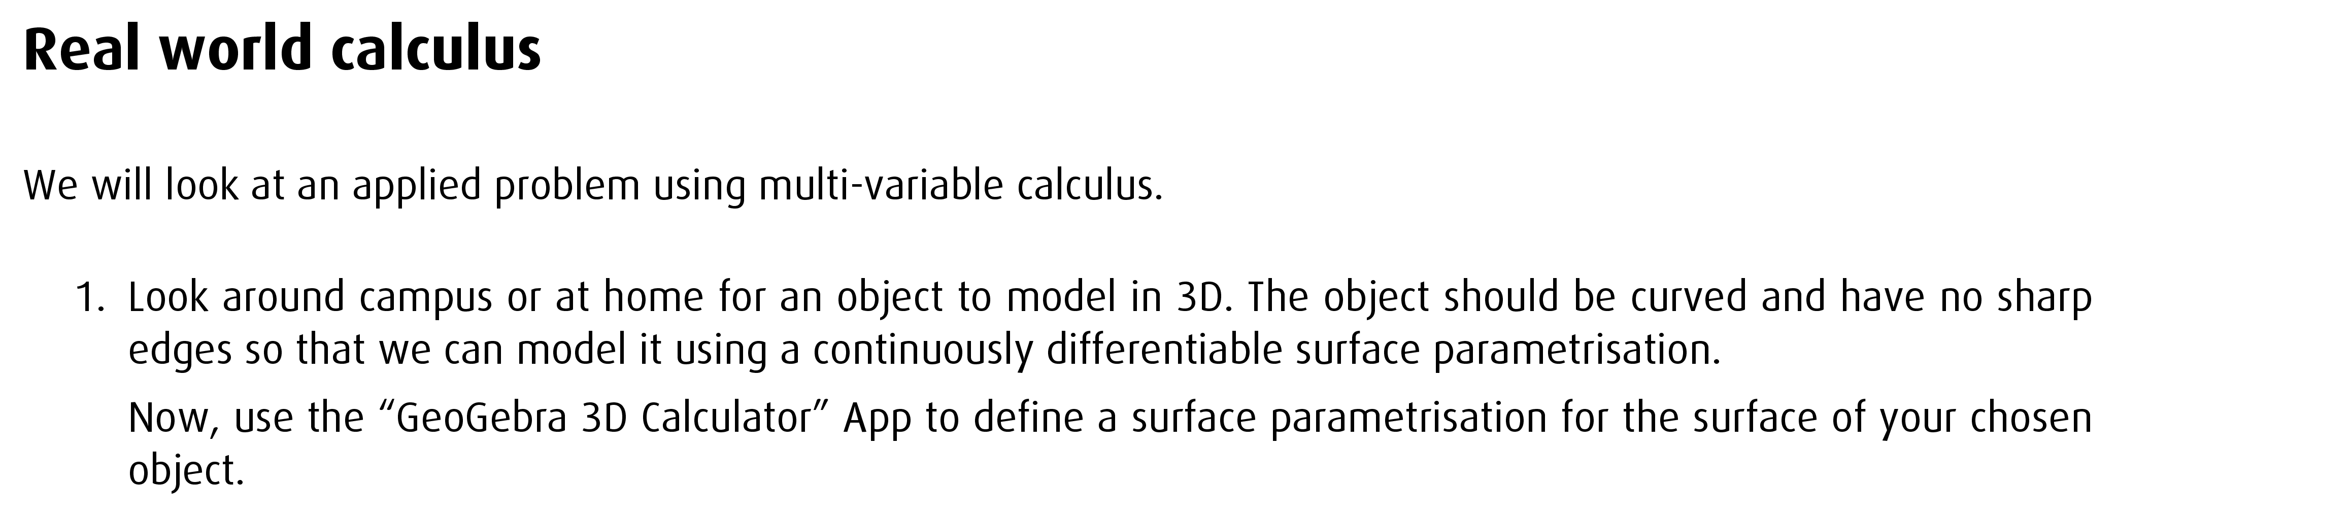

Human Judgement in Assessment
Multivariable Calculus
15 credits, level 5.
Let’s try a banana:
Bananas are curved.
Let’s say the curve is a cubic.
Bananas can be sliced into circles.
Find the tangent plane to the curve.
Vary the radius of the circles.

Slide 26
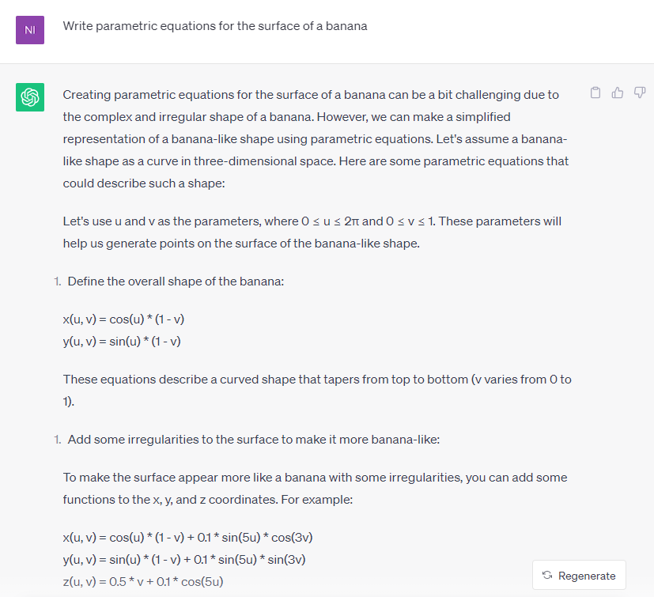
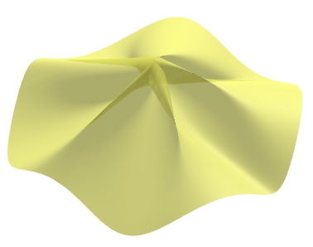
August 2023 – GPT4

Slide 27
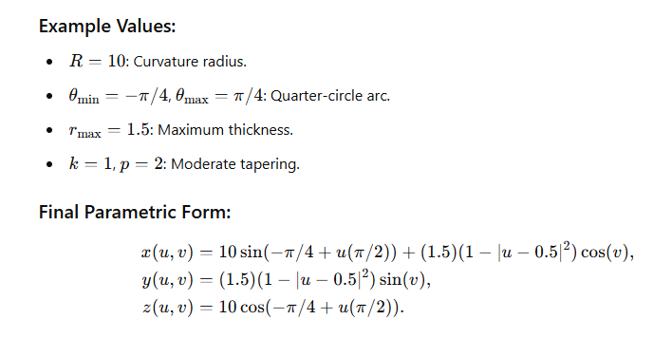
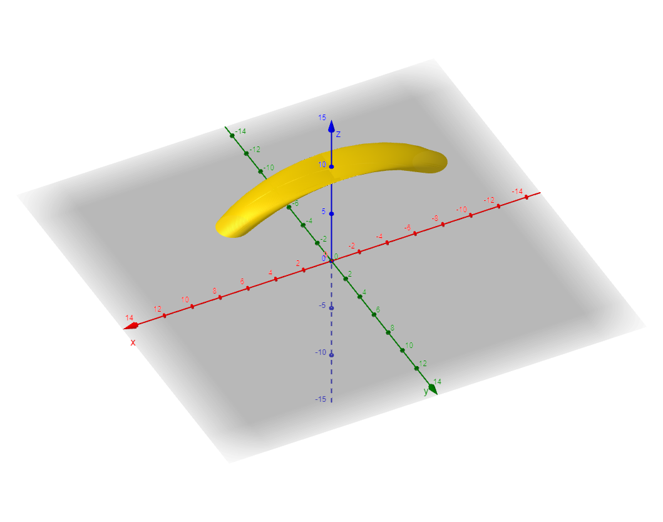
February 2025 – GPTo1

Slide 28
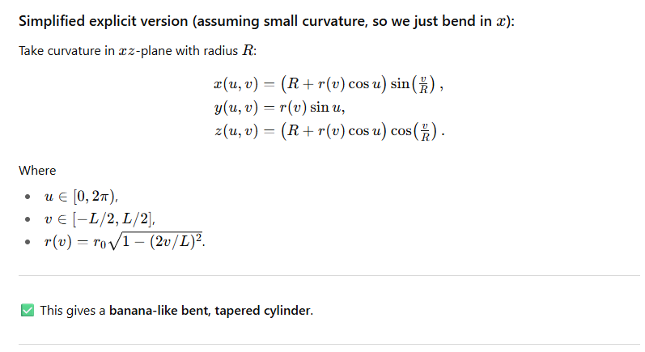
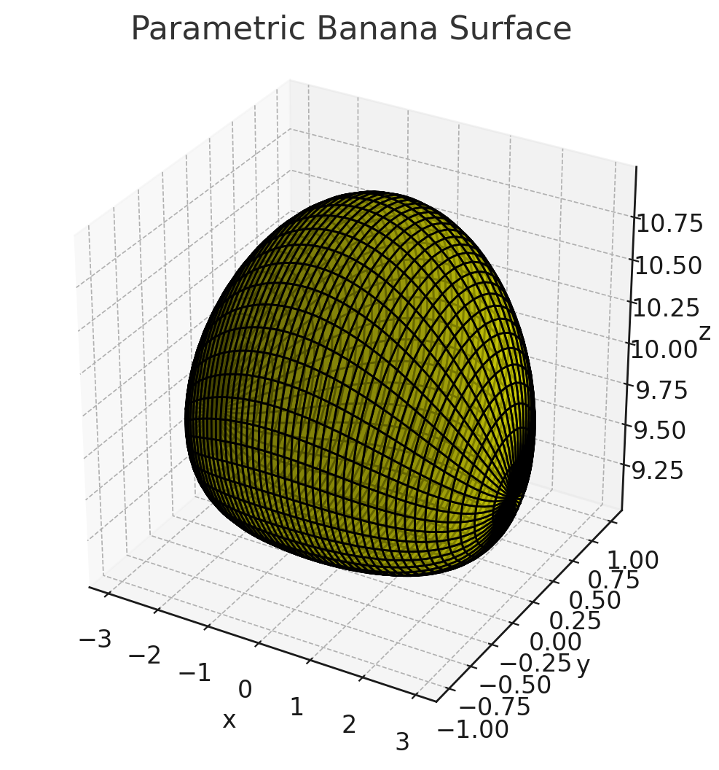
August 2025 – GPT5

Slide 29
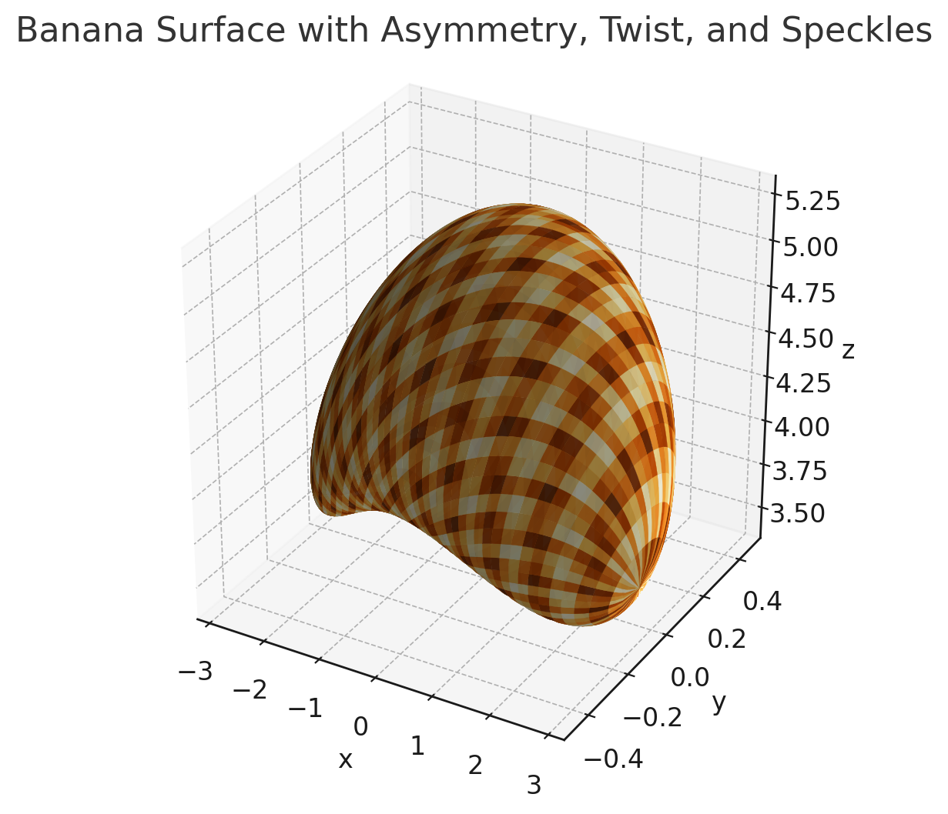
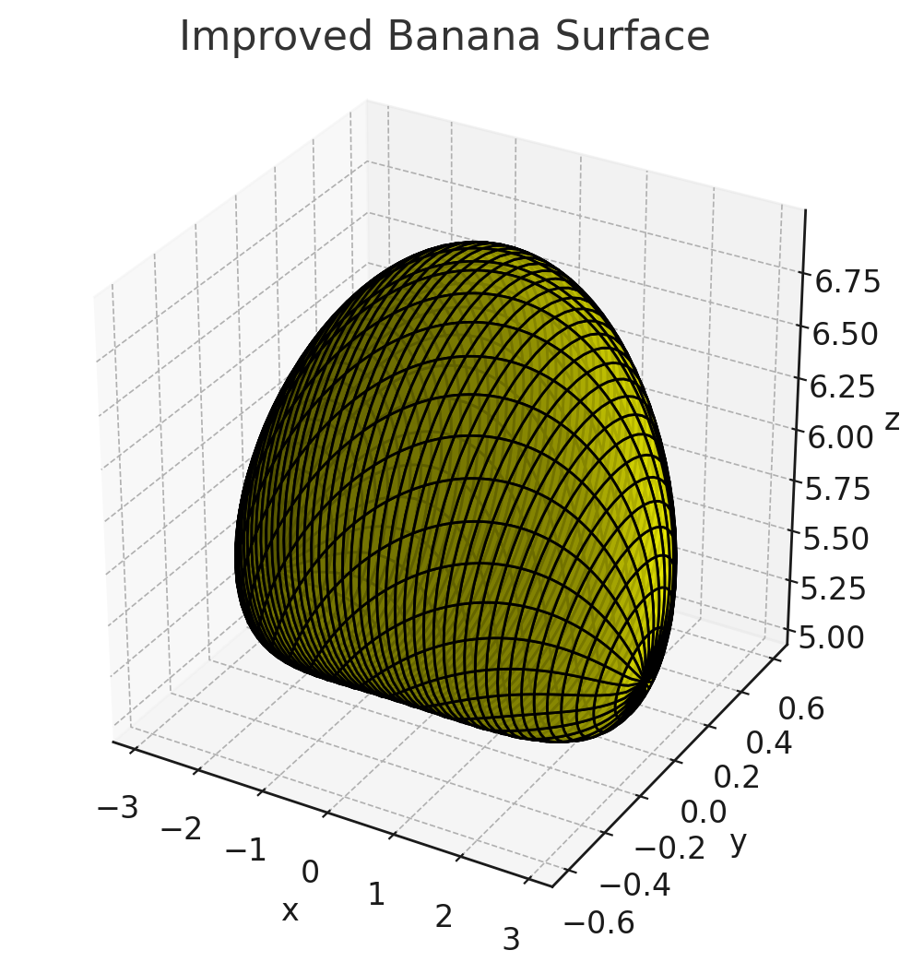
Can you examine the generated image, decide if it looks sufficiently like a banana, and if not update the parameters in the parametrisation and replot?
(5 iterations)

