Slide 1
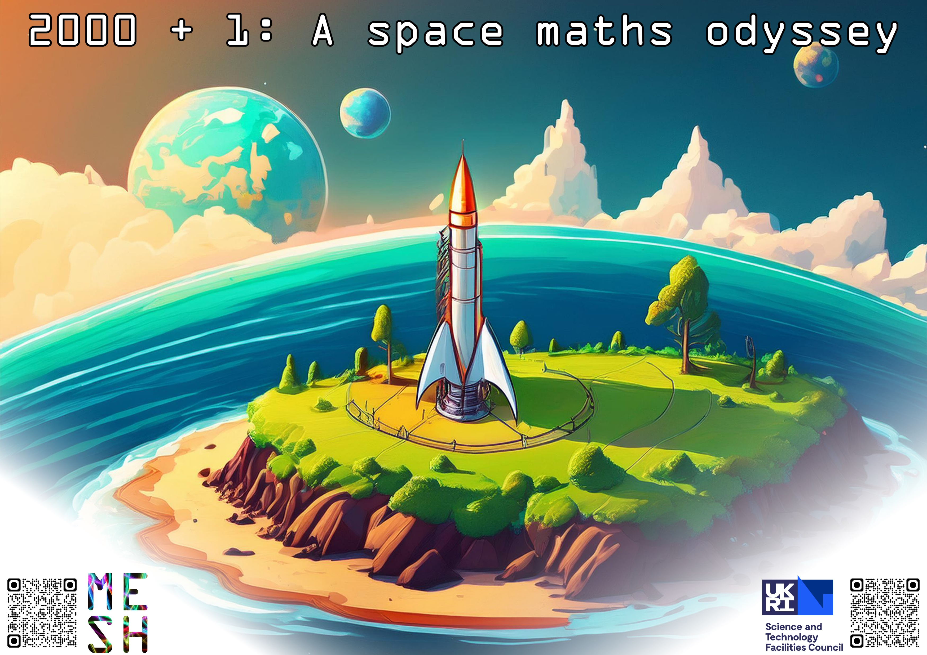
Landing page
Wren Academy
7&8 July 2025

Slide 2
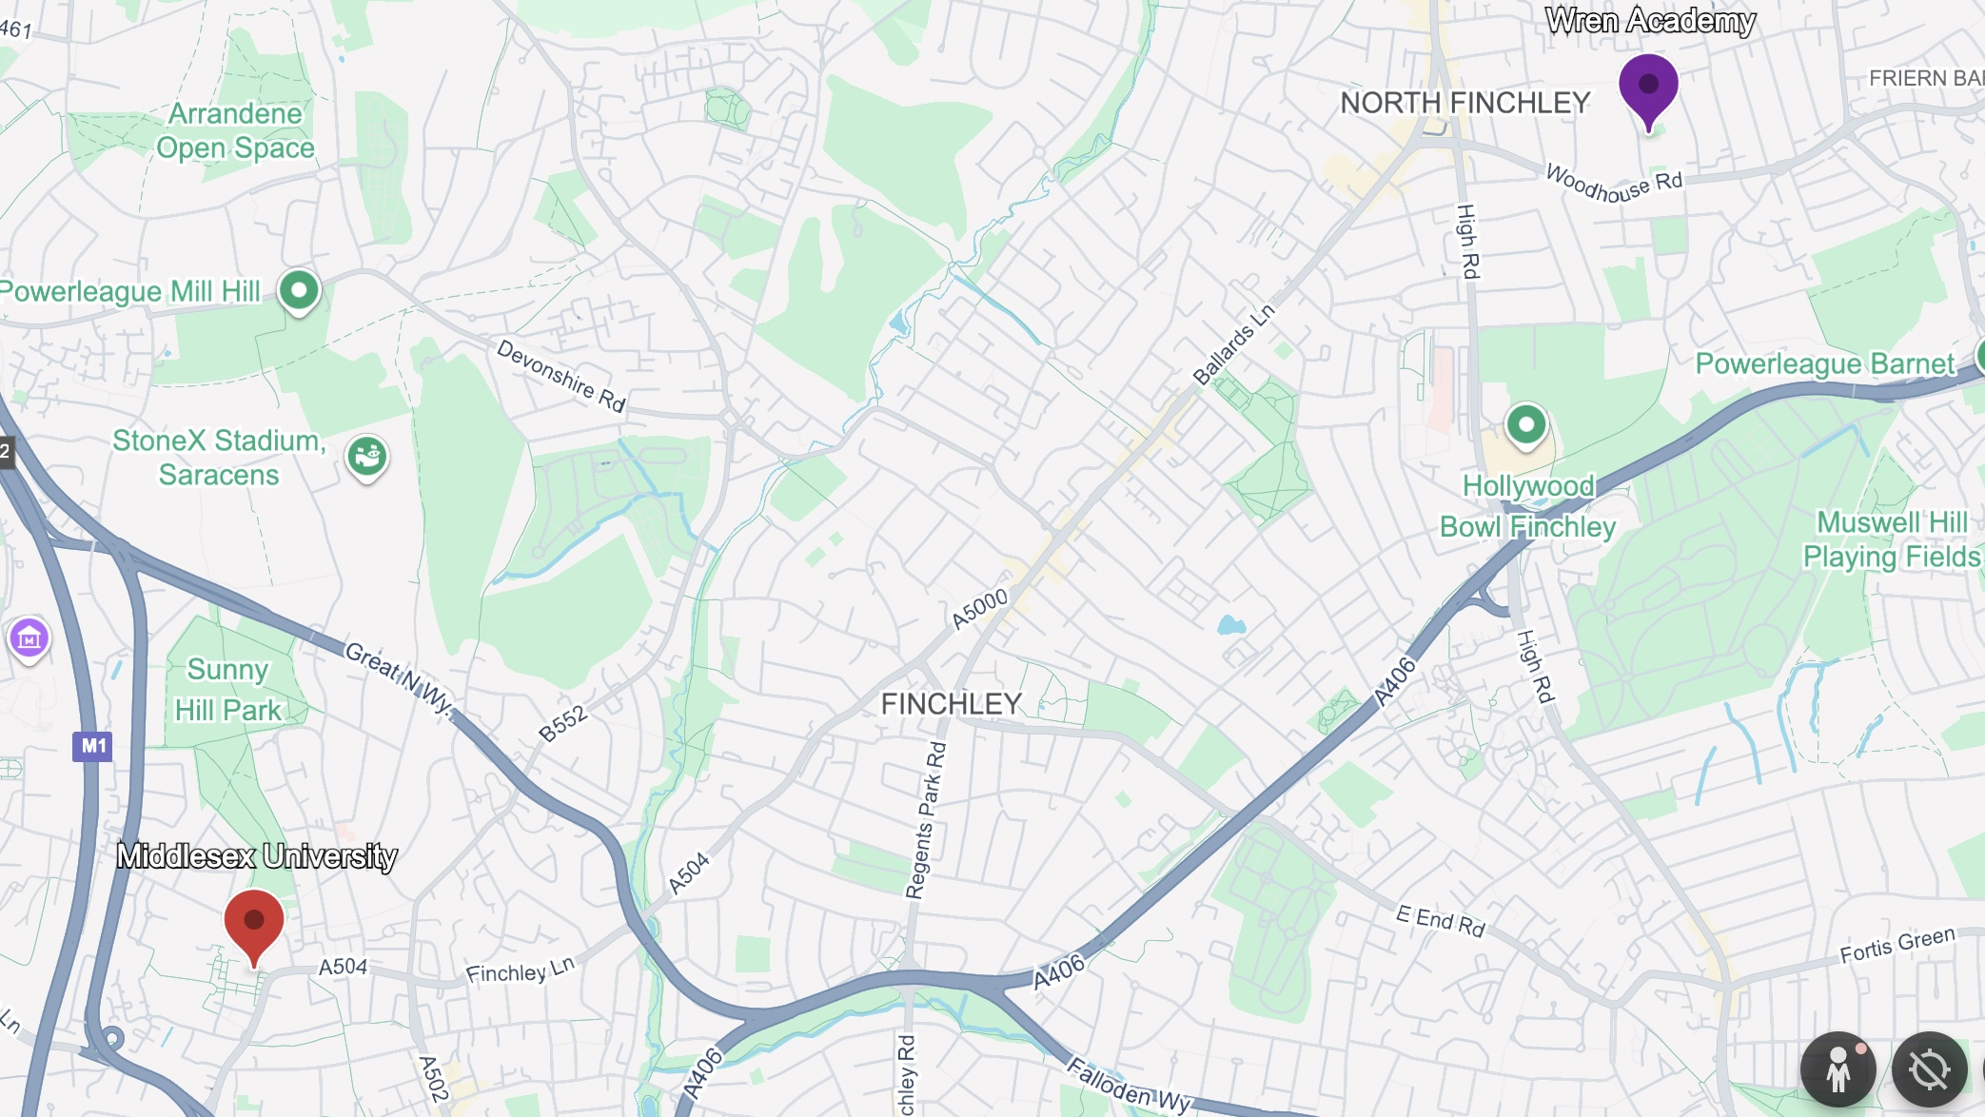
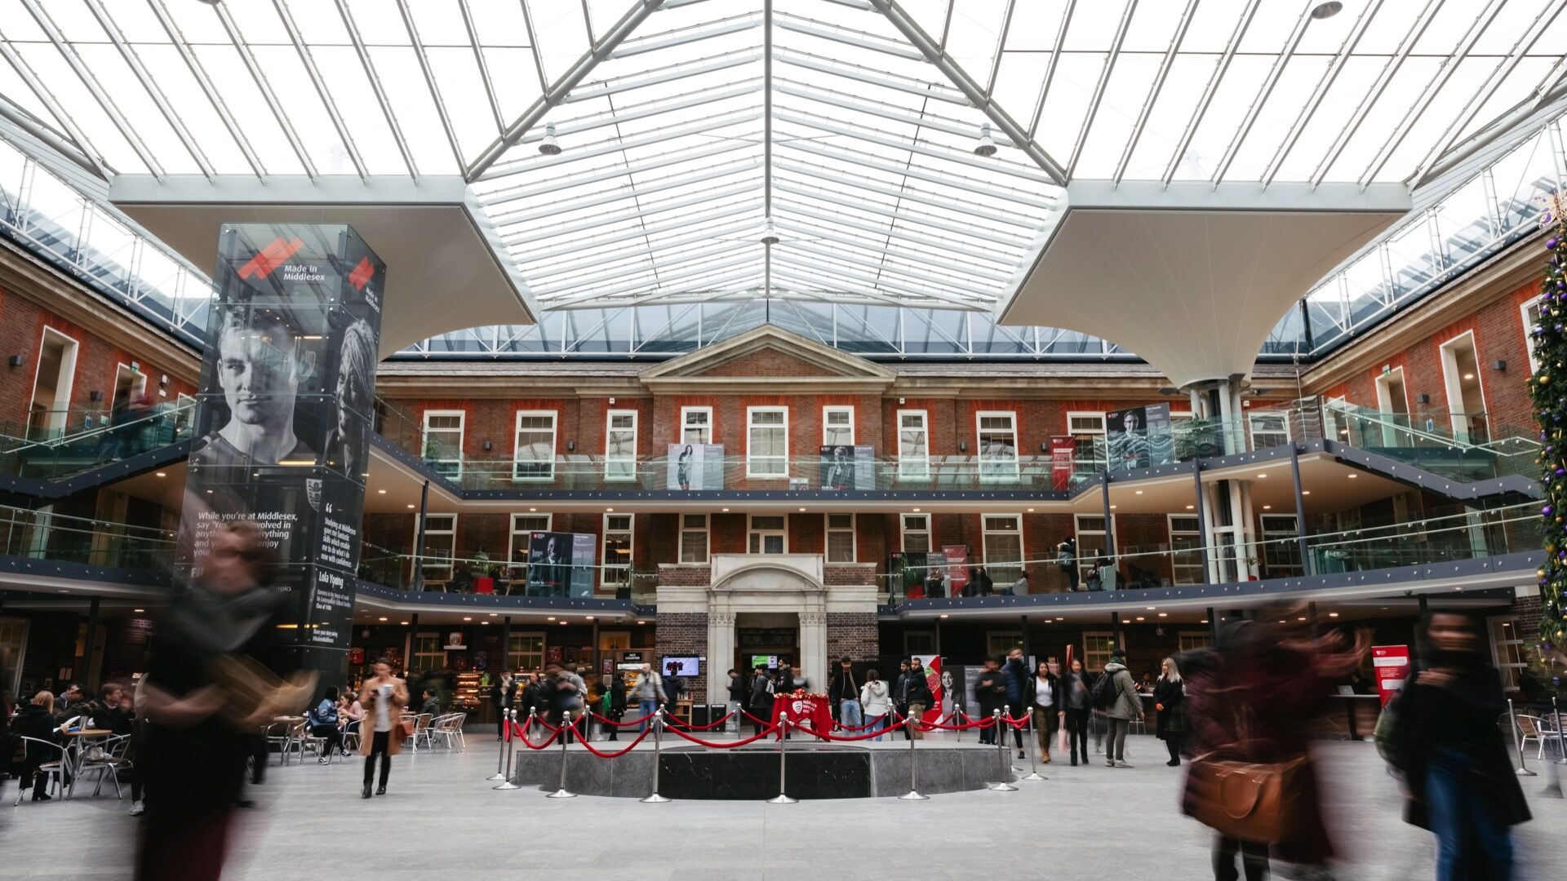

Welcome!
Associate Professor in Mathematics
Dr. Thomas Bending
Dr. Brendan Masterson
Dr. Nick Sharples
Senior Lecturers in Mathematics

Slide 3
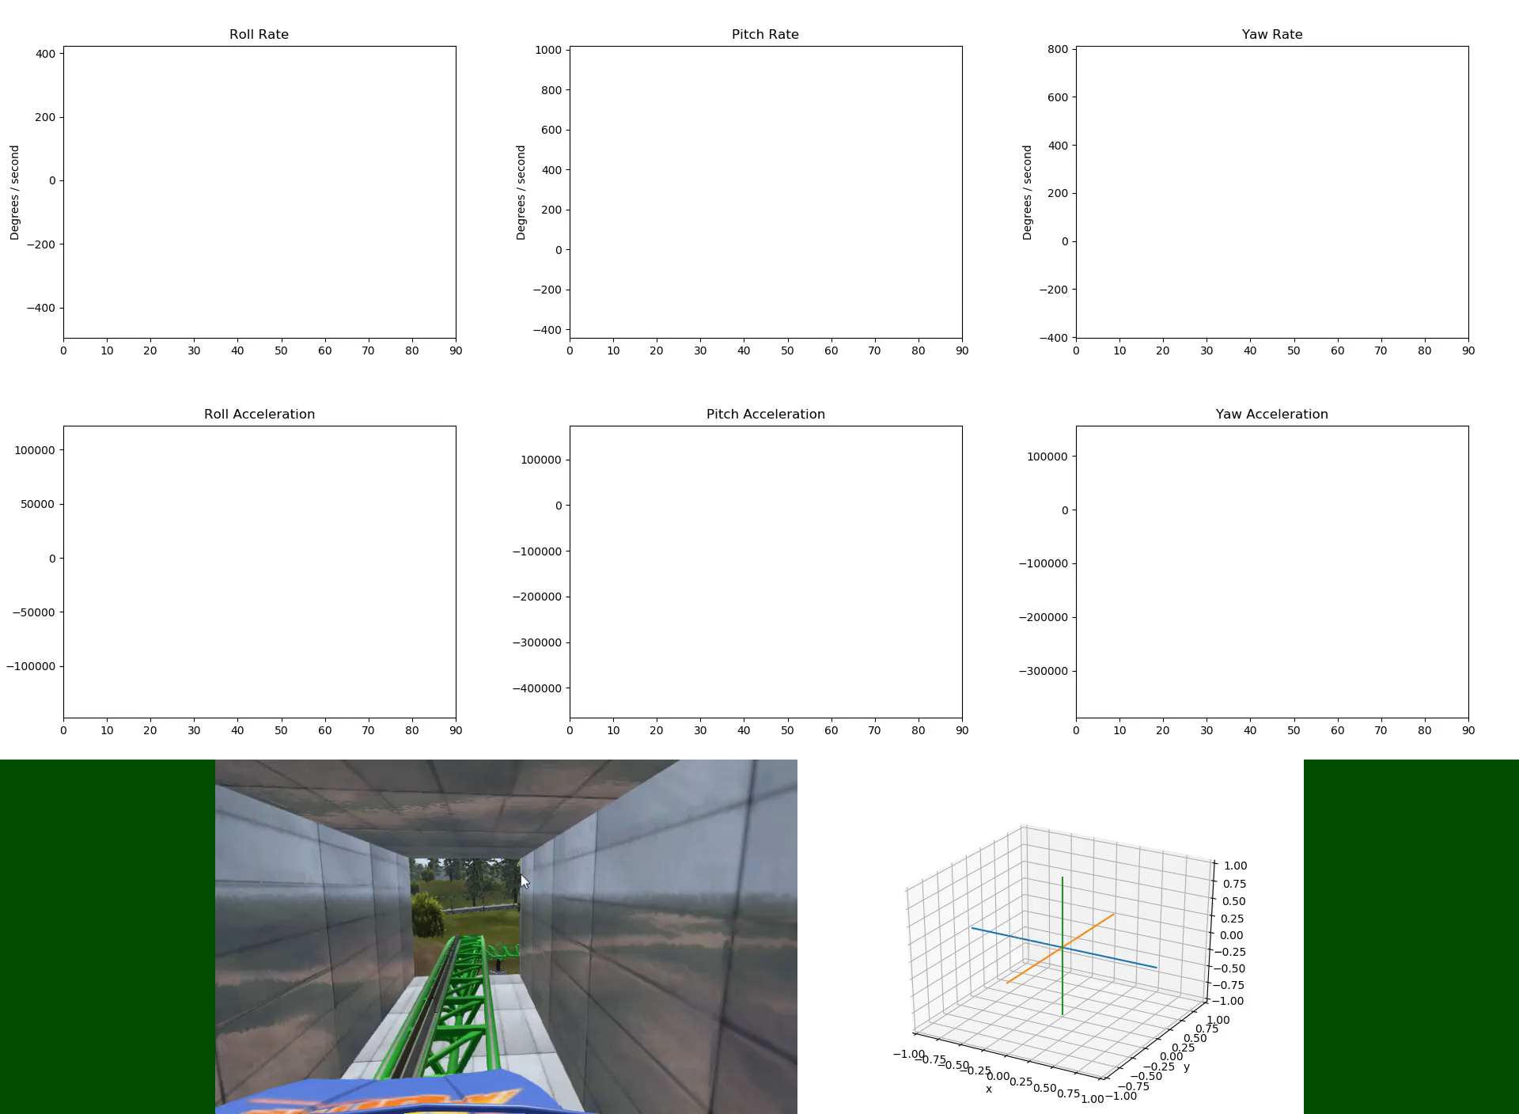
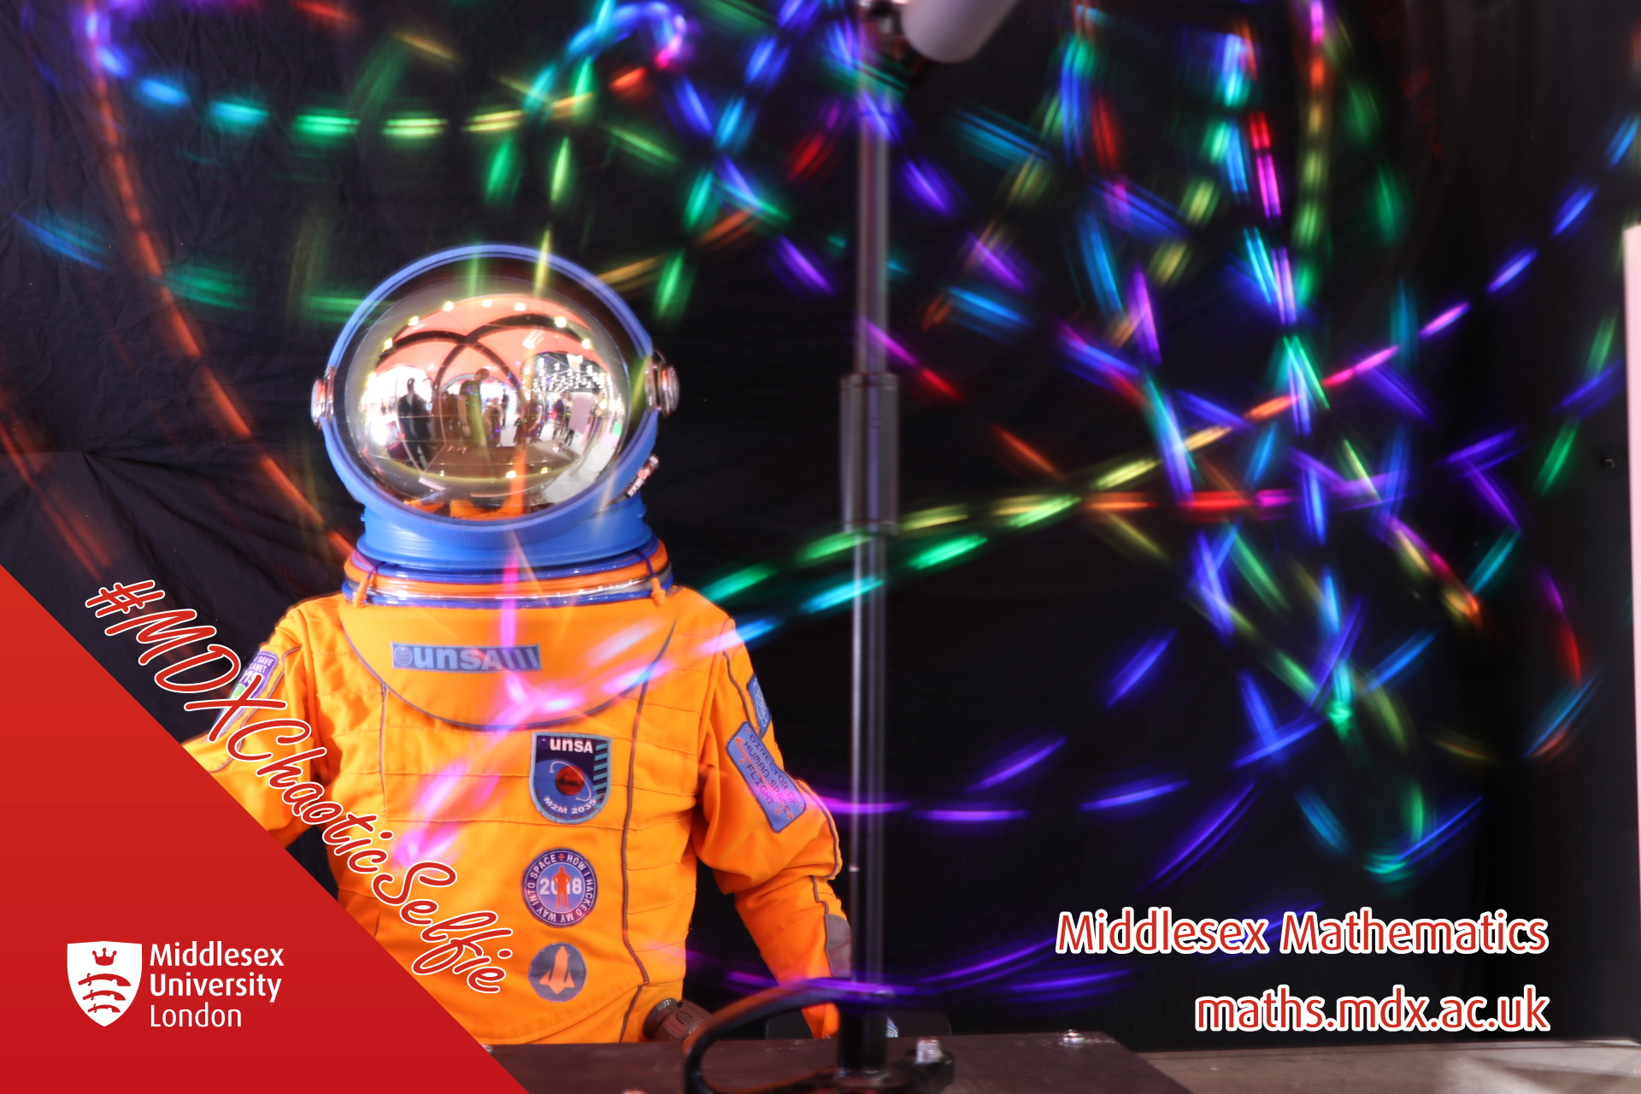
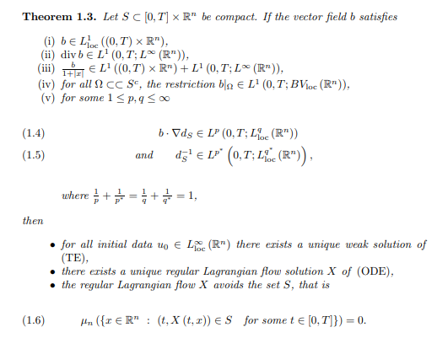
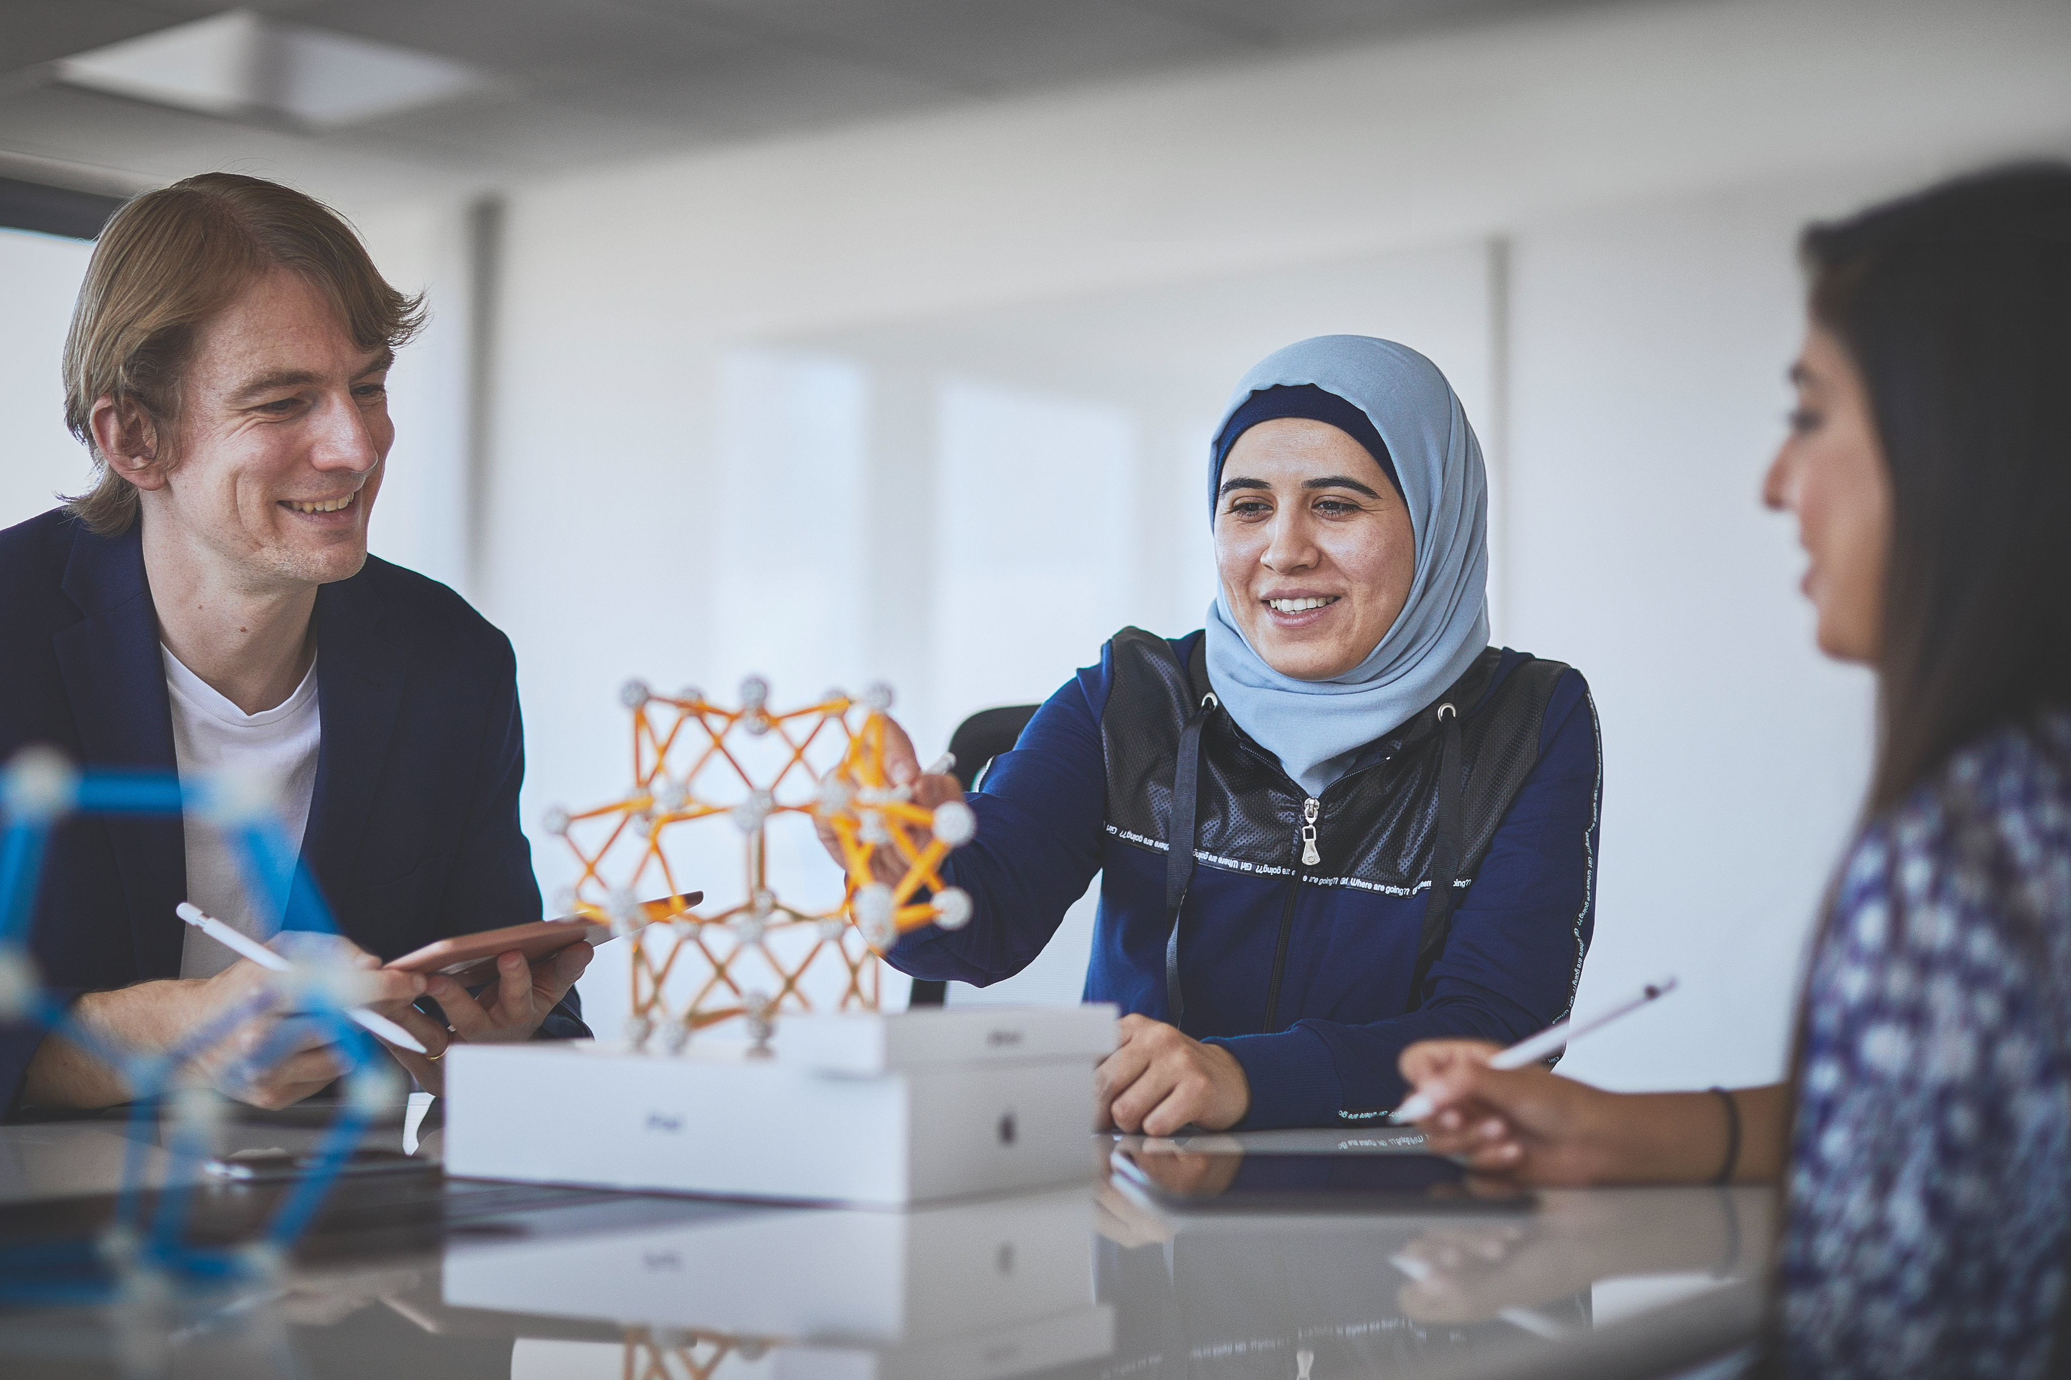
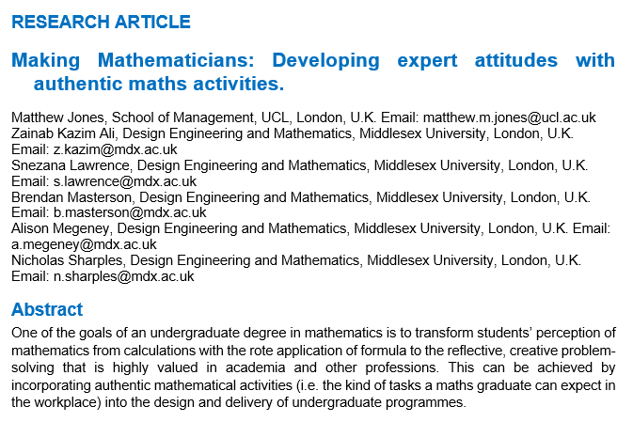
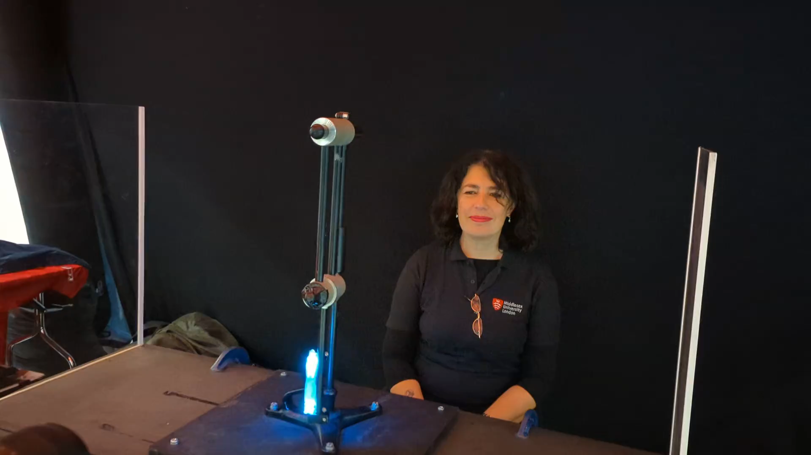
What do we do
Teach maths
Discover new maths
Find better ways of teaching maths
Outreach: bring maths into the community

Slide 4

Today: Space Maths
5:00
First: a short questionnaire.
We’re trying to understand how young people feel about mathematics and science.
Only complete the first side (for now).

Slide 5
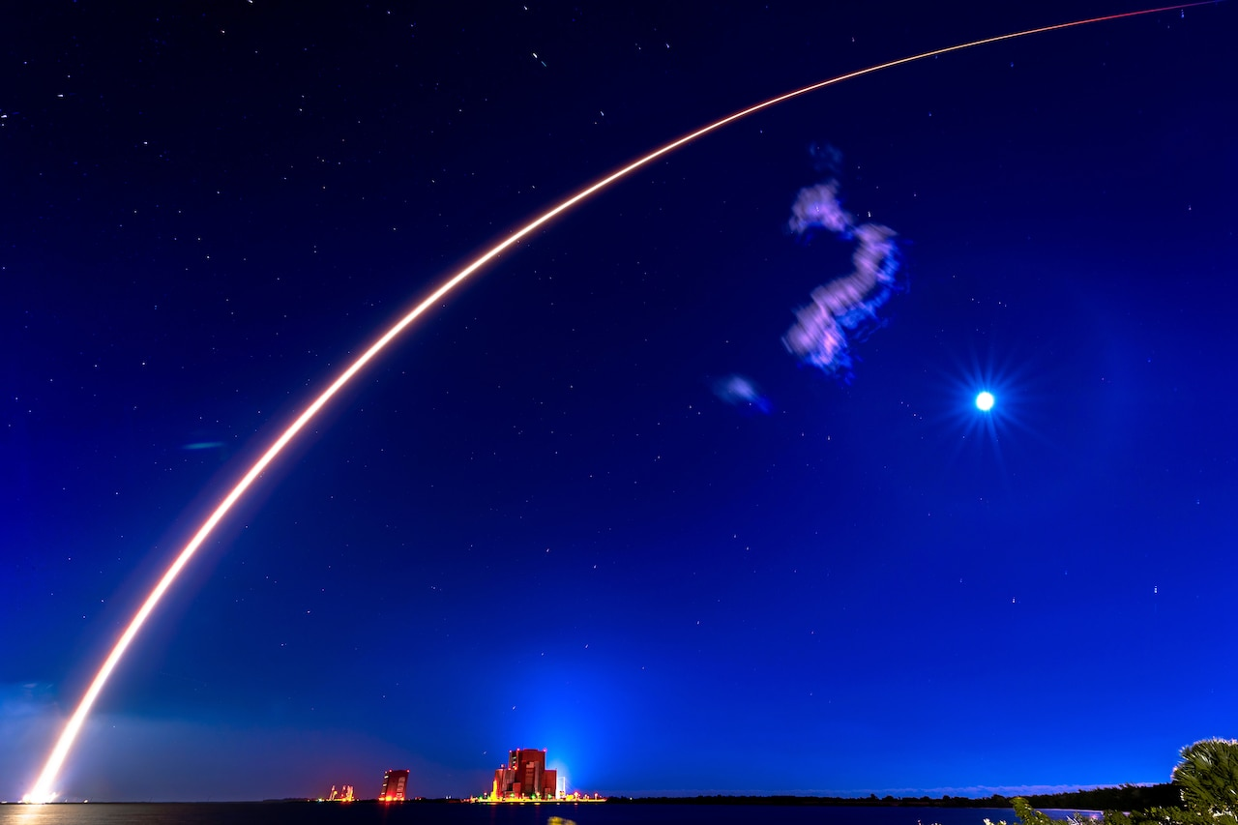


Maths in space: launches and trajectories
Maths needed:
Speed
Angles
Time
150 seconds after launch, an Apollo rocket is travelling at 3000 m/s.
What is the average acceleration of the rocket?
$$20 \text{m}/{\text{s}}^{2}≈2\text{g}$$
Credit:
Joshua Conti, Space Force

Slide 6









Maths in space: mapping out the universe
How far away is the star?
$$d$$
$$89.9997°$$
$$p$$
$$30,000,000,000,000,000 \text{m}=1 \text{parsec}$$
What kind of triangle is this?
Right angled, scalene triangle.
What is the distance $d$?
$$≈150,000,000,000 \text{m}$$
What is the angle $p$?
$$0.0003°$$

Slide 7
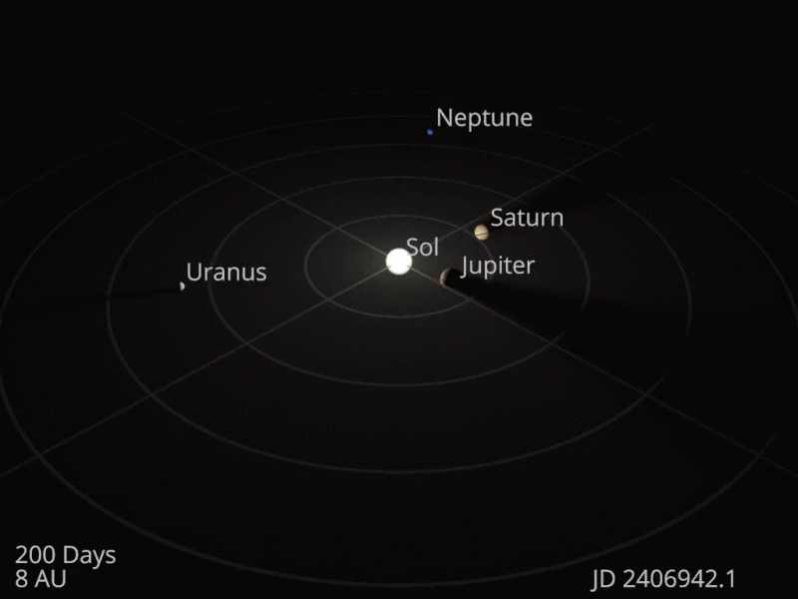
Maths in space: understanding the cosmos
Cosmologists try to understand how the
Datumizer, CC BY-SA 4.0 <https://creativecommons.org/licenses/by-sa/4.0>, via Wikimedia Commons

Slide 8
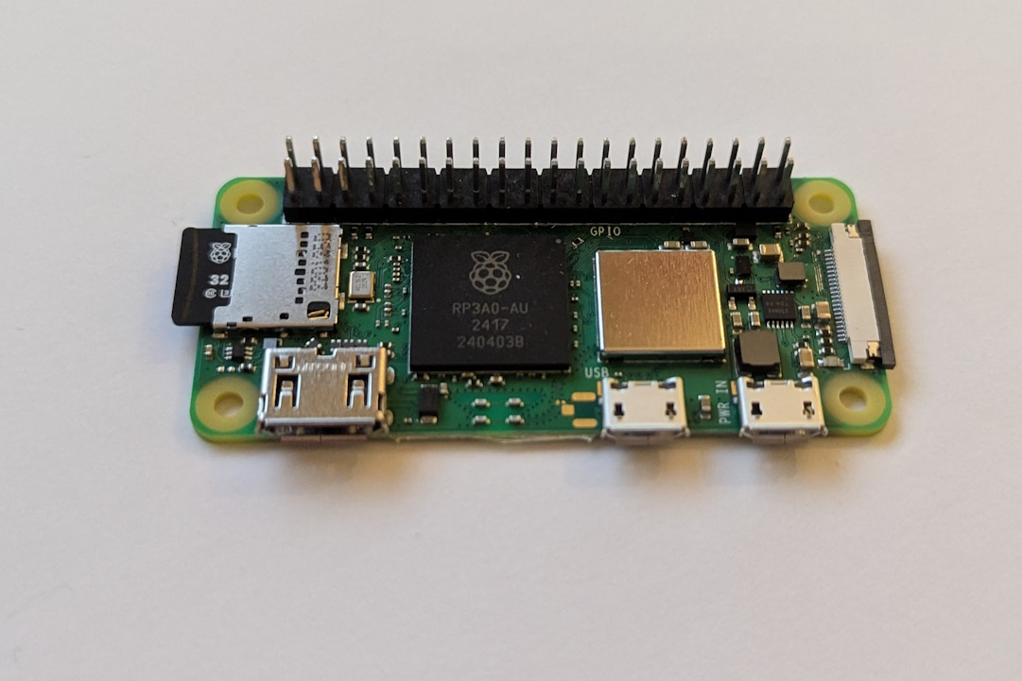

Solar Power in Space: Shape and Area
System-on-a-chip
Each cm² of solar panel receives $0.05 \text{Watts}$ of sunlight power
1 cm²
Solar irradiance of Mars.
The best solar panels convert half of sunlight power into electrical power

Slide 9
Solar Power in Space: Designing Solar Panels
Parallel lines
Draw matching arrows on lines that are parallel
Lines of symmetry
Draw dashed lines to show the lines of symmetry

Slide 10

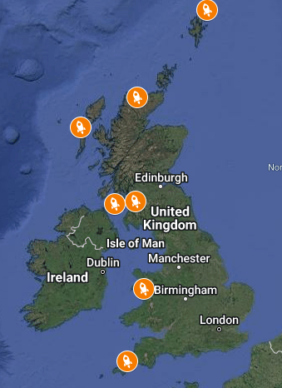
Science and Technology Facilities Council
Mission: Discover the secrets of the universe.
One of 7 tax-payer funded Research Councils in the UK.
Budget of £1.6 billion (2024-25) to invest in scientific research.
Focuses on funding expensive scientific facilities such as:
Central Laser Facility (in Rutherford, between Reading and Oxford)
National Quantum Computing Centre
Accelerator Science and Technology Centre (in Warrington)
UK Astronomy Technology Centre (in Edinburgh)
Square Kilometre Array Observatory (international project in South Africa and Australia)

Slide 11

2000 + 1: a space maths odyssey
We’re working with the STFC to make a computer game to teach maths!
We’re co-creating this game with young people in many schools, and would love to collaborate with you.
Have a go at designing solar panels for this game.
If you’d like your ideas to be included (under a creative-commons BY-NC-SA license) then either:
Hand your worksheet or let us take a photo of your work

Slide 12
Evaluation
5:00
Finally, finish the a short questionnaire.
We’re trying to understand the effect of activities like those you’ve done today.
Thank you for listening! Do you have any questions?

