Slide 1
Public engagement for student empowerment
CETL-MSOR 2024
Limerick
29th August
Dr Brendan Masterson
Dr Alison Megeney

Slide 2
Our students
The demographics of the MDX students have particular challenges:
59.0% of Full-Time Undergraduates are from IMD quintile 1 or 2*
38.5% were eligible for free school meals*
Digital poverty presents a significant obstacle to success for our students.
*latest OFS 2022-23 access and participation data
Notes:
sector: 30.4% parents are Higher managerial, administrative and professional
MDX – 13%
FSM – top non-private full university.
iPads were introduced to have a common platform to address digital poverty.
UDL
Diversifying LTA assessment
Inclusive, more choice,
Employability – confidence – lack of social capital
Do I belong
Is the cost worth it
Will I get a job

Slide 3
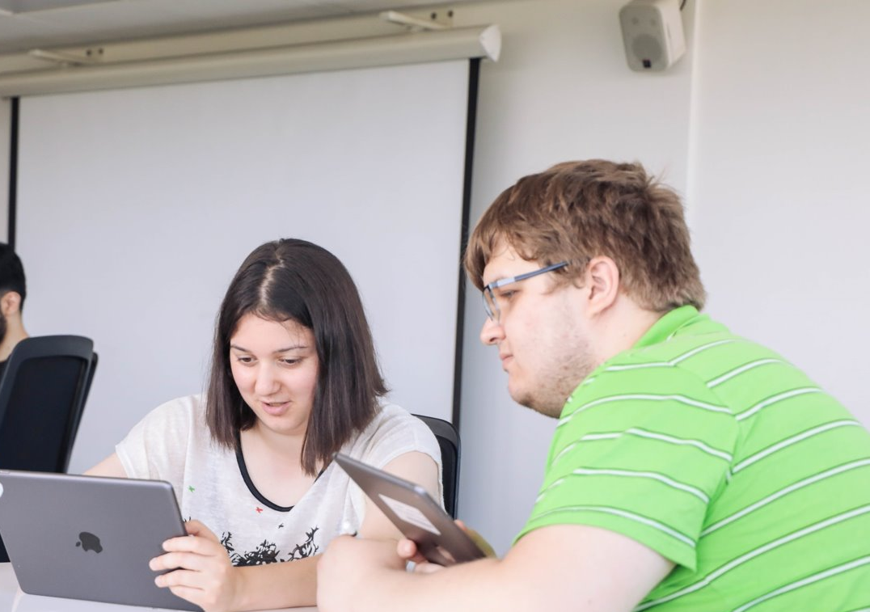
Core design principles
Ensure all students
can communicate mathematical ideas and concepts
can collaborate on mathematical problems
can demonstrate their learning in creative ways
have equitable access to technology to support their mathematical learning
Notes:
Key elements
Intellectually demanding curriculum
Problem solving and communication themes
Learning, teaching and assessment strategy
Flexible, inclusive and supported by technology
Portfolio of authentic evidence
MATT Best of old – written maths, abstraction, criticality etc
New, Supported by technology, flexible, new modes of communication, inclusive
Recognising importance of communication and different methods.
Now:
Students access and contribute to lectures using their iPads
Some work is being completed by iPad
Most feedback is being given by iPad
Next:
Almost all work can be completed by iPad
All feedback is given by iPad
Reference materials in an iPad accessible format

Slide 4
Authentic approach
Focus more on continuous “authentic” assessment and learning.
Employability skills:
Communication
Creativity
Problem-solving
Collaboration
Reflection
Industry tools
Authentic assessment: output appropriate for professional roles
Authentic problems: input appropriate for professional roles
Notes:
Enquiry based
Collaborative problem-solving
Authentic and future focussed
Varied, inclusive, accessible and technology enhanced
Supported via learning communities
input/output is our distinction. When we revalidated in 2019 we considered employability –theory and practical skills. Best of old and new. Tradition skills involved in problem solving ( abstraction, logical reasoning, critical thinking etc) but also digital and other skills. For our students what would make them different. How could we build their confidence. Skill recognition and confidence. Authenticity and means to demonstrate their learning. artefacts or manifestation
More on this later.
Authentic assessment: output is appropriate for professional roles
Authentic problems: input is appropriate for professional roles
Skill recognition and social capital.
Skills for talent economy.

Slide 5
Communication
Embedded and developed throughout the programme
Written maths
Presentations
Blogs
Videos
Technical reports
Essays
Notes:
AL
Problem solving
Critical thinking
Communication
Creativity
Collaboration
Independent Learning
Technology Enhanced

Slide 6
example: Communicating Mathematics
Mathematics Engagement Brief
This communication brief requires you to develop an activity or resource that could be used to promote, or engage people with, mathematics.
This can be done either by
a short mathematics activity with feedback sheet,
a blog (1000 - 2000 words or multimedia equivalent), or
a short video such as a screencast (2.5 – 4 minutes).
The activity or video must link clearly with a mathematical concept or problem and be suitable to be used to engage people with mathematics.
Notes:
AL
Allowing students to demonstrate their creativity

Slide 7
Notes:
AL
Work goes into their portfolio if evidence. Also reflection.
These can be shown to employers and used in references. Teaching.

Slide 8
Notes:
AL
As above

Slide 9
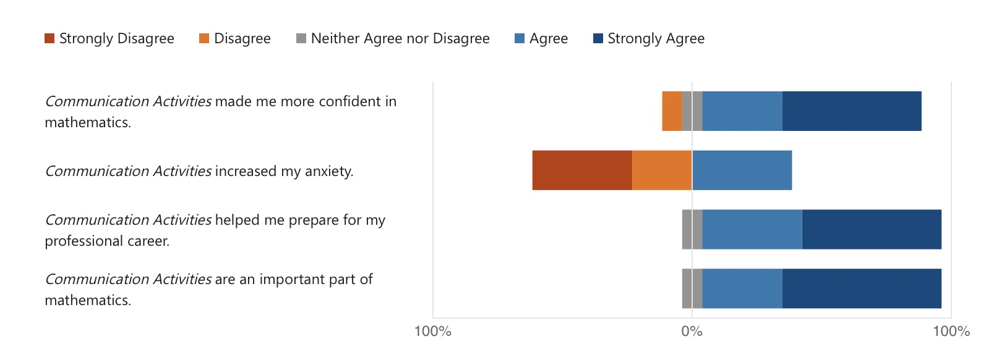
What the students say
Notes:
Brendan:
Student’s found communication activities to be very positive across the board.

Slide 10
What the students say
This allowed me to improve my presentation skills as it exposed a weakness of mine which I had previously believed was not an issue for me. This realisation inspired me to improve on my speaking skills.
Notes:
Brendan

Slide 11
What the students say
I just wanted to let you know that I've gotten my graduate job as a data analyst! Specifically, they were impressed with my communicating mathematics project.
Communicating mathematics project expanded my communication skills, working on a project that had real world application bridged that gap for me.
I did a presentation for my managers today and they were really impressed! They said it was really professional and better than other graduates. Just wanted to let you know that what I learned in communicating maths has really helped me.
Notes:
Brendan
Highlight positive quotes

Slide 12
Outreach
Notes:
BRENDAN – overall programme level feedback on the approaches and skill development. Link to
Problem solving
Critical thinking
Communication
Creativity
Collaboration
Independent Learning
Technology Enhanced

Slide 13
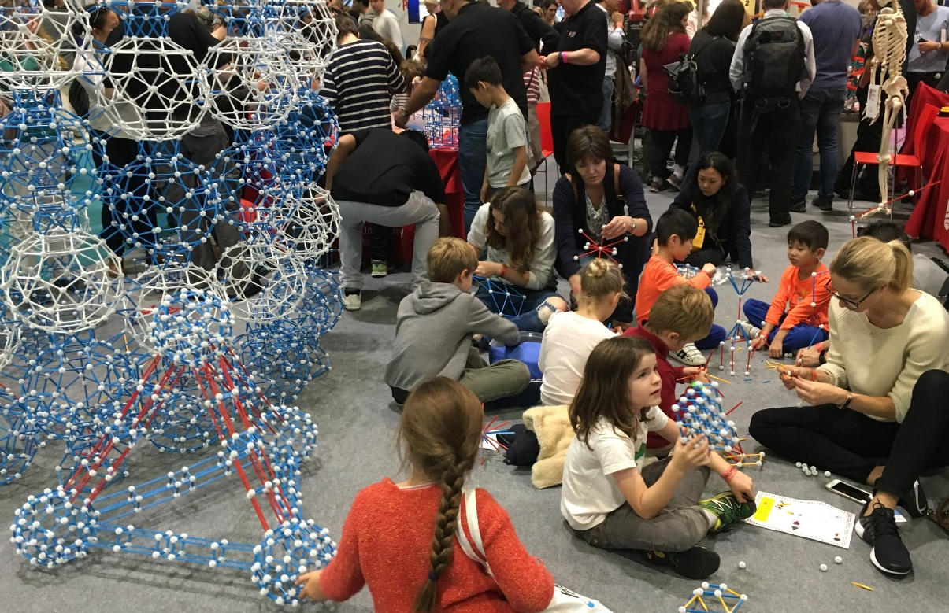
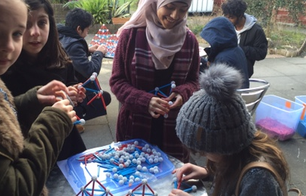
Outreach activities
At MDX we take part in a large number of activities including:
SmashFEST UK
New Scientist Live
World Skills
Teen Tech
MDX STEM festival
At these events students are tasked with the engaging the public and school children on maths concepts behind activities like:
Soma cube
Towers of Hanoi
Rubik’s cube
Platonic solids
And others
Notes:
Brendan
Students have been involved in a range of outreach outreach activities over the years communicating mathematical concepts to the public such as…

Slide 14
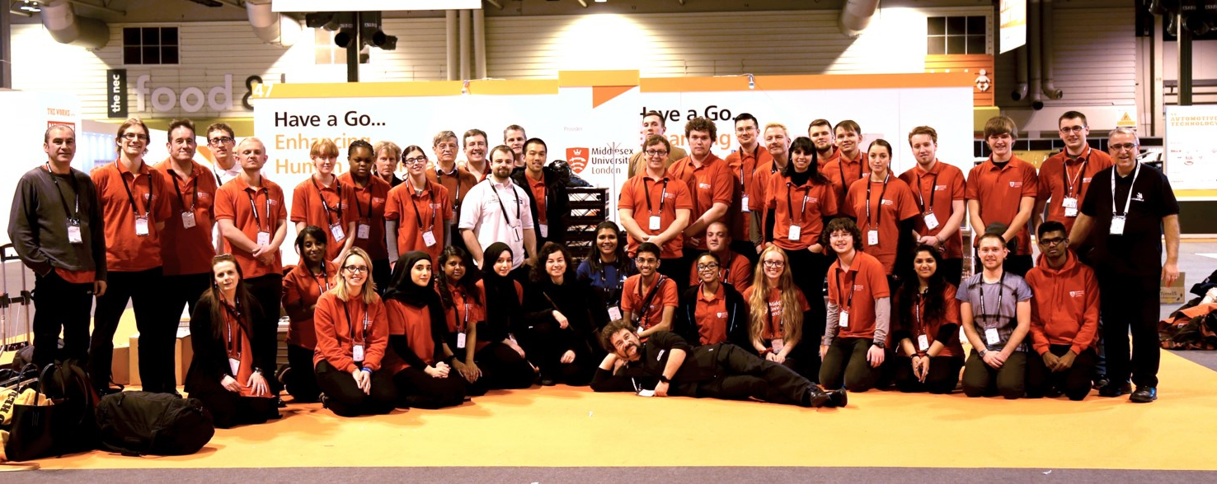
Outreach activities

Slide 15
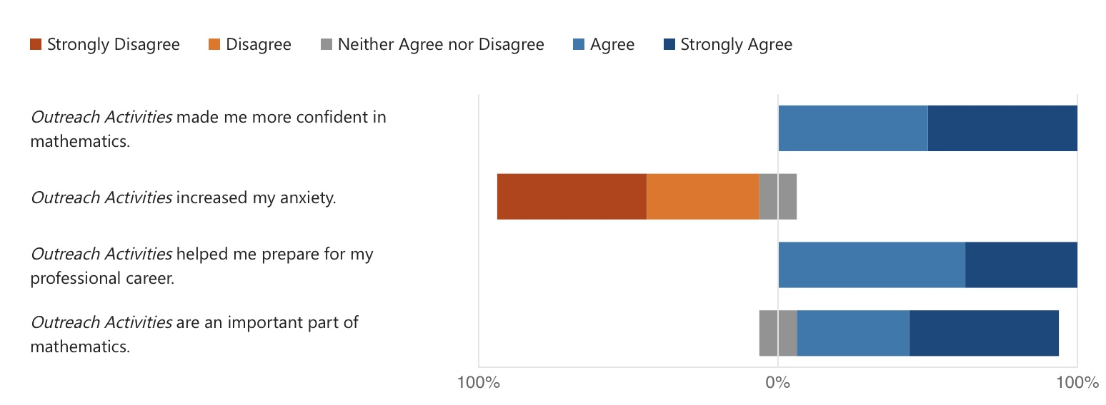
What students say
Notes:
Brendan
Again students find out reach activities positive

Slide 16
Outreach feedback
Outreach activities should be more organized and run by university, considering the budget availabilities, however, the more of these events, the more people, students, and public can be attracted to mathematics, and mathematics education, and the power of change mathematics can deliver.
By facing the public for hours at a time and having to explain mathematical concepts to people of varying age groups, this allowed me to improve my public speaking and improved my ability to adapt to various situations.
Notes:
Brendan
Highlight theme of quotes

Slide 17
What the students say
I believe that the impact of attending these three events were incredibly beneficial to my growth as a person as it gave me the opportunity to develop many skills such as interpersonal skills and communication skills.
During World Skills, it was great to be able to express my passion for Mathematics and impart that to the general public. It made me more confident in my mathematical knowledge as I knew the content and it helped me form a coherent answer in a way that was easily digestible.
Notes:
BRENDAN
Highlight theme of quotes

Slide 18
What the students say
Working with a crowd and having the lecturers around to correct me if I’d say something wrong made it easier for me to speak about different topics within maths without worrying about saying this the wrong way. Such activities helped me grow as a mathematician by offering confidence in myself and what I know to be true.
Confidence is also something else that all three have helped me with, not just in terms of communication but also confidence in my own ability in Maths.
Notes:
BRENDAN
Highlight theme of quotes

Slide 19
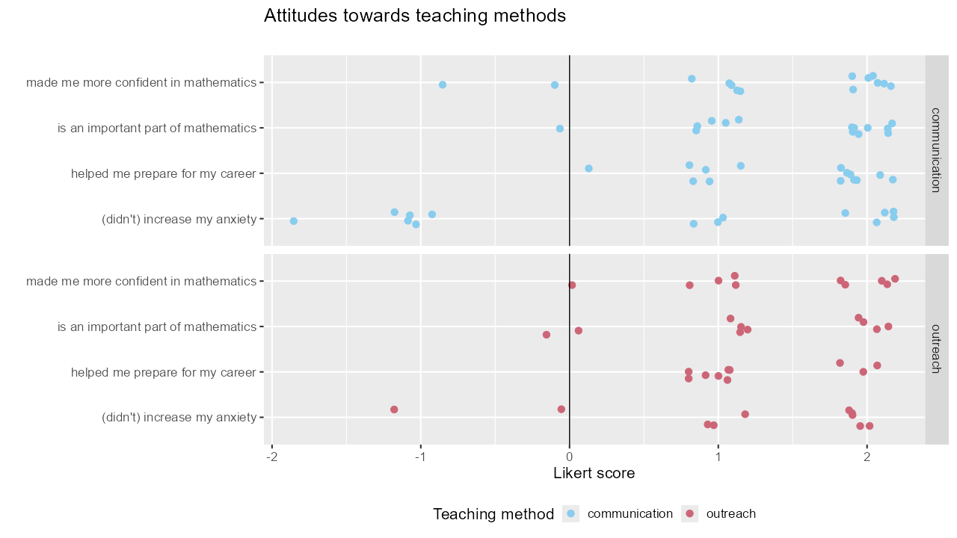
Notes:
Brendan
These scatter plots show the individual responses of students to each of these Likert questions about confidence or outreach activities.
Here -2 indicates ”strongly disagree”, -1 indicates “disagree” and so on.
Overall we see that students found these activities to be very positive.
It is worth noting that the outreach activities for the vast majority of students didn’t seem to negatively impact student anxiety at all. However, this was much more of a mixed bag when is came to the communication activities. This is possibly but to the fact that students were often being assessed in the communication activities but not in the outreach.

Slide 20
2000+1: A maths Space Odyssey

Slide 21
2000 + 1: a Space Maths odyssey
Project aims to engage school students from disadvantaged areas with STFC activities.
Through a series of outreach cocreation activities school students will how mathematics applies to space travel.
The end product will be an inactive game in which school students can:
Design their own planet
Add their planet to their school/year/class solar system
Explore this universe to see planets from other school students
Use this as a platform to share ideas with friends
Notes:
Brendan
We recently got an STFC grant.
Here’s what we plan to do with it

Slide 22
2000 + 1: a Space Maths odyssey
Our own students will work as Mathematics Ambassadors engaging school students and the public in these activities.
The goal for our student is to enhance our own student’s communication abilities and social capitol through these outreach events.
To date students have:
worked at MDX STEM Festival and engaged school students in creative activities like imaginative planetary design and relate them to concepts such as orbits.
Next steps:
Students to visit STFC funded facilities to learn more about their work
Arrange school visits to work with school students on this cocreate activities
Notes:
BRENDAN
Here’s how we envision our students being involved.

Slide 23
What the literature says
At university, teaching is focused too narrowly on exam preparation. Students need more experiences where they convey to others their mathematical thinking. (Borovik and Gardiner, 2007 and French et al., 2023).
Through these engagement activities students become more confident in class (Megeney, 2015).
Problem-solving and communication are important parts of active learning in mathematics (Crawford, 1996).
Notes:
Brendan
Look! The literature agrees with us!

Slide 24
Summary
Communication is an important employability skill that maths graduate often lack.
Our programmes have been designed to include communication skills and opportunities for outreach participation.
When students have reflected on these skills and found them to be:
Positive for their confidence in mathematics
Positive for their career preparation
Important parts off mathematics
While generally not have a negative impact on anxiety.
Moving forward we are making student communication and outreach the cornerstone of our STFC funded project.
Notes:
Brendan
Summary and stuff

Slide 25
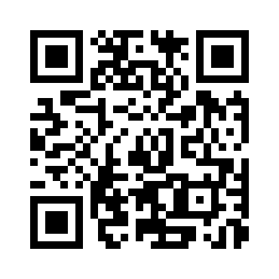
Questions?
meshresearch.org
MESH Research Group
Dr Brendan Masterson b.masterson@mdx.ac.uk @BrendanMasters4
Dr Alison Megeney a.megeney@mdx.ac.uk @DrAliMegs
Dr Matthew Jones matthew.m.jones@ucl.ac.uk @doc_jones1
Dr Snezana Lawrence s.lawrence@mdx.ac.uk @snezanalawrence
Dr Nick Sharples n.sharples@mdx.ac.uk @nick_sharples
Dr Zainab Kazim Ali z.kazim@mdx.ac.uk
Notes:
Order of speaking and other Mesh Members

Slide 26
References
Megeney, A. (2016) Engaging with Mathematics: How mathematical art, robotics and other activities are used to engage students with university mathematics and employability skills, MSOR Connections, CETL-MSOR Conference 2015, pp 61-65.
Borovik, A.V. and Gardiner, T. (2006), Mathematical Abilities and Mathematical Skills, accessed via http://www.mathematics.manchester.ac.uk/~avb/pdf/abilities2007.pdf (August 2024).
Crawford, K. (1996), Vygotskian Approaches in Human Development in the Information Era, Educational Studies in Mathematics (31), pp 43-62.
French, S., Dickerson, A., & Mulder, R. A. (2023). A review of the benefits and drawbacks of high-stakes examinations in higher education. Higher Education, pp 1- 26.

