Slide 1
Authentic activities for making mathematicians
CETL-MSOR 2024
Limerick
29th August
Dr Brendan Masterson
Dr Alison Megeney
MESH Research Group
Notes:
Brendan

Slide 2
Our students
The demographics of the MDX students have particular challenges:
59.0% of Full-Time Undergraduates are from IMD quintile 1 or 2*
38.5% were eligible for free school meals*
Poverty presents a significant obstacle to success for our students.
*latest OFS 2022-23 access and participation data
Notes:
Brendan
sector: 30.4% parents are Higher managerial, administrative and professional
MDX – 13%
MDX Free School Meals – top non-private full university.
Employability – confidence – lack of social capital
When our student join - Our students are focussed on getting jobs – money is a concern.
Our students really worry about University – should I go?
Do I belong
Is the cost worth it
Will I get a job
Is Maths the right degree? – should I do an accounting and finance degree??

Slide 3
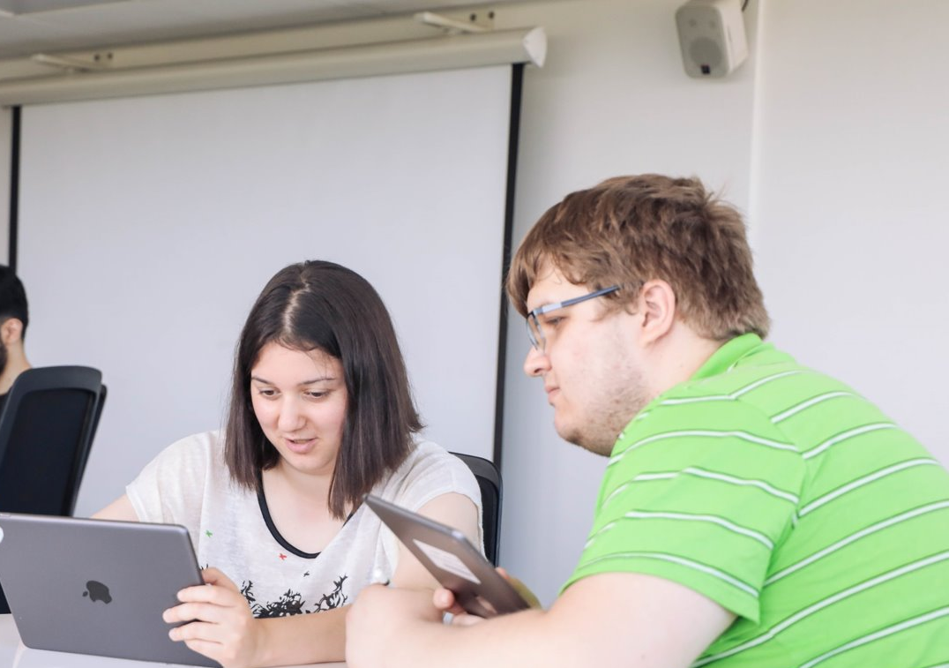
Authentic by Design
Key elements
Intellectually demanding curriculum
Problem solving and communication themes
Learning, teaching and assessment strategy
Authentic and future focussed
Designed to build confidence
Flexible, inclusive and supported by technology
Portfolio of authentic evidence
Notes:
Brendan
Designed to develop confidence
Confidence in their mathematical ability through problem solving and communication but also using portfolio to evidence their skills.
Portfolio provides them evidence to showcase to employers.
Outreach built in to support them in confidence and communication. All have mathematical ability.
Supported via learning communities. Online and on campus.

Slide 4
Authentic approach
Focus more on continuous “authentic” assessment and learning.
Employability skills:
Communication
Creativity
Problem-solving
Collaboration
Reflection
Industry tools
Authentic assessment: output appropriate for professional roles
Authentic problems: input appropriate for professional roles
Notes:
Brendan
input/output is our distinction. When we revalidated in 2019 we considered employability –theory and practical skills. Best of old and new. Tradition skills involved in problem solving ( abstraction, logical reasoning, critical thinking etc) but also digital and other skills. For our students what would make them different. How could we build their confidence. Skill recognition and confidence. Authenticity and means to demonstrate their learning. artefacts or manifestation
Authentic assessment: output is appropriate for professional roles
Authentic problems: input is appropriate for professional roles
Skill recognition and social capital.
Skills for talent economy.
NO EXAMS - Exams are efficient, Seen as rigorous, Gold standard, Elitist
They rely on a timed, one-shot-only display of virtuosity and scholarship.
Is this what professional mathematicians do?
Key elements for mathematician is creative thinking, collaboration and communication – not suited for exams.
Exams are Unfair – The stress associated with sitting examinations is experienced disproportionately by young people from economically disadvantaged backgrounds, who
are over-represented amongst those with social, emotional and mental health issues. This puts them at greater risk of failing to do themselves justice in high
stakes testing. Read - French, S., Dickerson, A., & Mulder, R. A. (2023). A review of the benefits and drawbacks of high-stakes final examinations in higher education. Higher Education, 1-26.
EDI is important to MDX in our context - Mental health.

Slide 5
Choice in Assessment
Choice in submission format
Communicating mathematics (Level 6):
Students could submit work as
an essay
a blog
a short video
Real and Complex Analysis (Level 6):
Students could explain their thinking with
a formal argument
an illustration
a recorded audio explanation
a recorded video explanation
e.g.
“Argue that all multivariable polynomials are differentiable at every point.”
Choice in problem
Mathematical Statistics (Level 5):
Students choose dataset to analyse
Students could choose
analytic techniques, or
simulation
Problem Solving and Communication (Level 5):
Student choice of problem to solve (more later).
e.g.
“Calculate a confidence interval using a method of your choice.”
Notes:
Al
In this section we introduce 4 of our novel teaching and assessment methods that are part of our authentic approach.
Authentic assessment: output is appropriate for professional roles. This could be in a variety of formats.
Authentic problems: input is typical of professional roles. This could be raw data, a vague problem, or some significant judgement in strategy (analytic techniques vs simulation).
By giving students choice they have their own agency so stay engaged. We also help them develop the particular skills that align with their interests and hopefully their chosen careers (e.g. the nuances of geospatial datasets, or joining separate datasets).

Slide 6
PROBLEM SOLVING
A solar-powered satellite is on an elliptical orbit of the sun. Explore how much energy the satellite can generate per orbit, and per hour. What capacity batteries should the satellite carry?
An ion-engine provides a low, constant thrust for a spacecraft. Suppose a spacecraft in a stable earth orbit activates its ion-engine. What is the trajectory of this spacecraft? How fast does it go?
A spacecraft in a stable orbit around a planet is about to fire its engines. How does the direction the spacecraft is pointing affect its trajectory?
Suppose an object is moving around randomly in space. Will it ever reach earth?
Celestial bodies tend to be approximately spherical. Can we measure how spherical they are to compare them?
Problem Solving and Communication 30 credits, (level 5).
Students choose one vague prompt.
Submission is a group report and presentation (worth 15 credits).
Worked on in timetabled workshops with guidance and support from lecturers.
Notes:
Al
Authentic problems are distinct from 'applied' problems.
Authentic problems:
Are often vaguely defined;
Allow students to use every tool at their disposal;
Encourages students to seek guidance from their lecturer.
These problems give students agency, require them to translate the “real world” into mathematical language that they are becoming experts with, and help develop initiative and creativity.
All these skills are critical for mathematicians to excel in their careers.

Slide 7
Problem Solving Rubric
“You are primarily being assessed on the approach you take to solving problems, rather than the actual solution”
Report (60 marks, group)
Introduction Formulation and Strategy (10 marks)
Problem Solving (30 marks)
Solution (10 marks)
Conclusion, Reflection and Further Work (5 marks)
Presentation (5 marks)
You give a thorough description of how you’ve approached the problem.
You explain what you have tried (that did and didn’t work), and identify which activities helped you progress.
You should describe how your group has interacted to work on the problem and what roles and responsibilities you agreed on.
Presentation (40 marks)
Oral presentation (20 marks, individual)
Supporting resources (20 marks, group)
“The module is stimulating and the lecturers make the subjects engaging.
It is fantastic that our classes were run at times outside the classroom, allowing us to visit places of interest together, explore and
share ideas. I honestly enjoyed every single class.”
Notes:
Al
Not a 15 mark “problem solving” exam question.
But a long duration group coursework – assessment is the student documenting the process of problem solving: making mistakes, trying things and thinking mathematically.
Even if the students’ efforts don’t actually lead to a substantial solution.

Slide 8
Reflection
In your reflection discuss the merits of interacting with staff, students and the public, indicating what you think are the benefits and challenges of the activities you completed.
Data and Information (Level 4):
Reflect on the outreach event “Hacktivity Week”
(5% of grade)
Reflect on your approach, describing what you would do differently for a future problem, and evidence your improvement as problem solvers.
Problem Solving and Communication (Level 5):
Reflect on problem solving group work (5% of grade)
Reflect on communication work (10% of grade)
This reflective piece should be between 500-1000 words.
Discuss the knowledge and skills (including time management) used to complete the brief
Identify the challenges encountered
Critically evaluate the work produced (video, activity sheet, blog),
Justify your approach to the task
Indicate how feedback was acted upon
Indicate how work could be improved or further developed
Indicate how research and problem-solving skills were used to complete the brief.
Project (Level 6):
Keep a reflective diary of supervisor meetings (10% of grade)
Real and Complex Analysis (Level 6):
Peer review exercise.
Notes:
Al

Slide 9
Artificial Intelligence
Mathematical Statistics 30 credits, level 5.
More student choice!
Open-ended brief, but
Guidance on expected content
Guidance on epistemic links
Refer to our shared body of theory (not ChatGPT’s!)
Compare with ChatGPT output.
Authentic! Interviewees will need to demonstrate what they can offer over Ai.
“[chatGPT] doesn’t determine what interesting variables could be for us. It just does every variable.”
“OpenAI was not able to produce short data analysis with sensible code.”
Notes:
Al
The use of Ai is not currently a formal part of our syllabus or assessment strategy.
However,
students have been exploring it, possibly without understanding its limitations.
some students are concerned that Ai will affect their careers.
Ai will be in our students' workplaces, so some familiarity is useful.
by explicitly including Ai in assessment we can discourages its undeclared use.
In this assessment students explicitly compare their attempts at data analysis (Question 2) with the attempts of an LLM (Question 4).
Students reflect on the mistakes or lack of judgement that the LLM displays, and write about how their work is better than the Ai output.

Slide 10
Mathematics Attitudes and Perceptions Survey
Code et al. 2016
32 Likert questions in 7 categories
Growth mindset “Math ability is something about a person that cannot be changed very much.” (disagree)
Real world “Learning math changes my ideas about how the world works.” (agree)
Confidence “I can usually figure our a way to solve math problems.” (agree)
Interest “I enjoy solving math problems.” (agree)
Persistence “If I am stuck on a math problem for more than ten minutes, I give up or get help.” (disagree)
Sense making “It’s a waste of time to understand where math formulas come from.” (disagree)
Answers “There is usually only one correct approach to solving a math problem.” (disagree)
32 Likert questions in 7 categories
Growth mindset “Math ability is something about a person that cannot be changed very much.”
Real world “Learning math changes my ideas about how the world works.”
Confidence “I can usually figure out a way to solve math problems.”
Interest “I enjoy solving math problems.”
Persistence “If I am stuck on a math problem for more than ten minutes, I give up or get help.”
Sense making “It’s a waste of time to understand where math formulas come from.”
Answers “There is usually only one correct approach to solving a math problem.”
There’s a consensus on the attitudes of “expert” mathematicians.
Original study looked at US (non-specialist) undergraduate math courses.
Pre-post study showed worsening attitudes for these students! (But flipped is “less harmful” than traditional teaching.)
Notes:
Al
Our study – we applied an existing attitudes and perceptions instruments: the MAPS. Tested and factor analysed on N=3411 US undergraduate students in 2016.
Remarkable pre-post result: students attitudes *worsened* over the semester for every category!

Slide 11
Our study
27 Likert questions in 7 categories
Growth mindset
Real world
Confidence
Interest
Persistence
Sense making
Answers
Identity “I am a mathematician.”
Our students had chosen to study specialist maths programmes – they were already interested in maths!
We added a statement on identity to the questionnaire.
Current students and recent graduates were given a link to a questionnaire:
They rated the statements recalling their attitudes before university.
They were asked about various teaching methods we’ve used.
They rated the statements about their current attitudes.
“Quasi-pre-post”
Perhaps doesn’t capture the change in attitudes.
But captures
Current attitudes.
Current perception change in attitudes.
Notes:
Al
For anonymity and expedience we only surveyed the students once, but got them to complete the MAPS two times: first as a retrospective “what I felt before university” then their current attitudes.
Of course, students’ recollections of their before-university attitudes may not be accurate. Future work will include a proper pre-post assessment.
However, our approach is measuring how students currently think their attitudes have changed.

Slide 12
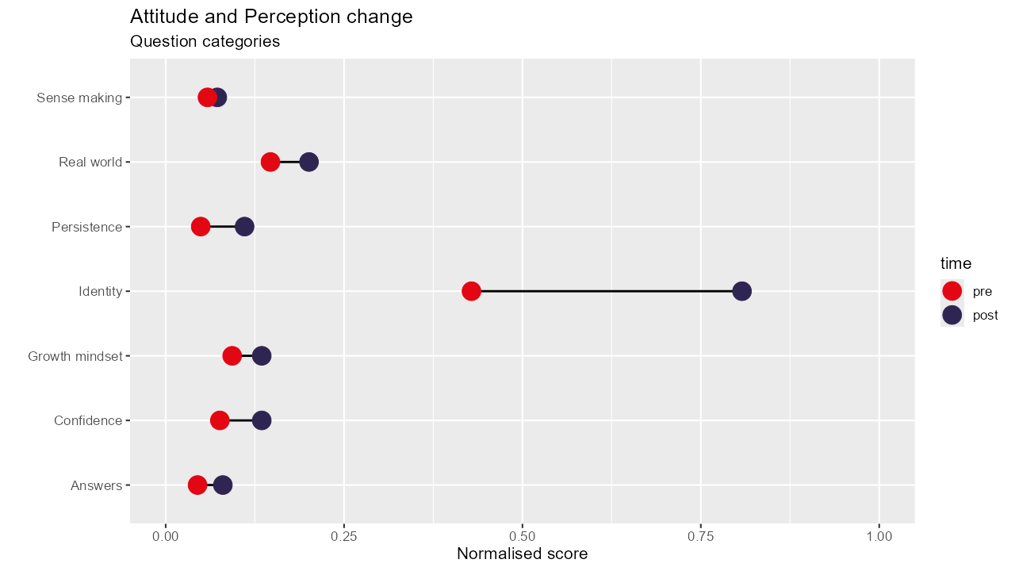
Notes:
A score of 1 means every student strongly agreed with the expert consensus for every statement in that category: e.g. they have the same attitudes to growth mindset as mature mathematicians.
A score of -1 means every student strongly disagreed with the consensus for every statement in that category.
A score of 0 means (on average) neutral for the statements in that category.
From the graph we see:
our students average scores are all positive – on average students agree with the expert consensus.
in all categories students attitudes moved towards the expert consensus over time.

Slide 13
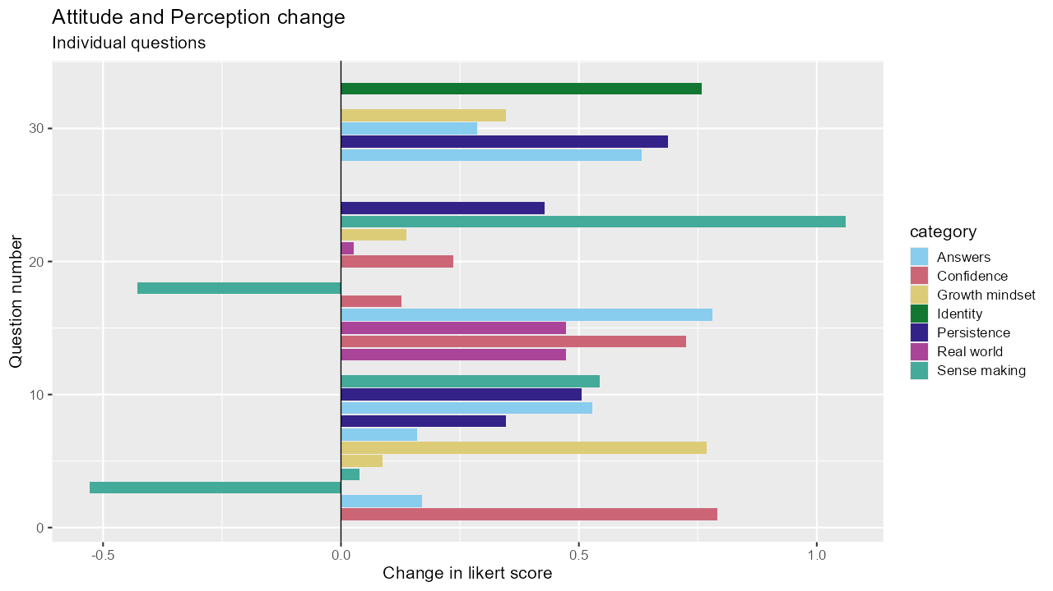
Notes:
We now look at individual questions (numbered 1 to 32, on the y-axis).
A positive score is a change towards the expert consensus.
From the graph we see:
Some questions have big leaps towards consensus.
Two questions move away from consensus.

Slide 14
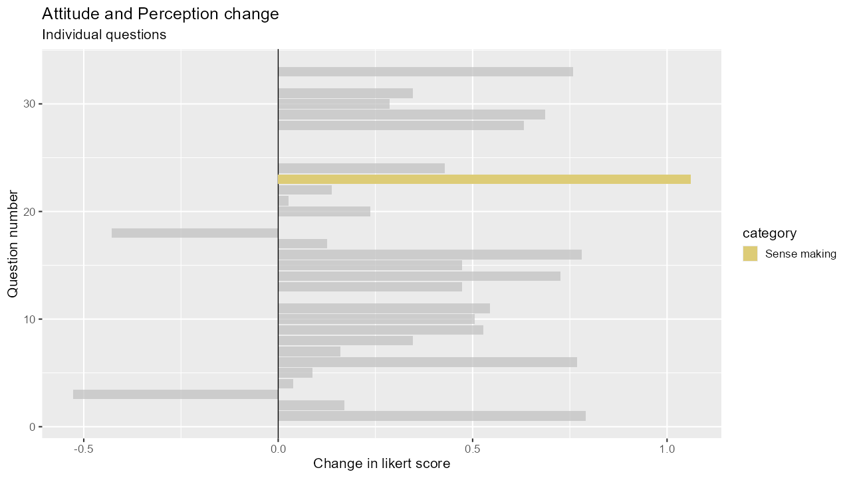
“When I am solving a math problem, if I can see a formula that applies then I don’t worry about the underlying concepts.” (expert consensus: disagree)
Notes:
This is like an introduction to logic course: we need to keep track of the negations!
Our students increasingly disagree with this statement. They are moving closer to the expert consensus.
So: they now worry about underlying concepts even if they have a formula that applies. This is mature mathematician behaviour!

Slide 15
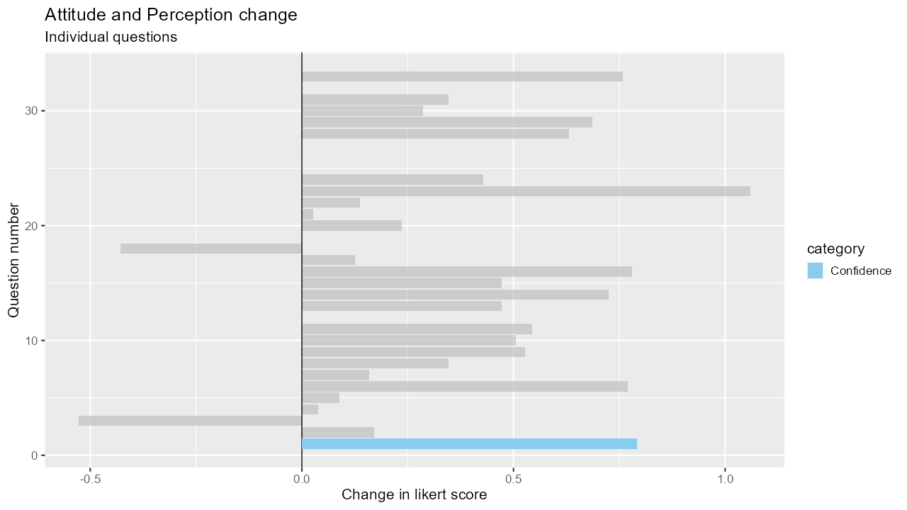
“After I study a topic in math and feel that I understand it, I have difficulty solving problems on the same topic.” (expert consensus: disagree)
Notes:
Our students now have less difficulty solving problems on topics they feel they understand.

Slide 16
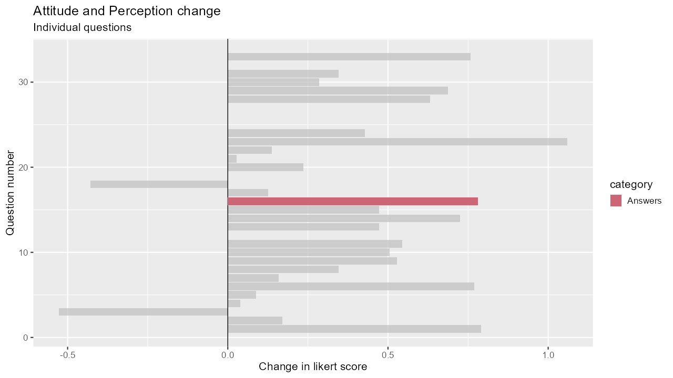
“To learn math, the best approach for me is to memorize solutions to sample problems.” (expert consensus: disagree)
Notes:
Our students no longer memorise solutions to sample problems. They think other approaches to learning are better.

Slide 17
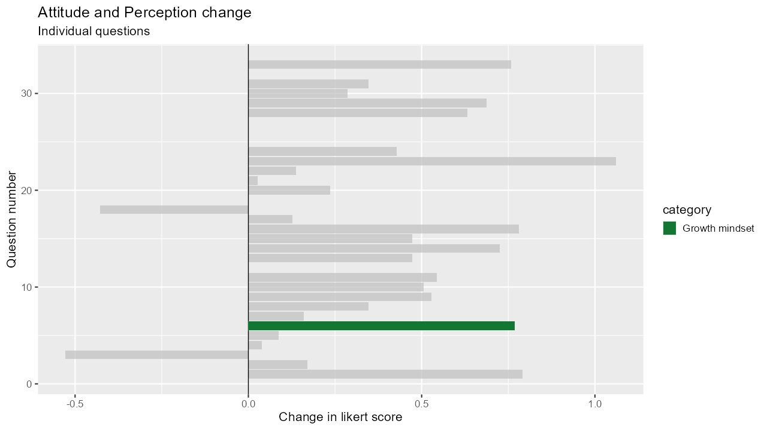
“Nearly everyone is capable of understanding math if they work at it.” (expert consensus: agree)
Notes:
Our students increasingly believe everyone is capable of understanding maths if they work at it.

Slide 18
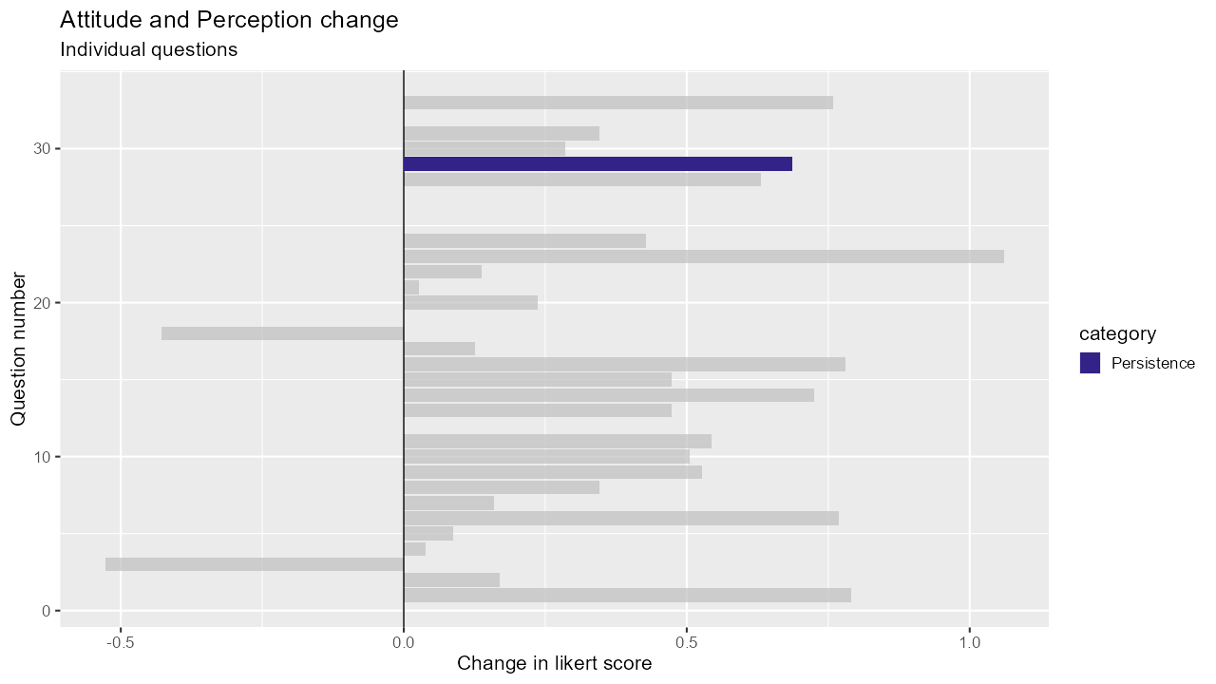
“I get upset easily when I am stuck on a math problem.” (expert consensus: disagree)
Notes:
Our students now get less upset when they are stuck on a maths problem.
We celebrate and value “getting stuck” in our Problem Solving sessions. Students write reflections on where they get stuck for credit.

Slide 19
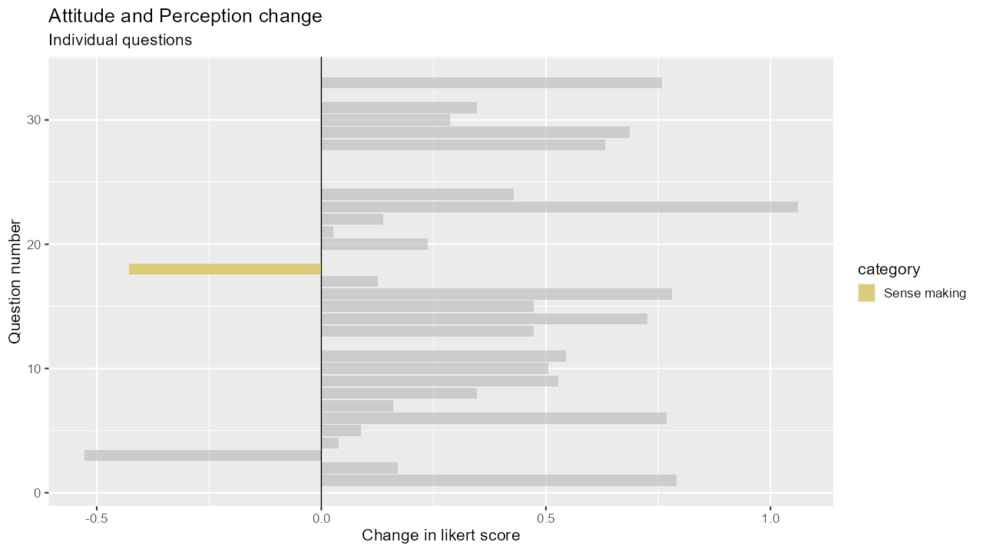
“It is a waste of time to understand where math formulas come from.” (expert consensus: disagree)
Notes:
However, our students increasingly think it’s a waste of time to understand where formulas come from.
Perhaps this is a comment on time management: they get more out of spending time on applications than the theory?

Slide 20
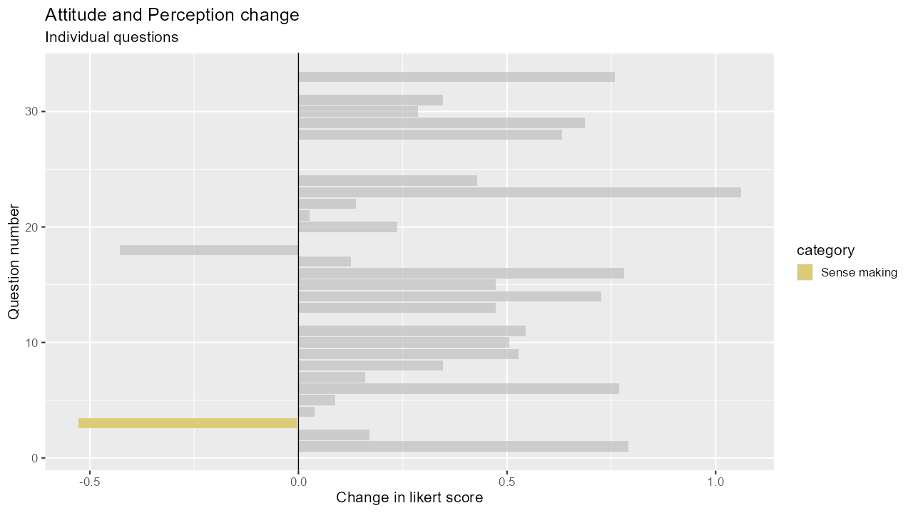
“I’m satisfied if I can do the exercises for a math topic, even if I don’t understand how everything works.”
(expert consensus: disagree)
Notes:
Our students are increasingly satisfied with just completing the exercises.
Is this just the increasingly transactional attitude students have – completing the exercises is sufficient to get a degree?
However, our exercises are broader than typical “textbook” exercises. They include problem solving, reflective and communicative elements, which require a good understanding of how everything works.

Slide 21
What makes a good … Lesson?
A-level
University
well explained and we practised a few questions on the topic after.
The more interactive the lessons were the better.
learning the concepts of the topics and working on problems with other students.
I liked it when the problems were slightly more difficult as it made me think about what I learned and find ways to solve it.
the topic was taught thoroughly and explained. Not just a step by step process on how to get the right answer.
where everyone discussed new topics taught.
having a problem and working through it with the lecturer. Going through similar examples of problems and at the end figuring out how to do it yourself.
fun, enjoyable compared to other subjects.
One where I felt able to query steps or logic I didn’t initially understand.
All lecturers I encountered enabled that.
Structured, with lots of textbook examples to go home and learn from
Notes:
Preference developed for active learning and collaboration/discussion

Slide 22
Interactive, lots of examples, good modelling. Background history leading to why we were learning what we did. Use of technology to support learning.
Interactive, interesting, was taught with a solid conceptual understanding.
able to put the things I learnt into practice. It could have been either a practical lesson or an exercise with real world variables.
when concepts learned in previous years/lessons came together to help solve a bigger problem.
Statistics
How to solve a problem with mathematical thinking
Leaning how to use my knowledge in real life/job setting.
Communicating Mathematics
Notes:
Widened ideas of what mathematics *is*: problem solving, historical context, communication, real-life applications, making connections from other areas.

Slide 23
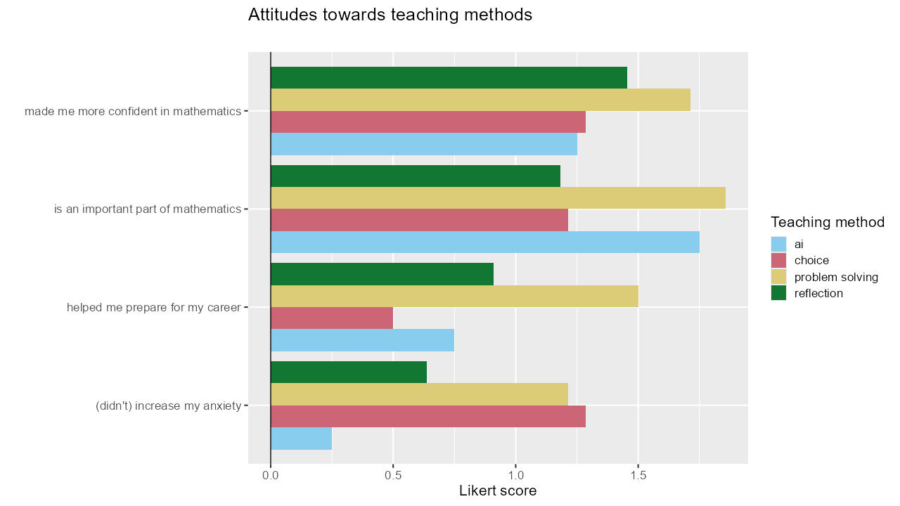
Notes:
Students are generally positive about the teaching methods we mentioned earlier.
They agree that the methods made them more confident and are an important part of mathematics.
Problem solving is specifically noted as helping graduates prepare for their career.
Reflection and Ai activities did cause anxiety in some students, so these activities should be introduced carefully and supported.
I think we could be more consistent in our use of reflection (programme-wide consistency on rubrics for reflection)
Ai is a new element in students’ assessment only appearing in some modules, perhaps surprisingly! Maybe anxiety can be managed by a gradual, consistent introduction.

Slide 24
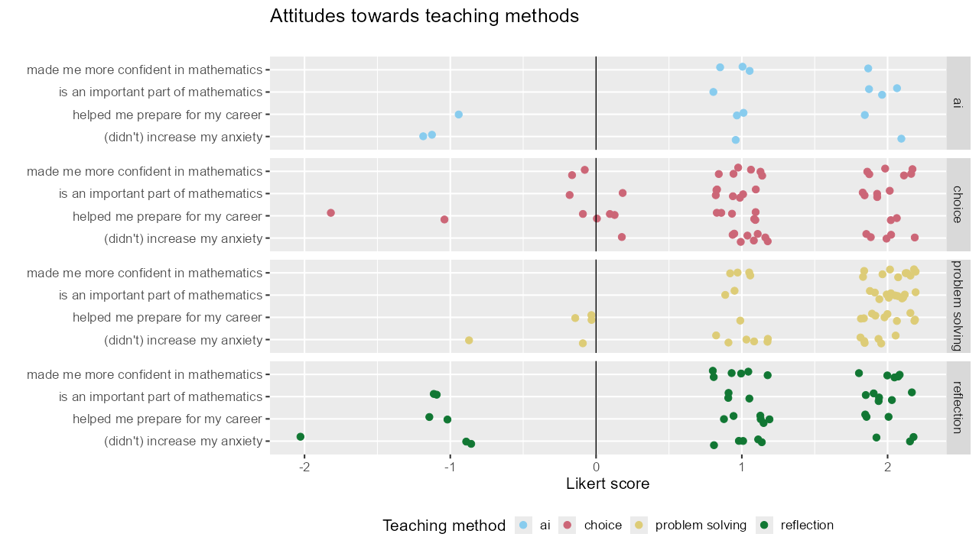

Slide 25
Summary

Slide 26
Authentic Activities for Making Mathematicians
BSc Maths students believe their attitudes and perceptions of mathematics have changed since undertaking their degree.
The changes in attitudes are shifted towards the expert consensus.
Ai, choice in assessment, problem solving, and reflection are viewed as
important parts of mathematics
that improve confidence.
Anxiety remains an issue with the less familiar Ai and reflection.
Future work:
Robust pre-post experimental design for specialist maths students.
Use quasi-pre-post design to measure efficacy of newly validated service maths modules.
Notes:
Mention again that Code et al. (2016)'s original study showed *worsening* attitudes towards mathematics for non-specialist students.
Future work:
"Robust" means giving students a MAPS questionnaire at the start of every academic year to (pseudonymously) track progress.
Service provision: we have students finishing their studies who did "traditional style" service modules. From September we will have students doing more reflective/problem solving modules.

Slide 27
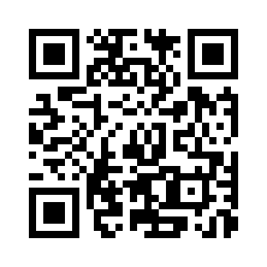
Questions?
meshresearch.org
MESH Research Group
Dr Brendan Masterson b.masterson@mdx.ac.uk @BrendanMasters4
Dr Alison Megeney a.megeney@mdx.ac.uk @DrAliMegs
Dr Matthew Jones matthew.m.jones@ucl.ac.uk
Dr Zainab Kazim-Ali z.kazim@mdx.ac.uk
Dr Snezana Lawrence s.lawrence@mdx.ac.uk @snezanalawrence
Dr Nick Sharples n.sharples@mdx.ac.uk @nick_sharples
Notes:
Order of speaking and other Mesh Members

Slide 28
References
French, S., Dickerson, A., & Mulder, R. A. (2023). A review of the benefits and drawbacks of high-stakes final examinations in higher education. Higher Education, 1-26.
Code, W., Merchant, S., Maciejewski, W., Thomas, M. & Lo, J. (2016) The Mathematics Attitudes and Perceptions Survey: an instrument to assess expert-like views and dispositions among undergraduate mathematics students, International Journal of Mathematical Education in Science and Technology, 47:6, 917-937, DOI: 10.1080/0020739X.2015.1133854

Slide 29
Exam Systematic Review
French et al. 2023
French, S., Dickerson, A., & Mulder, R. A. (2023). A review of the benefits and drawbacks of high-stakes final examinations in higher education. Higher Education, 1-26.
Systematic review of 122 pedagogy papers.
“We find that relatively few of the perceived academic benefits of high-stakes examinations have a strong evidence base...
By contrast, there is substantial evidence for pedagogical drawbacks of high-stakes summative examinations.”
Notes:
Just say here – No exams and this is why. Would encourage everybody to read
Exams are efficient, Seen as rigorous, Gold standard, Elitist
They rely on a timed, one-shot-only display of virtuosity and scholarship.
Is this what professional mathematicians do?
CBI – narrow and irrelevant
creative thinking, collaboration and communication
Unfair – The stress associated with sitting examinations is experienced disproportionately by young people from economically disadvantaged backgrounds, who
are over-represented amongst those with social, emotional and mental health issues. This puts them at greater risk of failing to do themselves justice in high
stakes testing.
EDI is important to MDX in our context - Mental health.
It is argued that exams are the most impartial way of assessing learners as the risk of unconscious marker bias, which can impact Black, Asian and Minority Ethnic (BAME) students and those eligible for Pupil Premium, is reduced. However, the myriad cultural references contained in exam papers across a wide range of subjects disadvantages those with less cultural capital, and the nuances of language in the rubric of exam papers trip up those who are not fluent speakers of English.
Do they make you work ready? - continuous assessment, seems on the surface fairer than concentrated examination;
Some areas of MSOR require particular assessment types to ensure the validity and integrity of the assessment. Controlled conditions, such as those provided by traditional invigilated examinations, are often essential. For example, the nature of the subject means that sometimes students can be expected to provide an answer which is very close to a model answer. Such controlled conditions also help ensure that only work produced by students themselves is being assessed, for example by following the principles in QAA’s guidance Contracting to Cheat in Higher Education.
Students who don’t do as well deemed less intelligent - observed this not true.
Perhaps a more specialised system would make education more accessible and inclusive while producing better results.
What skills do we want and will exams allow our students to demonstrate them.

