Slide 1
Cellular STEM: Maths on the Move
CETL-MSOR 2023
Cardiff
MESH Research Group
Dr Alison Megeney
Dr Nick Sharples
Dr Matthew Jones
Dr Snezana Lawrence
Dr Brendan Masterson
Notes:
Nick 1-9?
Al – 10-19
Nick 21 -23
Both – 24
Ditch biology
In this session, our team will demonstrate how communications technology has been employed to foster collaboration, create a sense of belonging, and invigorate the BSc Mathematics/Mathematics with Data Science learning communities through the Mathematics on the Move project.

Slide 2
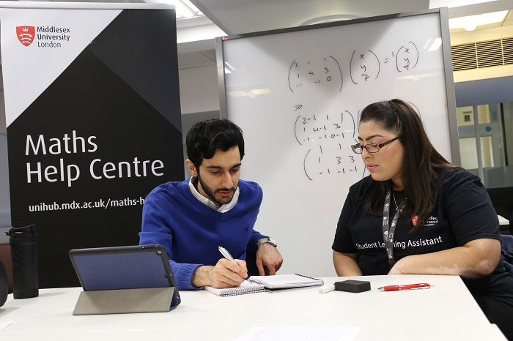
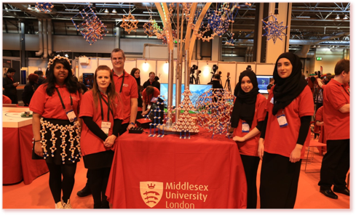
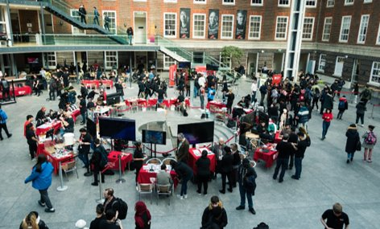
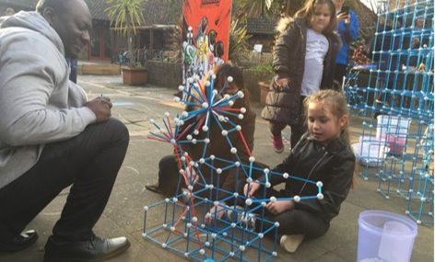
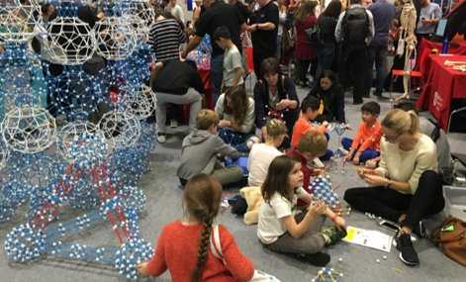
MDX Mathematics learning communities
Mathematical field trips, outreach, engagement and support activities.
Embedded within specialist programmes
SMASHFest
World Skills Live
New Scientist Live
MDX STEM Festival
Maths STEAM projects
Maths Help Centre
Much of this is offline, off-campus
Cellular STEM
Notes:
This innovative approach has not only helped students develop a cohort identity but has also fostered a sense of belonging within their mathematical community.
Once we started returning how could we use tech to reinvigorate the learning communities.

Slide 3
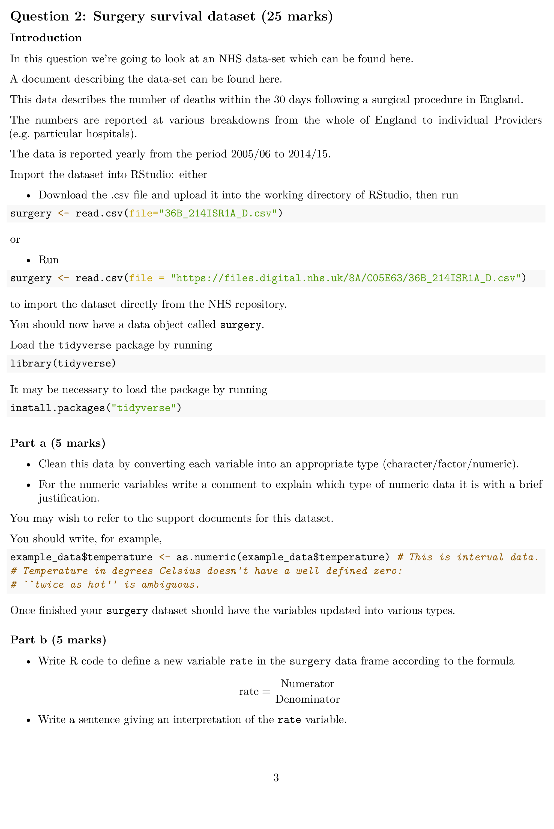
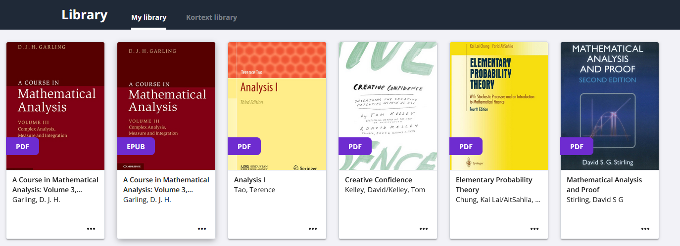
Pandemic CHANGES
Accelerated tech adoption in our delivery:
eBooks
Computers/iPads
Digital resources
Recorded lectures
Authentic assessment using the digital tools and datasets of industry
Feb 2021 – survey: $\frac{2}{3}$ of SAT staff using digital polls/whiteboards
Cellular STEM

Slide 4
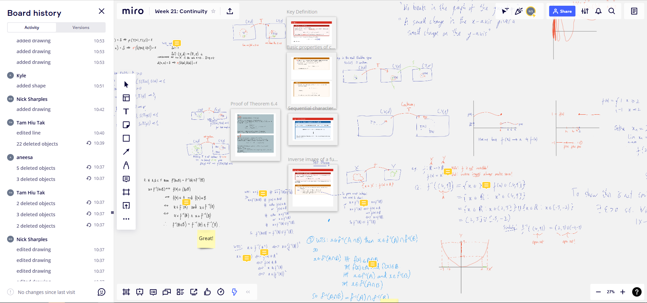
Pandemic CHANGES
Fostered digital communities:
Collaborative whiteboards
Threaded discussions
Zoom calls
Can be more inclusive e.g. multi-modal access

Slide 5
Return to In-person teaching
We wanted to
reinvigorate our off-campus learning experiences and communities
but
keep using the polished pedagogic technology.
We already loan iPads to students and design sessions around them.
The issue is internet connectivity off-campus.
Cellular STEM

Slide 6
Barriers
2020-21
2021-22
Pre-arrival survey:
Cellular STEM survey:
2020-21
2021-22
“large/unlimited” mobile data
“small/moderate” mobile data
5G access
4G access only
Cellular STEM

Slide 7
Background: MDX
Index of Multiple Deprivation
Free School Meals Eligibility
OFS 2021/22
IMD Quintile 1 | 24.3%
IMD Quintile 2 | 36.3%
 | 60.6%
OFS
2021-22 | 41.2% | 1st in sector
2020-21 | 43.1% | 1st in sector
2019-20 | 42.6% | 2nd in sector
2018-19 | 43.7% | 3rd in sector
(Non-profit, degree awarding institutions)
Cellular STEM
Notes:
Check 202-21 – First or second

Slide 8
Generation Z use of technology
2018 Ipsos Thinks: Beyond Binary: The lives and choices of Generation Z
Children from poorer families
Children in better-off households
“spend more time online”
“less likely to be using the internet for learning”
“less likely to develop certain [digital] skills”
“spend higher quality time [online], helping them… prepare for the future”
To encourage digital inclusion we need to consistently encourage the educational aspect of the digital world
Cellular STEM

Slide 9
Cellular STEM Project: details
Notes:
How we used tech to reinvigorate maths learning communities post pandemic

Slide 10
Equipment
3 × Netgear Nighthawk M5 Mobile Router
Battery powered
Small, highly portable
Connects to internet via 5G Mobile Network (with SIM card)
Provides access to 32 devices via WiFi
Ongoing costs:
Around £20 per month for unlimited data (we only pay for the months we use).
Alternatives:
Student devices may have limited battery / data allowance
Public WiFi can be unreliable and tricky to set up for large groups of students.
CELLULAR STEM
Notes:
Nick

Slide 11
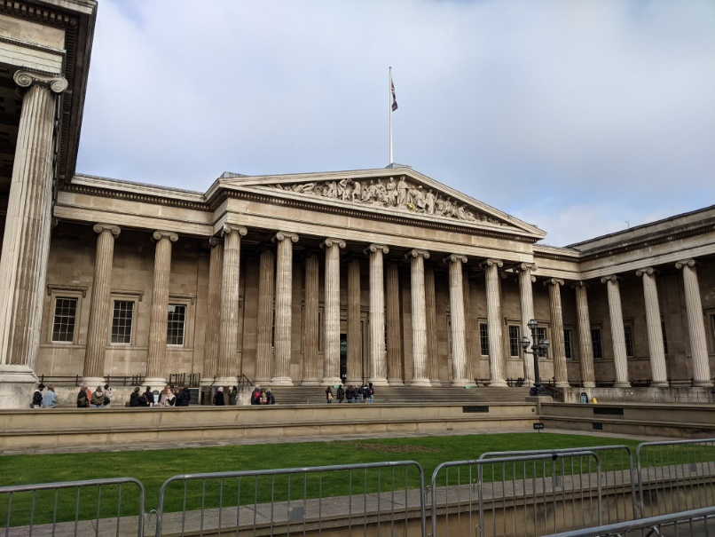
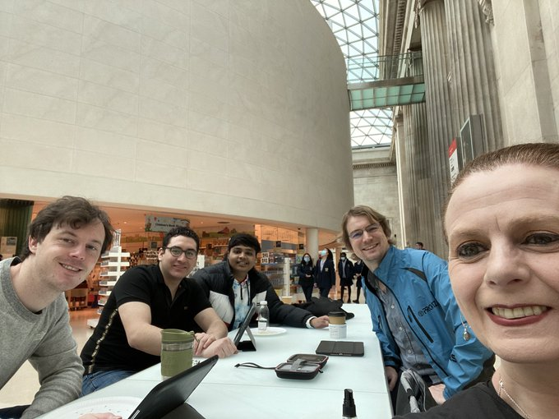
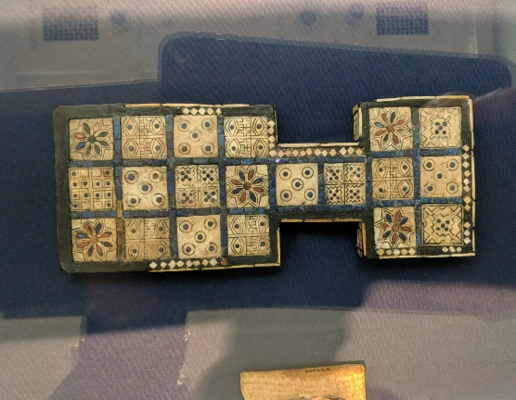
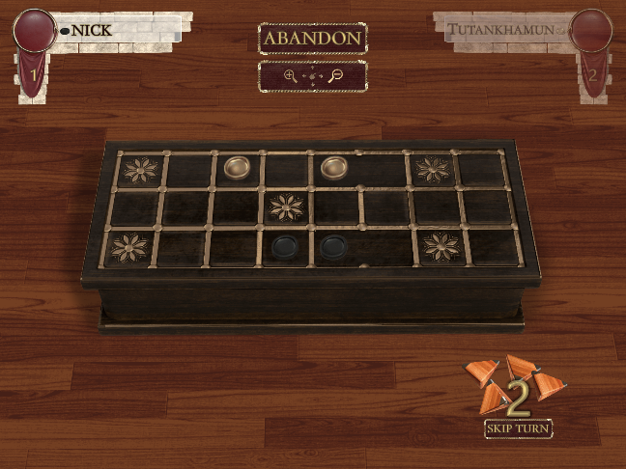
Maths Trip 1: British Museum and RusselL Square
Academic year 2021/22
Communication and co-ordination
throughout trip.
Collaborating using a virtual whiteboard.
The Royal Game of Ur: from the exhibit to the iPad
CELLULAR STEM
Notes:
meet – discuss maths – collaborate – rebuild their community

Slide 12
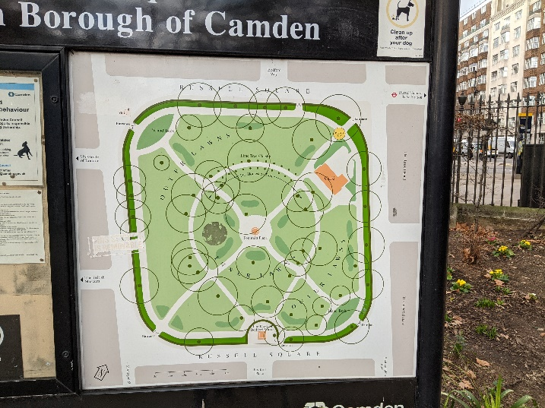
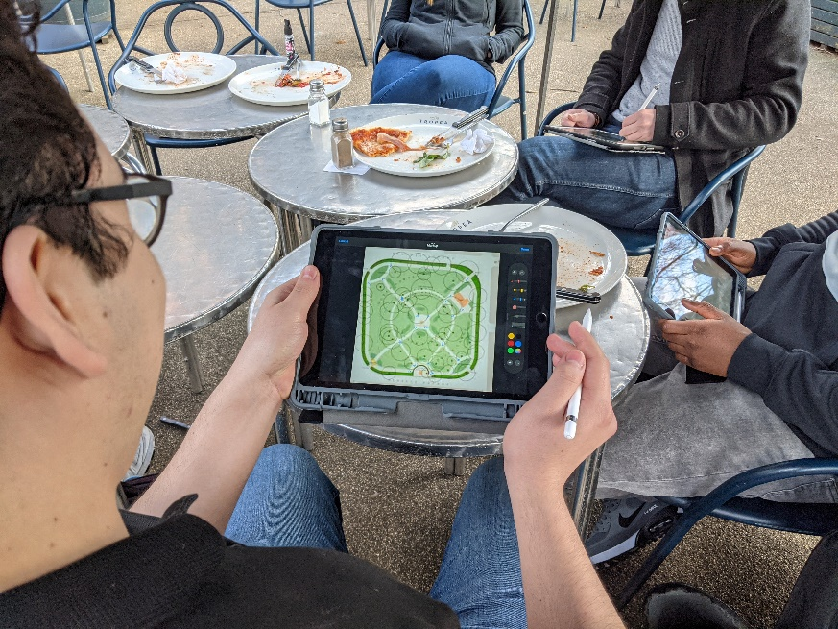
Maths Trip 1: British Museum and RusselL Square
Academic year 2021/22
Eulerian path finding on collaborative whiteboards
CELLULAR STEM
Notes:
cross year collaboration and discussion. Building relationships with lecturers and students

Slide 13
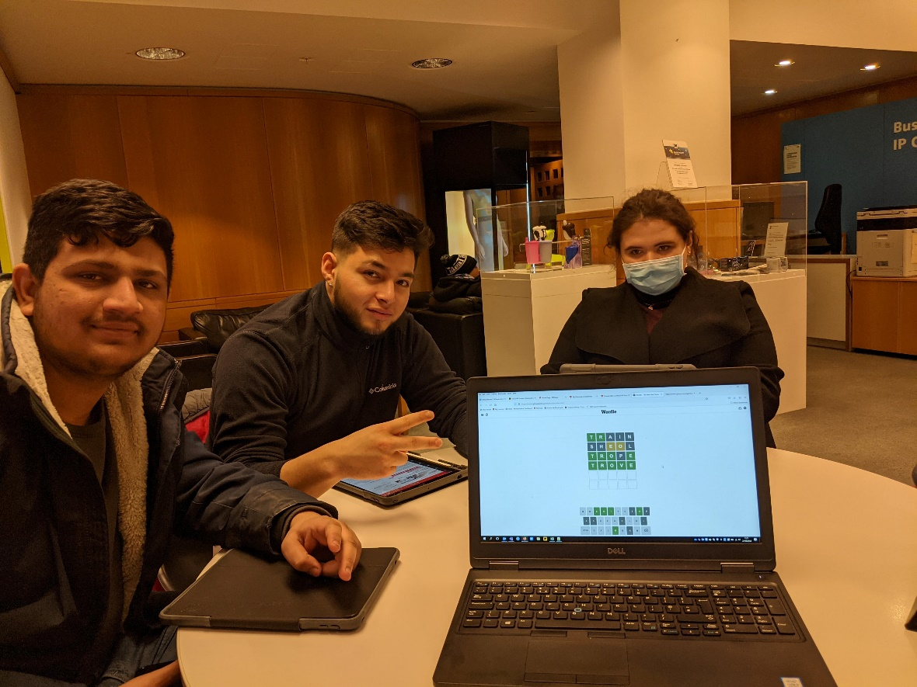
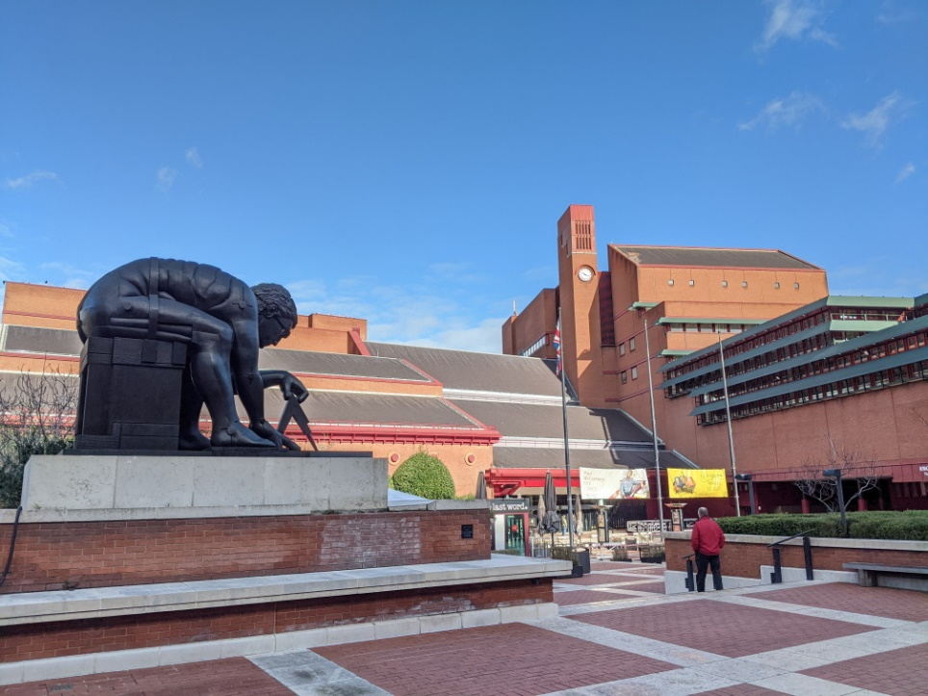
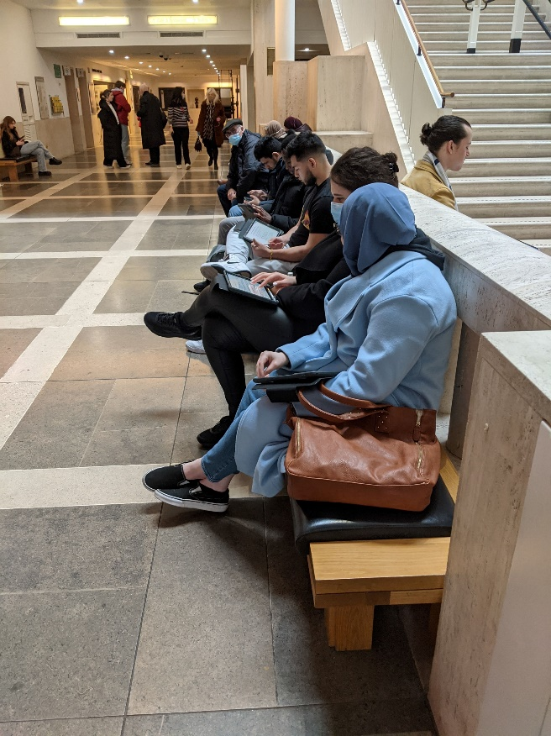
Maths Trip 2: British Library
Academic year 2021/22
Launched assessment for Problem Solving Methods.
Supported students in accessing the library reading rooms.
Students explored a variety of problems posted on a collaborative whiteboard.
CELLULAR STEM
Notes:
Al

Slide 14
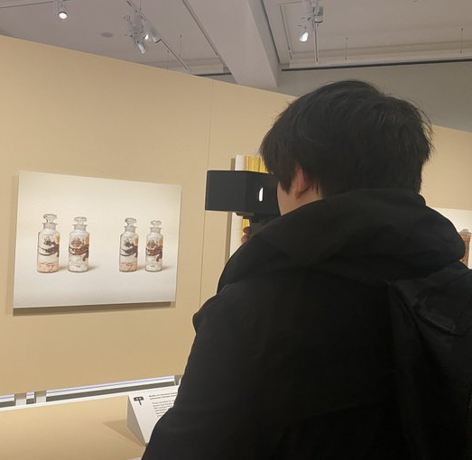
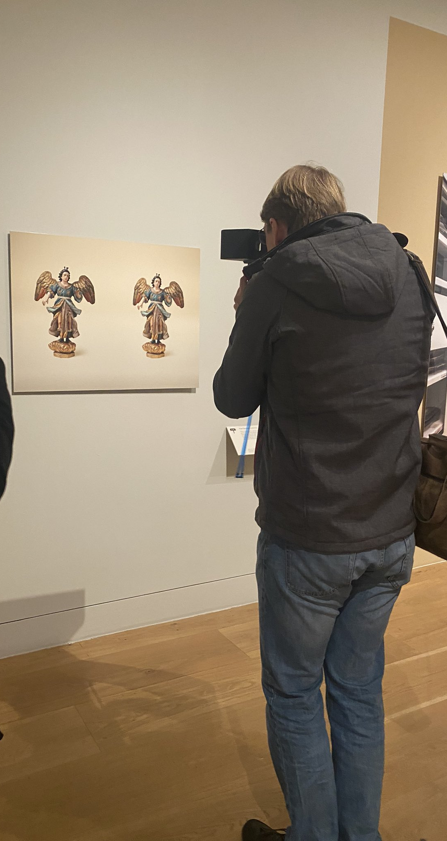
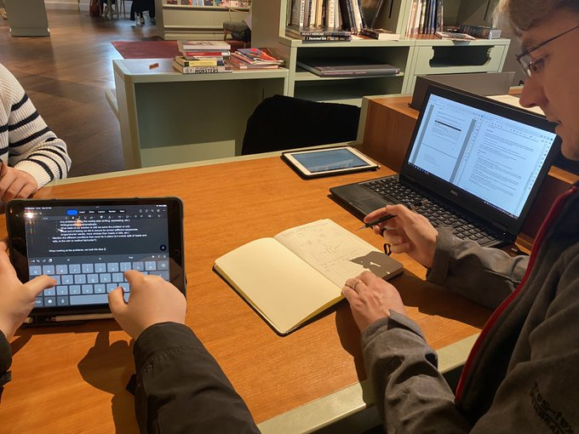
Maths Trip 3: Wellcome Collection – Objects in Stereo
Academic year 2022/23
Discussed mathematics!
Provided feedback on group problem solving assignment.
Provided feedback on communication briefs.
CELLULAR STEM

Slide 15
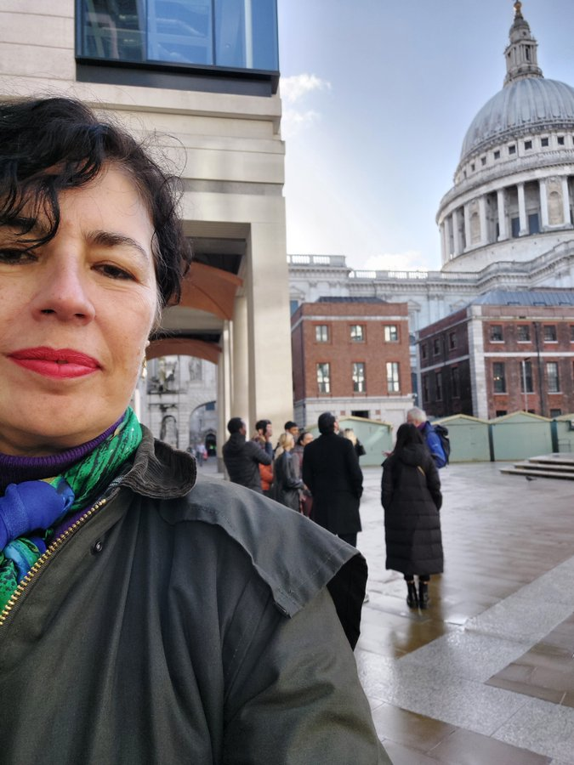
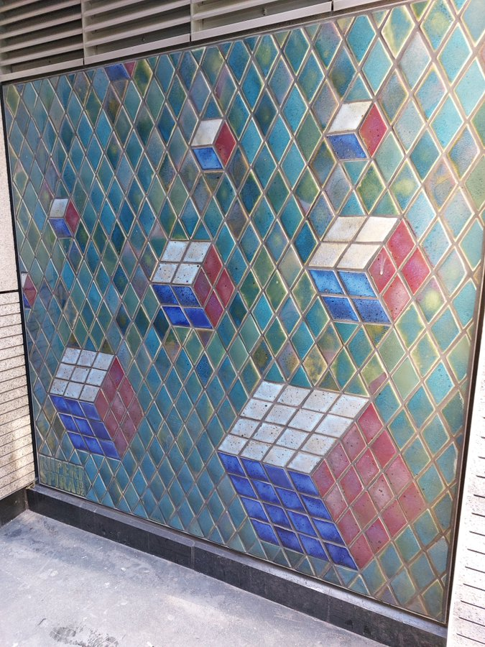
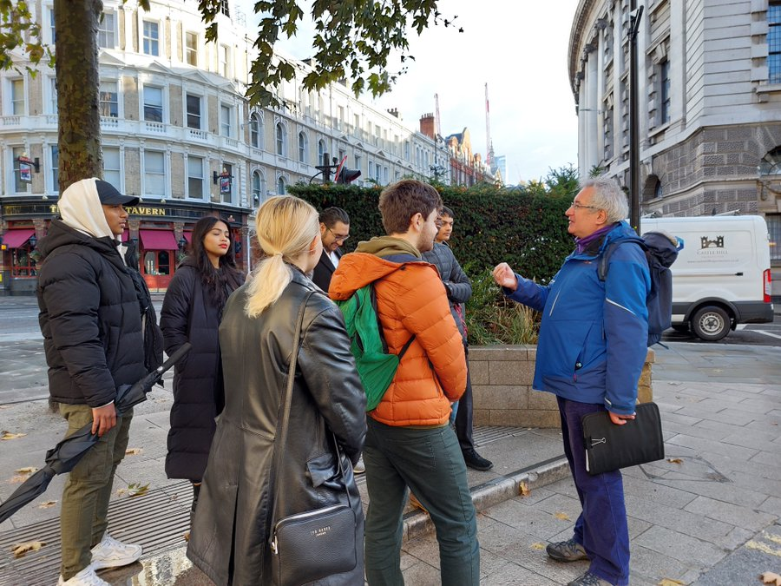
Maths Trip 4: Mathematics Walking Tour
Academic year 2022/23
Historical and social context of mathematics.
Launched a public engagement communication brief.
Supported communication and coordination.
CELLULAR STEM

Slide 16
Cellular STEM Project: Evaluation

Slide 17
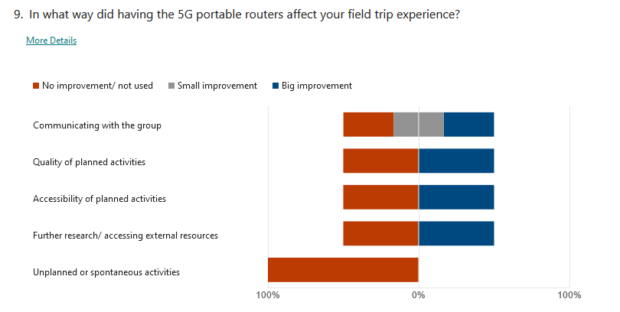
Surveyed Students on trips
Low response rate:
6 Maths
Key points:
Router connection was easy to use and high quality.
Internet connection was used for a wide variety of purposes
Some services worse than on-campus, some better, some comparable
British Museum
British Library

Slide 18
Student quote:
Learning through experience is 100% more powerful than theory learning.
More importantly the connections and networking that can come out of a fieldtrip is also extremely important.
The relationship with lecturers is also different and for me I stopped feeling like I was just a number in a classroom and I actually became comfortable with questioning and asking for help more often.
CELLULAR STEM

Slide 19
Students’ Attitudes to trips
Maths
CELLULAR STEM

Slide 20
Future work

Slide 21
2000+1: A Maths Space Odyssey
For 2023/24 and 2024/25 the theme will be the mathematics associated with space!
Places to visit
Science Museum
Royal Observatory
Planetarium (Greenwich)
Hampstead Observatory
New Scientist Live
Big Bang Festival
STFC sites (to be determined)
Cellular STEM
Notes:
Workshop facilitators will include the project personnel listed below together with recruited undergraduate mathematics and arts students. If the project is funded, facilitator training will be embedded in the “Problem Solving and Communicating” mathematics module and “Engaging with mathematics” seminars. Some lecture time will be dedicated to discussing the mathematics of orbital mechanics, the STFC and its public engagement strategy, and co-creation skills to prepare students for facilitating workshops. Maths students’ engagement with the co-creation process will form part of their module assessment. This project provides an authentic science communication experience for undergraduates while directly connecting them to the work of the STFC.

Slide 22
2000+1: A Maths Space Odyssey
Embedded in
Problem solving and communication
Cross year programme activity weeks
Programme seminar series
Cellular STEM
Notes:
Workshop facilitators will include the project personnel listed below together with recruited undergraduate mathematics and arts students. If the project is funded, facilitator training will be embedded in the “Problem Solving and Communicating” mathematics module and “Engaging with mathematics” seminars. Some lecture time will be dedicated to discussing the mathematics of orbital mechanics, the STFC and its public engagement strategy, and co-creation skills to prepare students for facilitating workshops. Maths students’ engagement with the co-creation process will form part of their module assessment. This project provides an authentic science communication experience for undergraduates while directly connecting them to the work of the STFC.

Slide 23
Summary
Maths on the Move project helped
Rebuild learning communities by combining off-campus experiences with digital provision
Enrich the learning experience, particularly for locked-down students
A small investment allows for high-quality internet-connected field trips
Don’t assume students have a sufficient internet connection
Quality and accessibility of off-campus activities increases with the tech
Gen-Z attitude to tech:
We should model how to use tech off-campus to continue education
Cellular STEM
Notes:
Al and Nick -
This slide needs work I think
Our team will detail how the Mathematics on the Move project capitalizes on our connections in London and how engaging with students off-campus has enabled us to facilitate, encourage, and empower mathematics students to explore new experiences and recognize the value of mathematics in diverse contexts.

Slide 24
Questions?
MESH Research Group
Dr Alison Megeney a.megeney@mdx.ac.uk @DrAliMegs
Dr Nick Sharples n.sharples@mdx.ac.uk @nick_sharples
Dr Brendan Masterson b.masterson@mdx.ac.uk @BrendanMasters4
Dr Matthew Jones matthew.m.jones@ucl.ac.uk @doc_jones1
Dr Snezana Lawrence s.lawrence@mdx.ac.uk @snezanalawrence
Notes:
Order of speaking and other Mesh Members

