Slide 1
No-exam mathematics
Automating coursework generation in Word, LaTeX and R
CETL-MSOR 2023
Cardiff
MESH Research Group
Dr Alison Megeney
Dr Nick Sharples
Dr Matthew Jones
Dr Snezana Lawrence
Dr Brendan Masterson

Slide 2
Mathematics Degrees
Key features
Intellectually demanding curriculum
Mathematical thinking, abstraction, and logical reasoning
Problem solving
Mathematical communication
Inclusive and accessible LTA
Prepare students for employment or further study
No-exam mathematics
Notes:
Ensure all students
Support – problem solving and communication
Going beyond decolonising
Mathematical thinking and logical processes
Assessment good practice - The availability of a variety of assessment methods, and acknowledgement of the difficulties that students from different academic, social or cultural backgrounds may face with some forms of assessment
flexible approaches to assessment tasks that enable learners to demonstrate different competencies
A wide variety of methods may be used for assessment according to context and purpose, recognising that learners may exhibit different aptitudes in different forms of assessment. Automatically marked online assessment has widespread application, particularly for formative work. All assessments, including traditional invigilated examinations, should be designed taking into consideration both matters of accessibility and factors around equality, diversity and inclusion.
can communicate mathematical ideas and concepts
can collaborate on mathematical problems
can demonstrate their learning in creative ways
have equitable access to technology to support their mathematical learning

Slide 3
Examinations
MSOR QAA Benchmark – EDI Assessment good practice 1.27
The availability of a variety of assessment methods, and acknowledgement of the difficulties that students from different academic, social or cultural backgrounds may face with some forms of assessment.
MSOR QAA Benchmark – Assessment 3.48
Some areas of MSOR require particular assessment types to ensure the validity and integrity of the assessment.
Controlled conditions, such as those provided by traditional invigilated examinations, are often essential.
No-exam mathematics
Notes:
Exams are efficient, Seen as rigorous, Gold standard, Elitist
They rely on a timed, one-shot-only display of virtuosity and scholarship.
Is this what professional mathematicians do?
CBI – narrow and irrelevant
creative thinking, collaboration and communication
Unfair – The stress associated with sitting examinations is experienced disproportionately by young people from economically disadvantaged backgrounds, who
are over-represented amongst those with social, emotional and mental health issues. This puts them at greater risk of failing to do themselves justice in high
stakes testing.
EDI is important to MDX in our context - Mental health.
It is argued that exams are the most impartial way of assessing learners as the risk of unconscious marker bias, which can impact Black, Asian and Minority Ethnic (BAME) students and those eligible for Pupil Premium, is reduced. However, the myriad cultural references contained in exam papers across a wide range of subjects disadvantages those with less cultural capital, and the nuances of language in the rubric of exam papers trip up those who are not fluent speakers of English.
Do they make you work ready? - continuous assessment, seems on the surface fairer than concentrated examination;
Some areas of MSOR require particular assessment types to ensure the validity and integrity of the assessment. Controlled conditions, such as those provided by traditional invigilated examinations, are often essential. For example, the nature of the subject means that sometimes students can be expected to provide an answer which is very close to a model answer. Such controlled conditions also help ensure that only work produced by students themselves is being assessed, for example by following the principles in QAA’s guidance Contracting to Cheat in Higher Education.
Students who don’t do as well deemed less intelligent - observed this not true.
Perhaps a more specialised system would make education more accessible and inclusive while producing better results.
What skills do we want and will exams allow our students to demonstrate them.

Slide 4
MDX Context
Index of Multiple Deprivation
Free School Meals Eligibility
OFS 2021-22
IMD Quintile 1 | 24.3%
IMD Quintile 2 | 36.3%
 | 60.6%
OFS
2021-22 | 41.2% | 1st in sector
2020-21 | 43.1% | 1st in sector
2019-20 | 42.6% | 2nd in sector
(Non-profit, degree awarding institutions)
No-exam mathematics
Notes:
Add something about BAME here

Slide 5
Technique 1: Word MailMerge

Slide 6
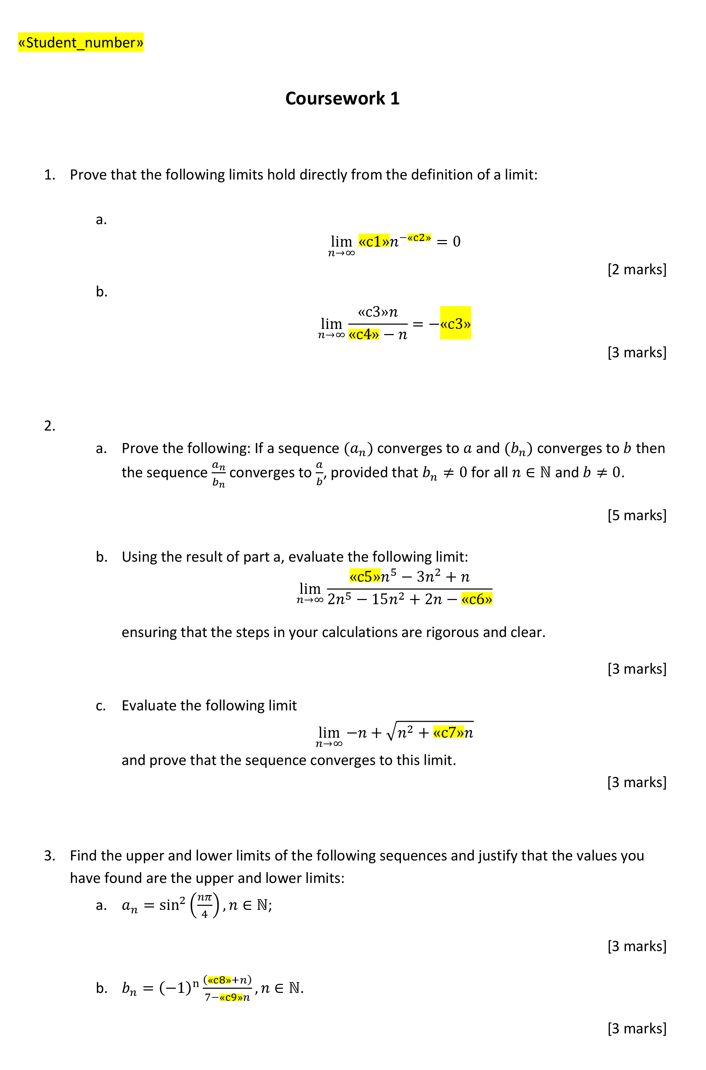
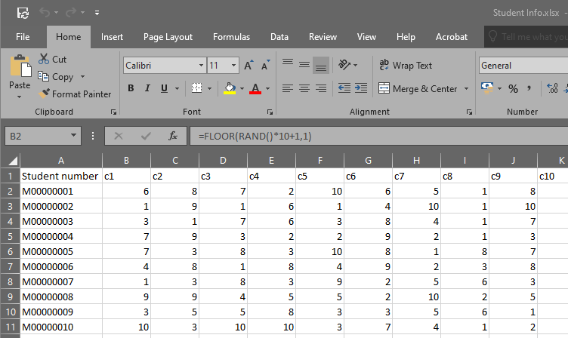
Export to csv
(random numbers are volatile!)
Mail merge
No-Exam Mathematics

Slide 7
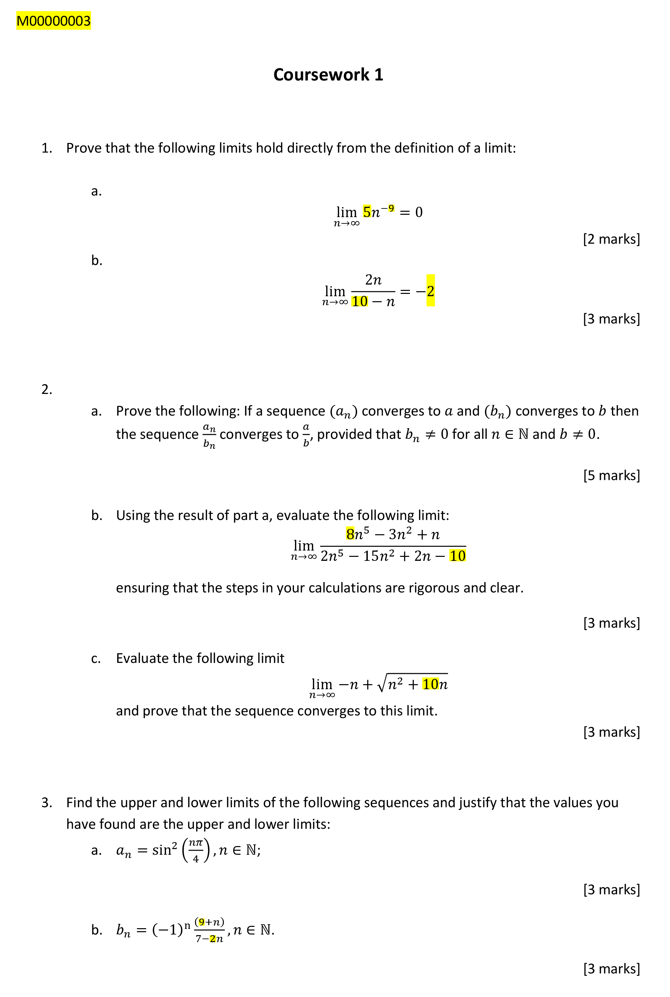
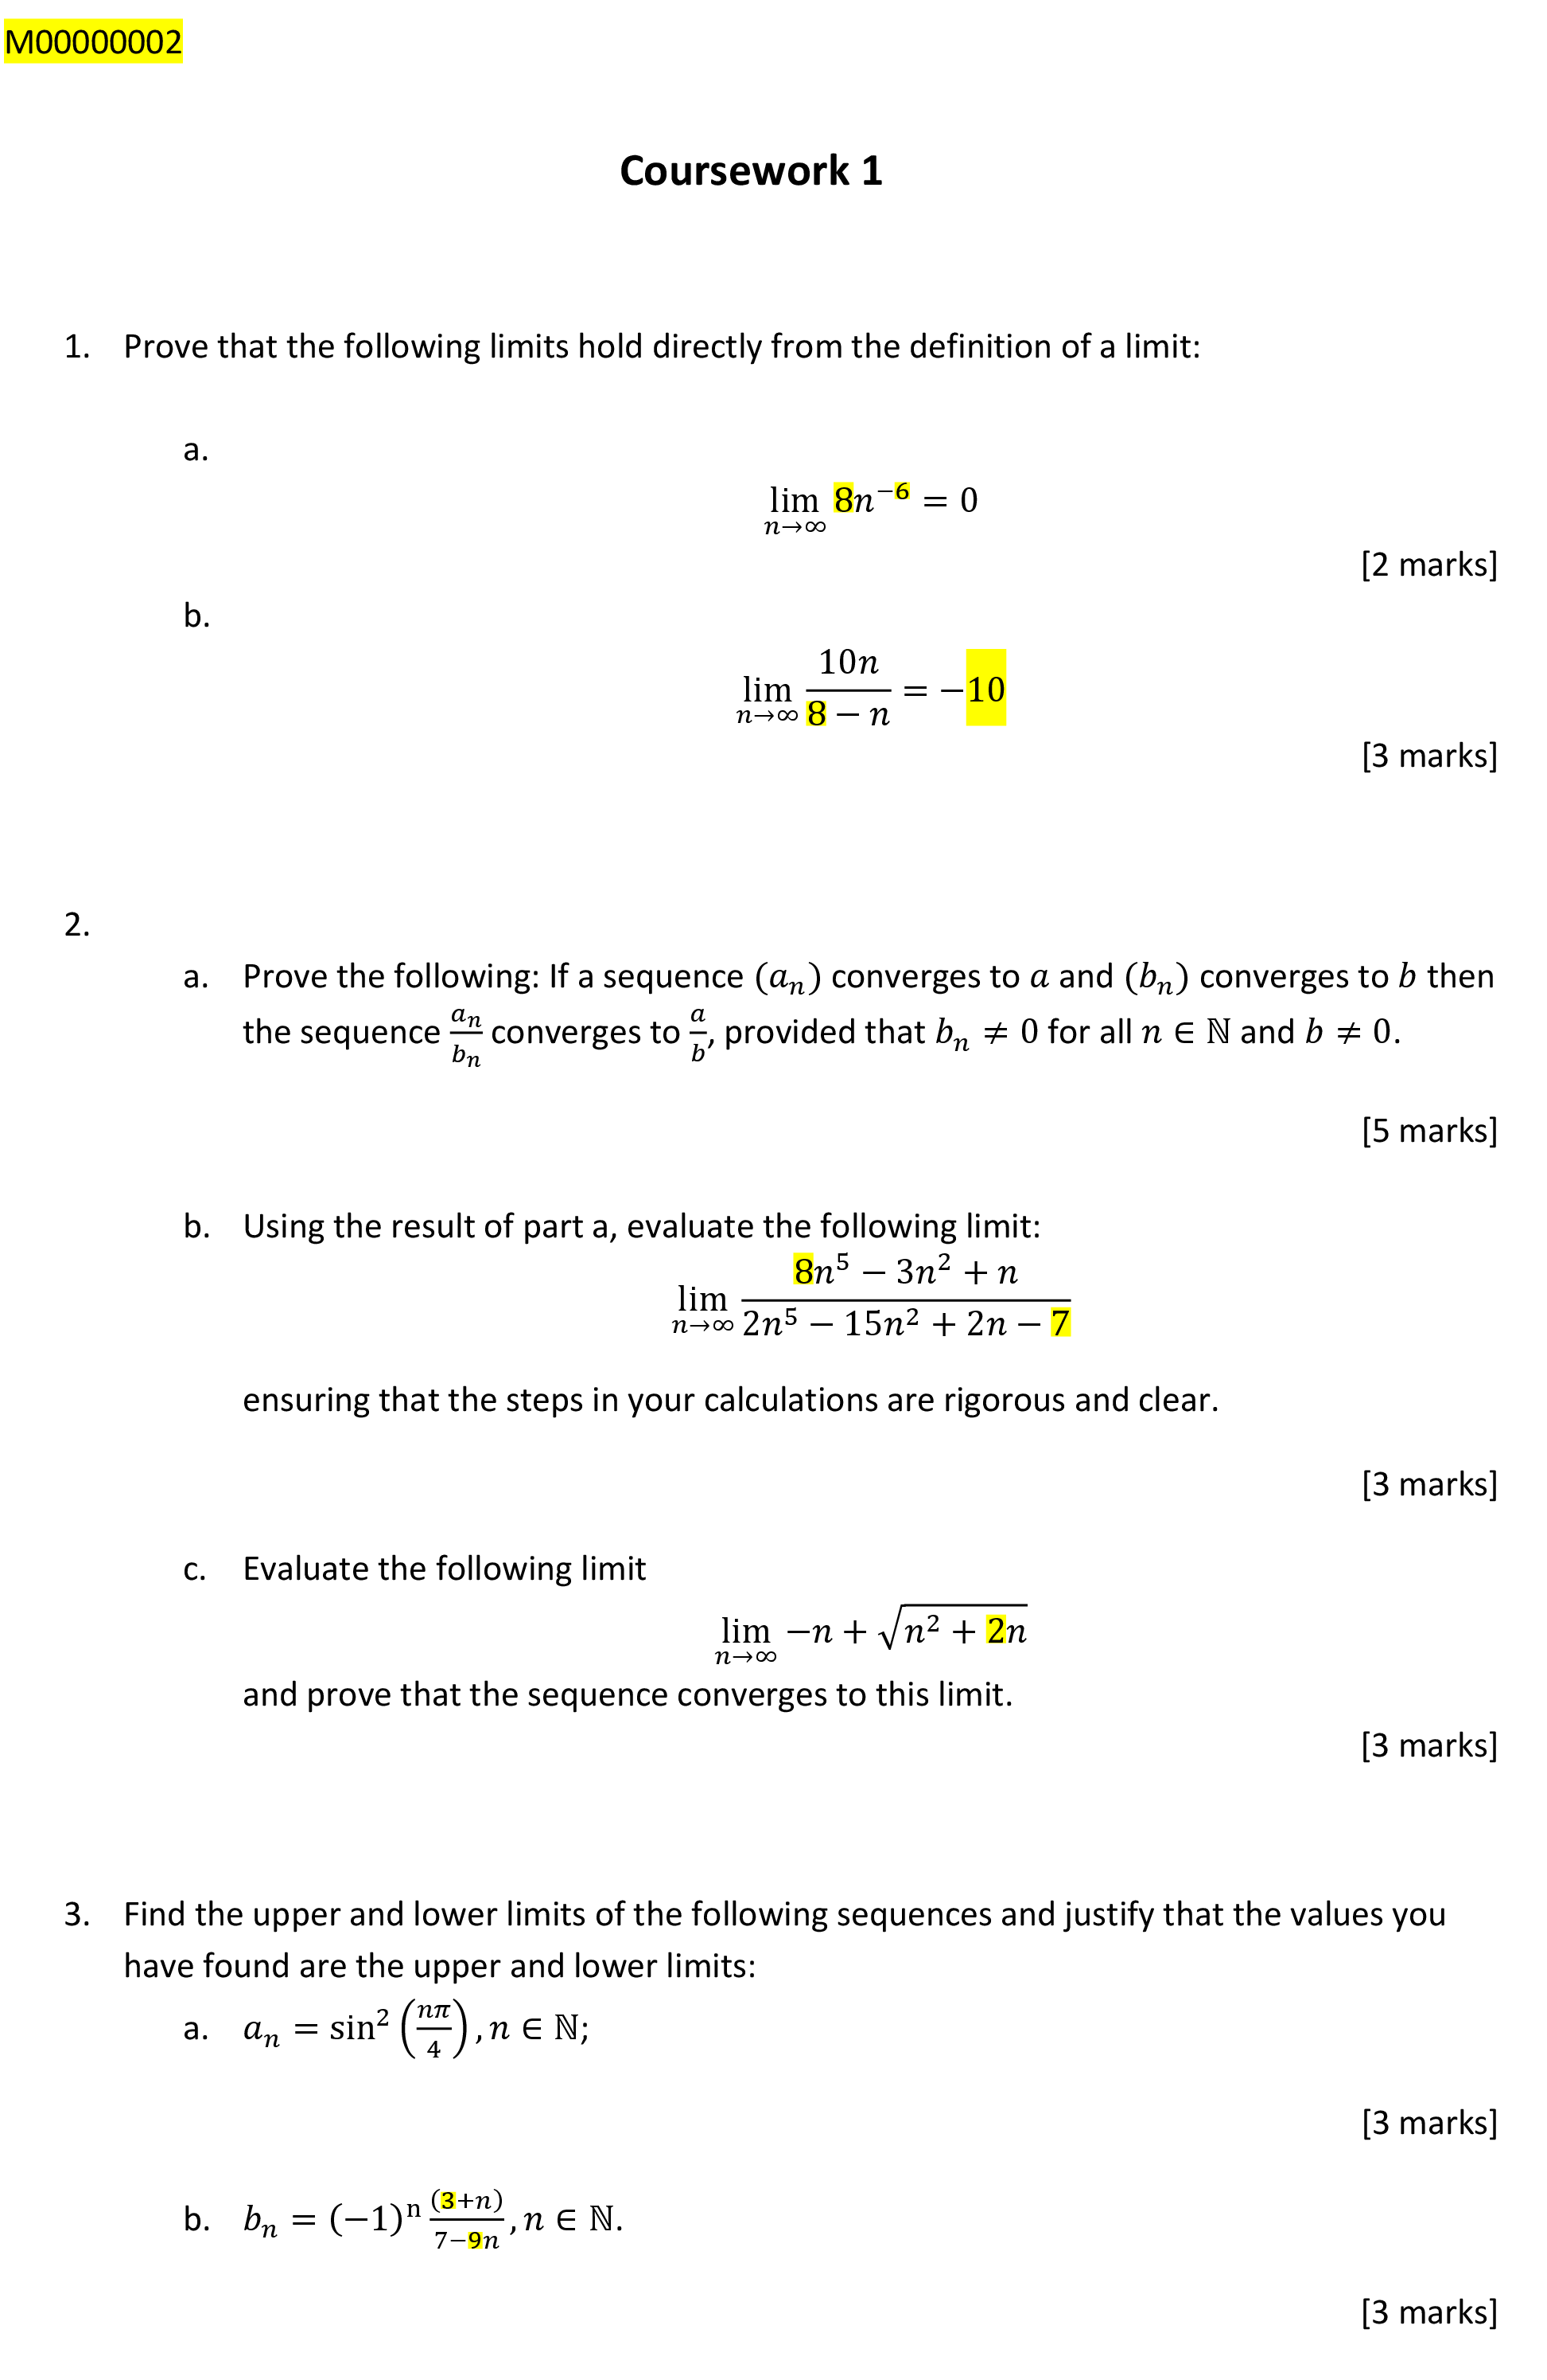
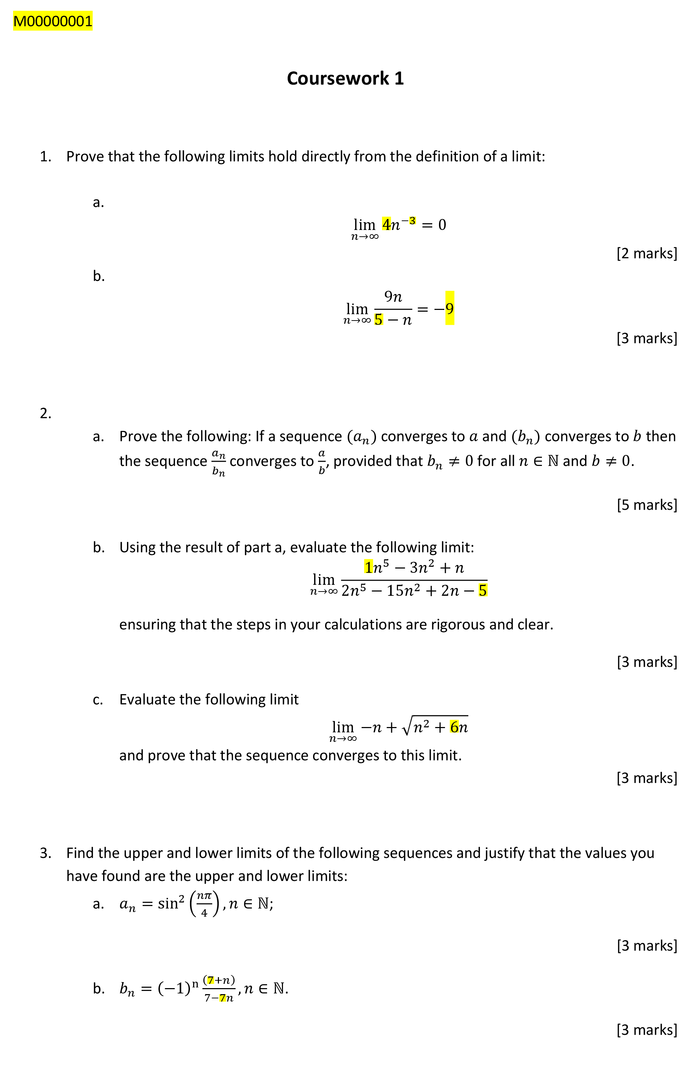
“Merge to PDF”
Can also automatically email the PDF to students.
Add student emails into the spreadsheet.
Check the output first!
Pros:
Straightforward workflow.
Uses software all staff are familiar with.
Cons:
Limited scope for calculations.
Can’t (easily) set a seed. Any corrections/edits will totally change the document.
No-Exam Mathematics

Slide 8
Technique 2: LaTeX and Python

Slide 9
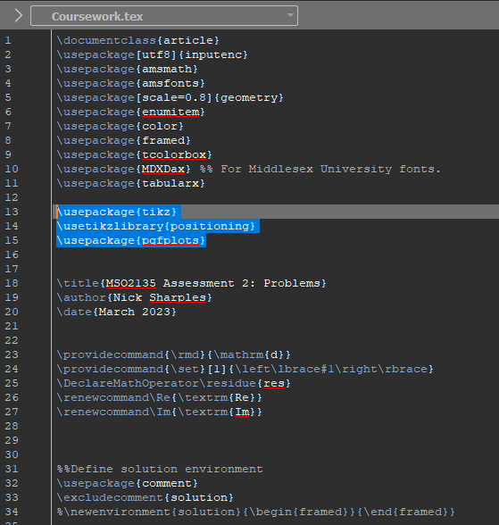
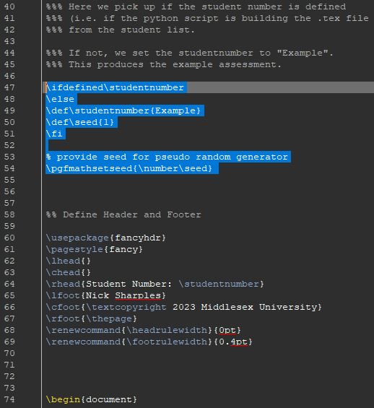
LaTeX preamble
No-exam mathematics

Slide 10
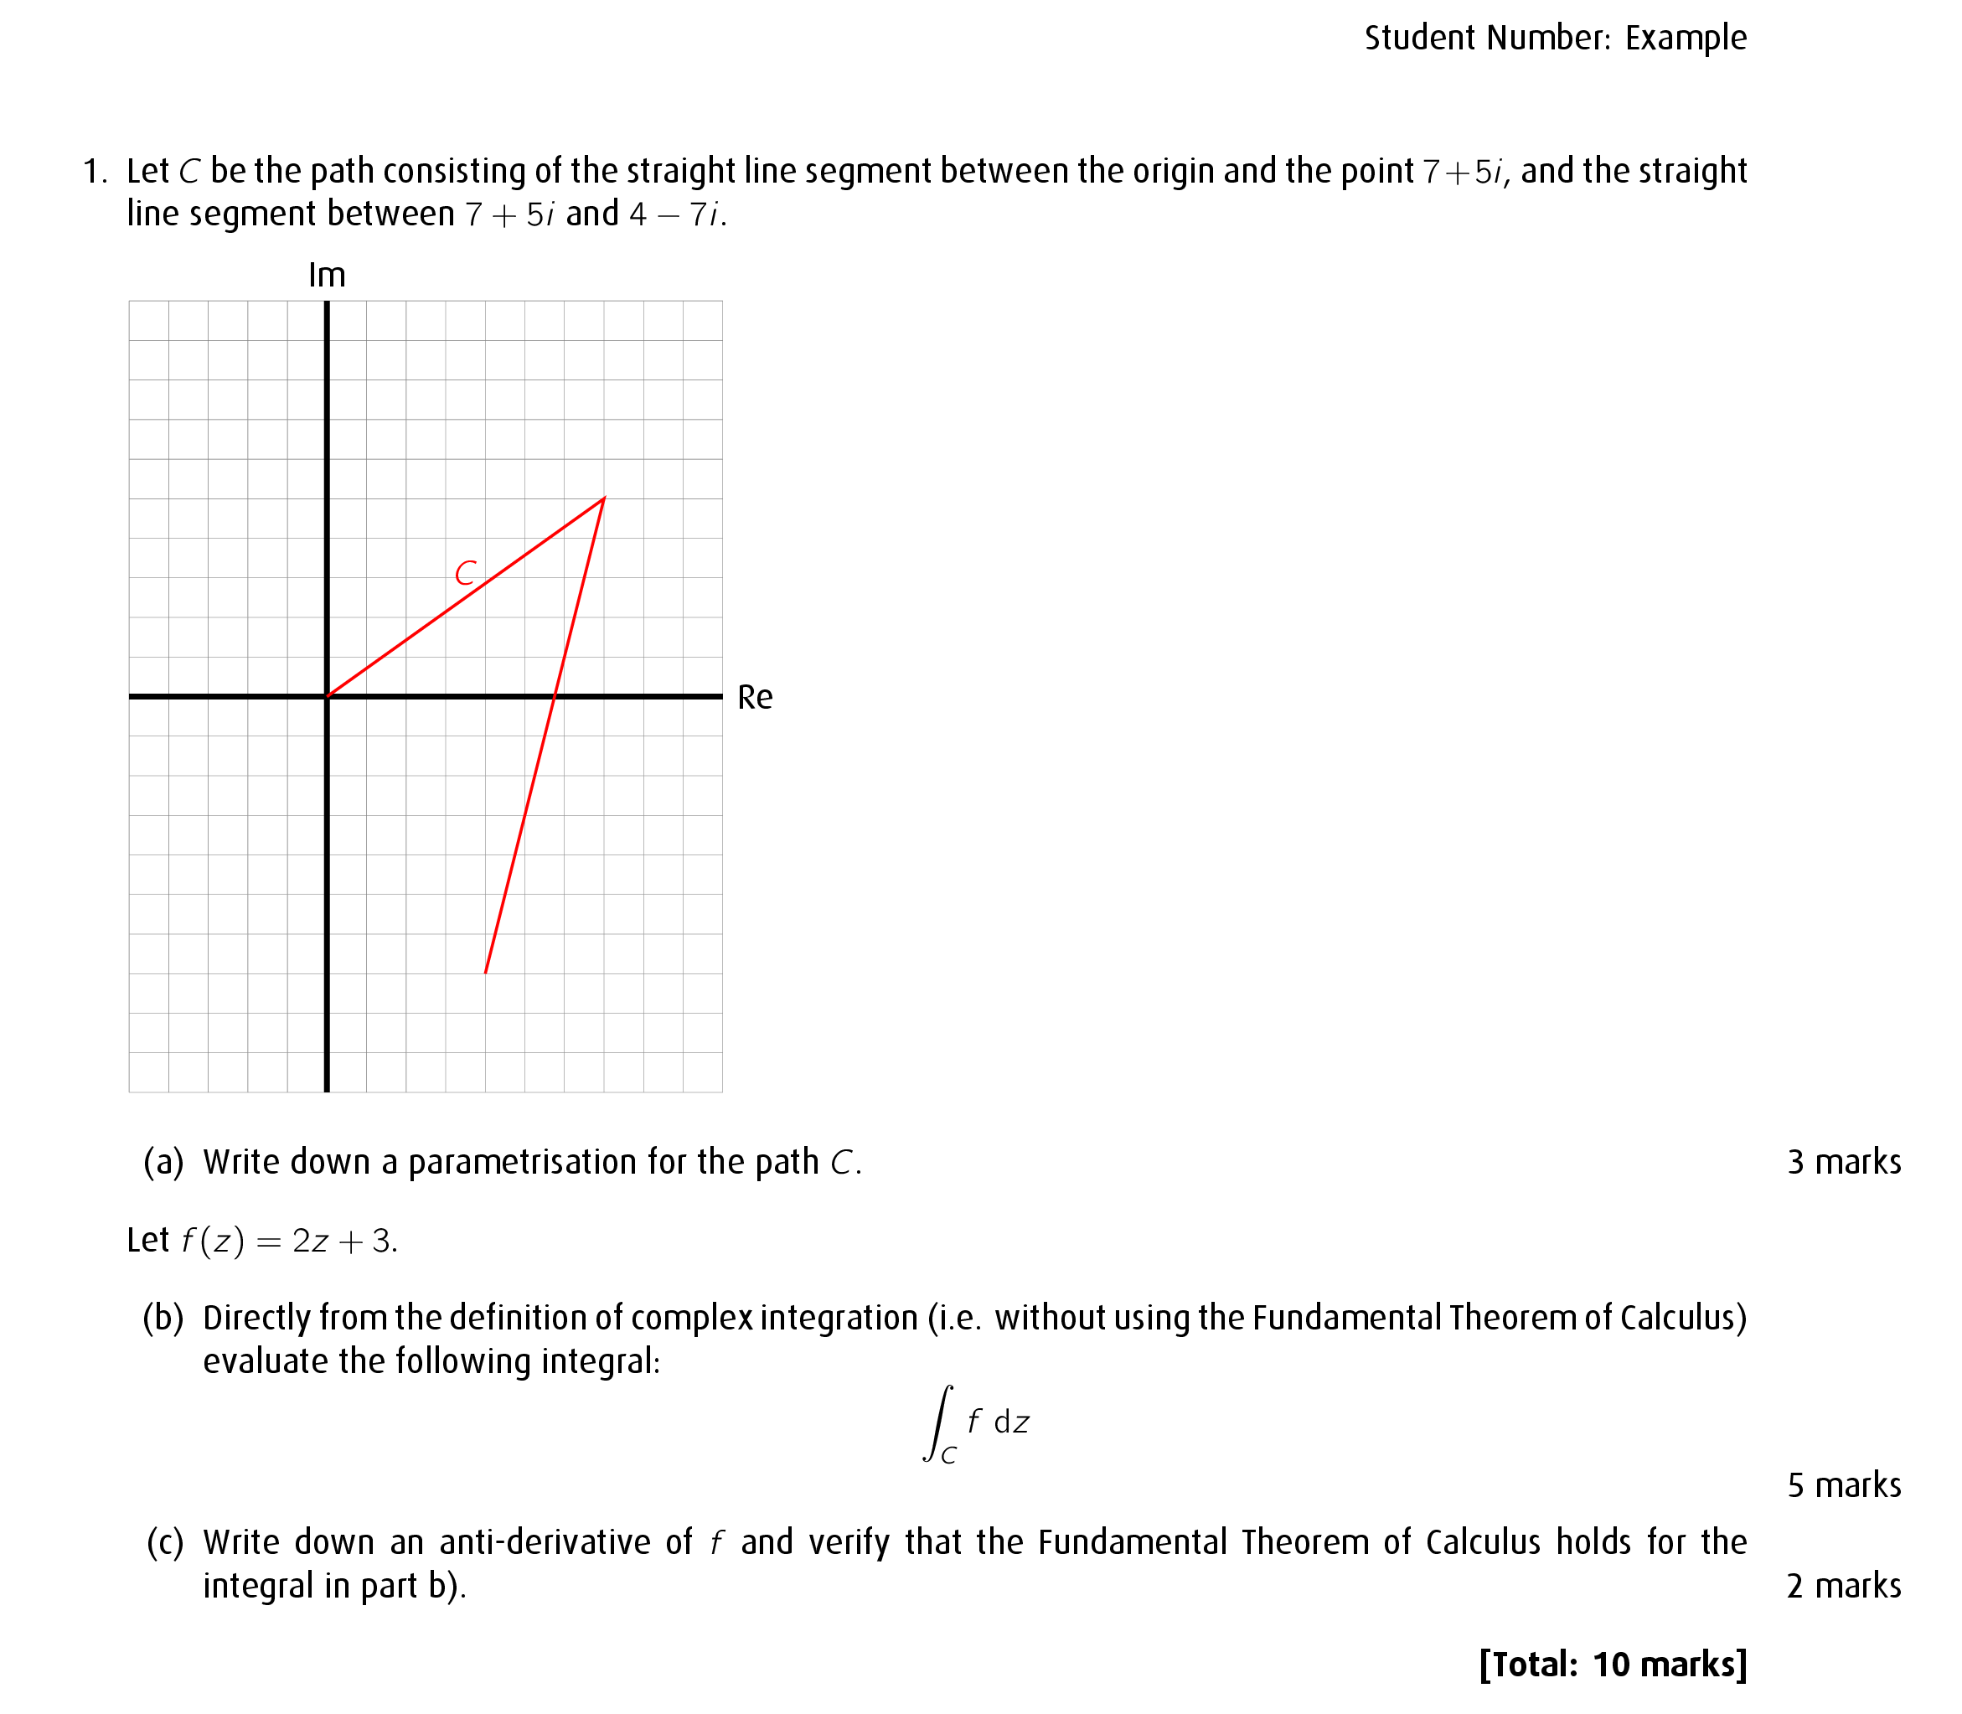
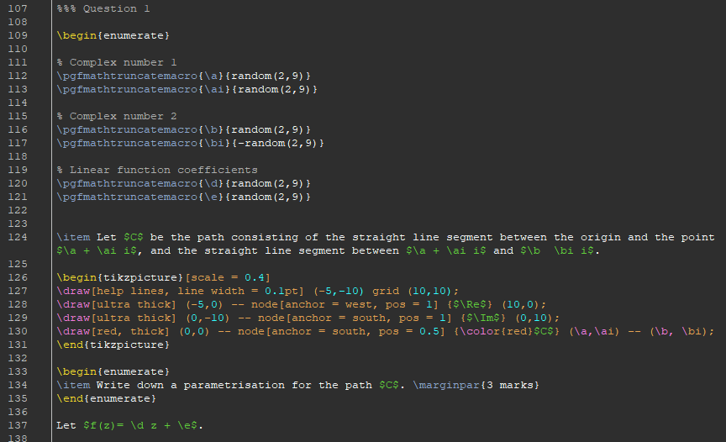
Example question:
\pgfmathtruncatemacro
is needed to get rid of unwanted floats
No-exam mathematics

Slide 11
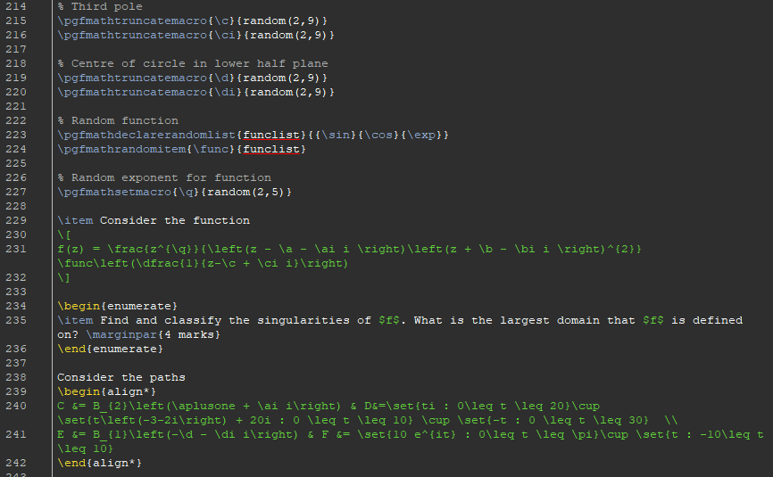
Example question:
We can randomly choose from a list of objects with
\pgfdeclarerandomlist
\pgfmathrandomitem
No-exam mathematics

Slide 12
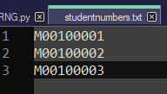
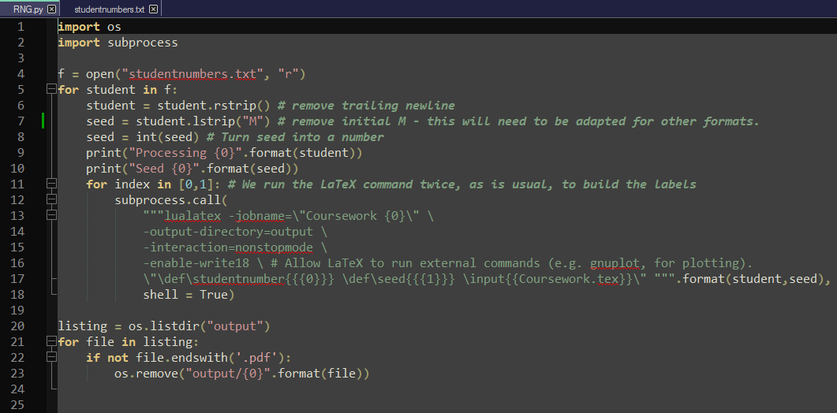
Generate the coursework
Run: python RNG.py
No-exam mathematics

Slide 13
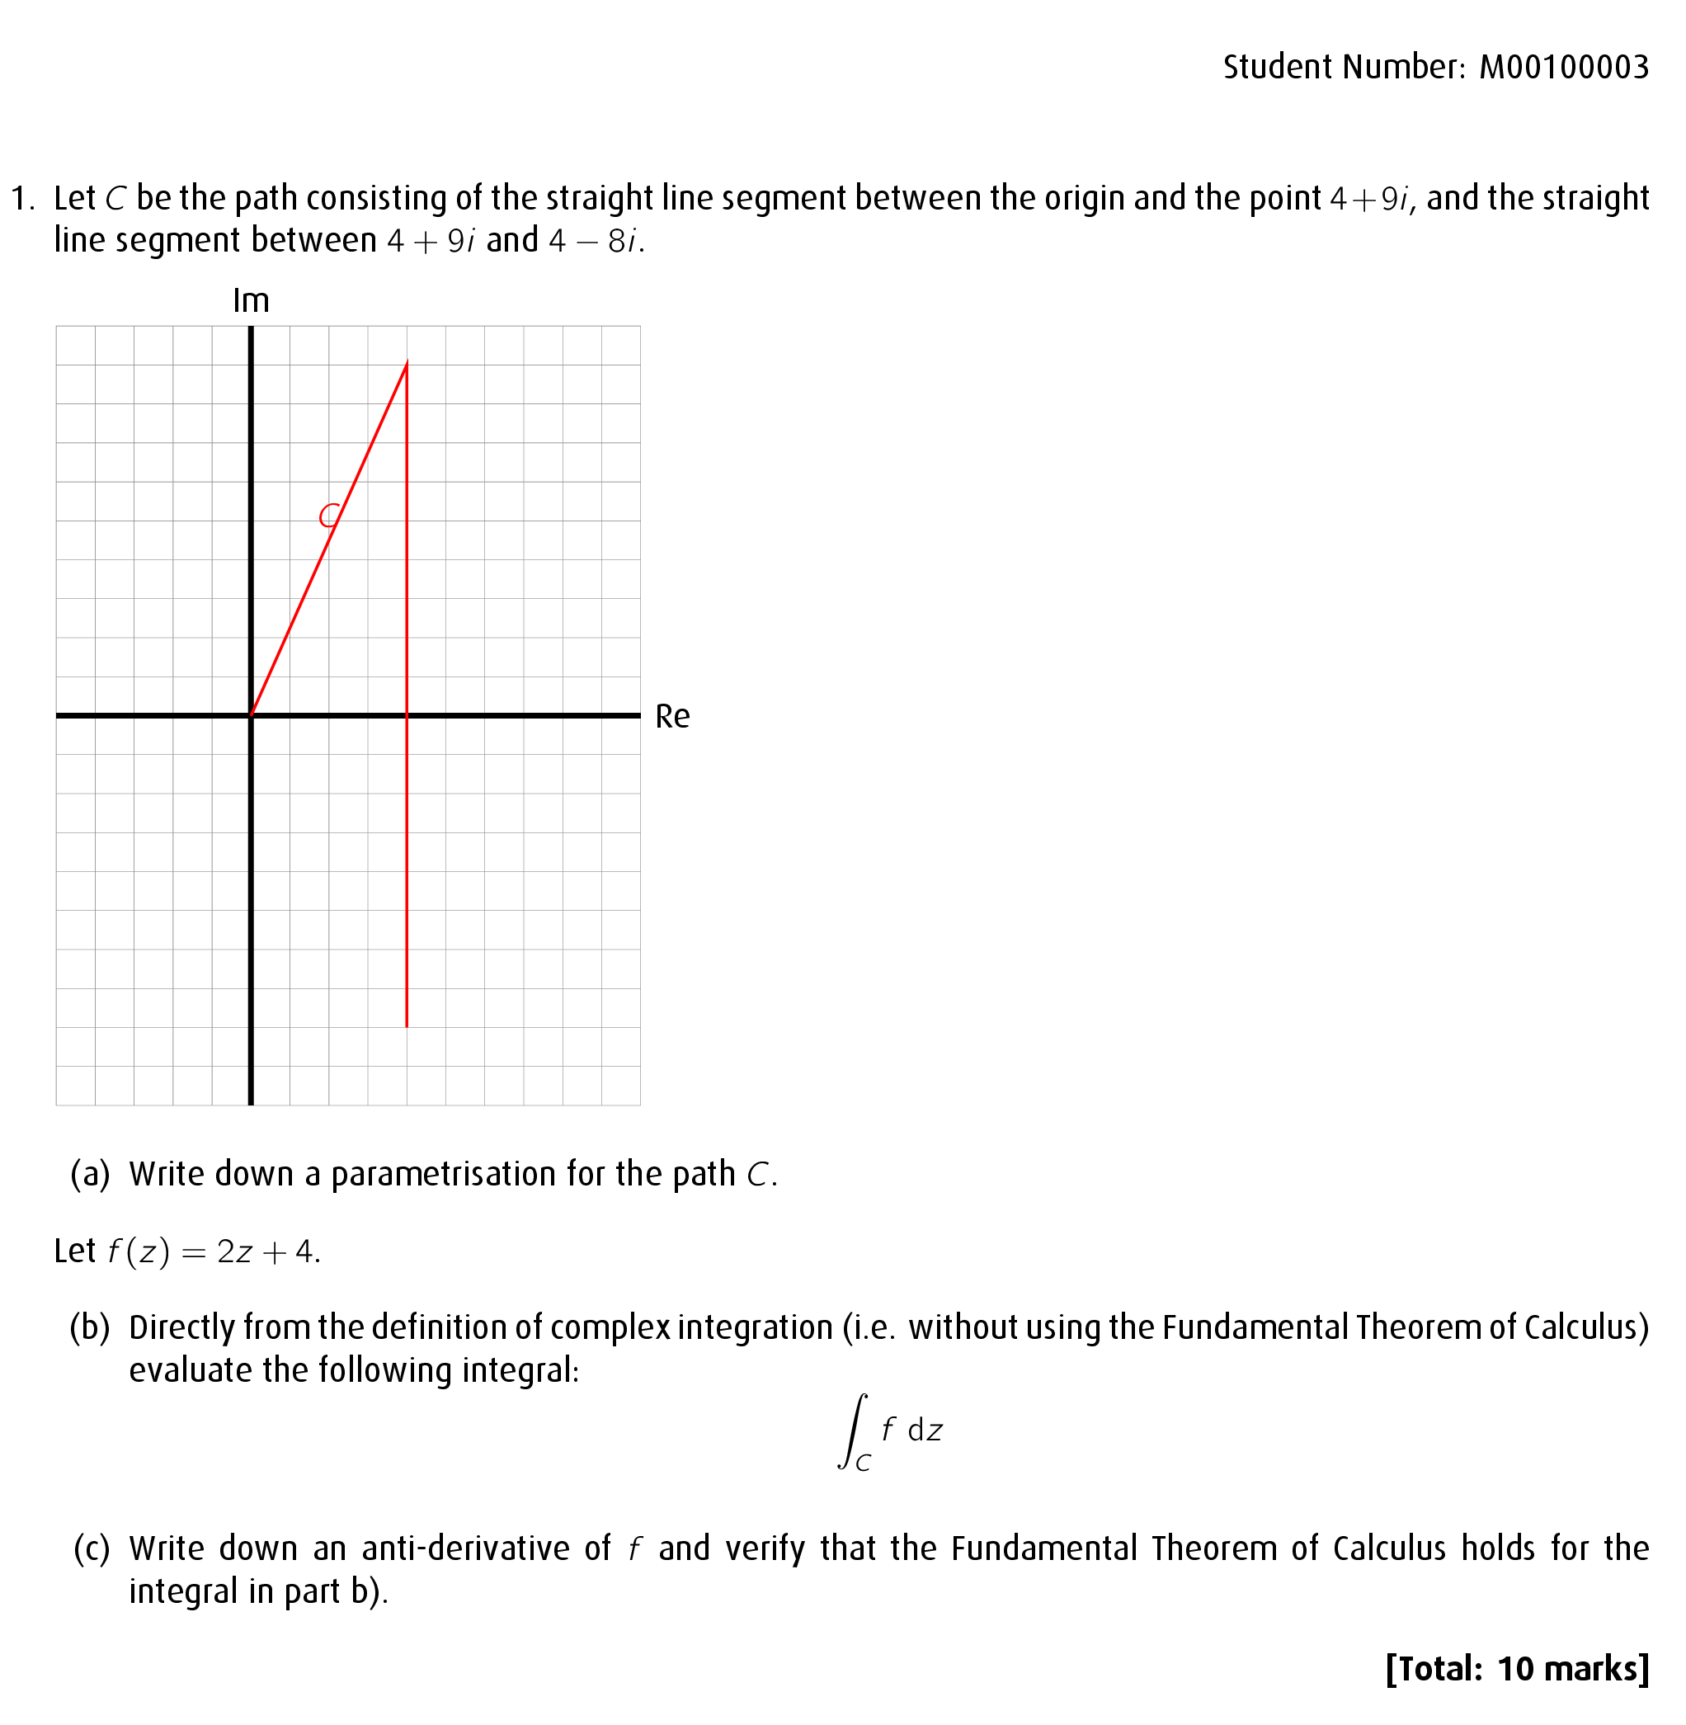
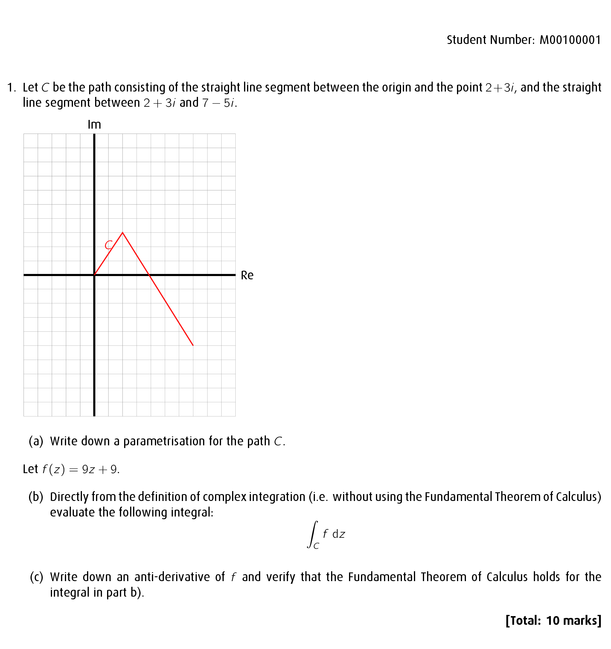
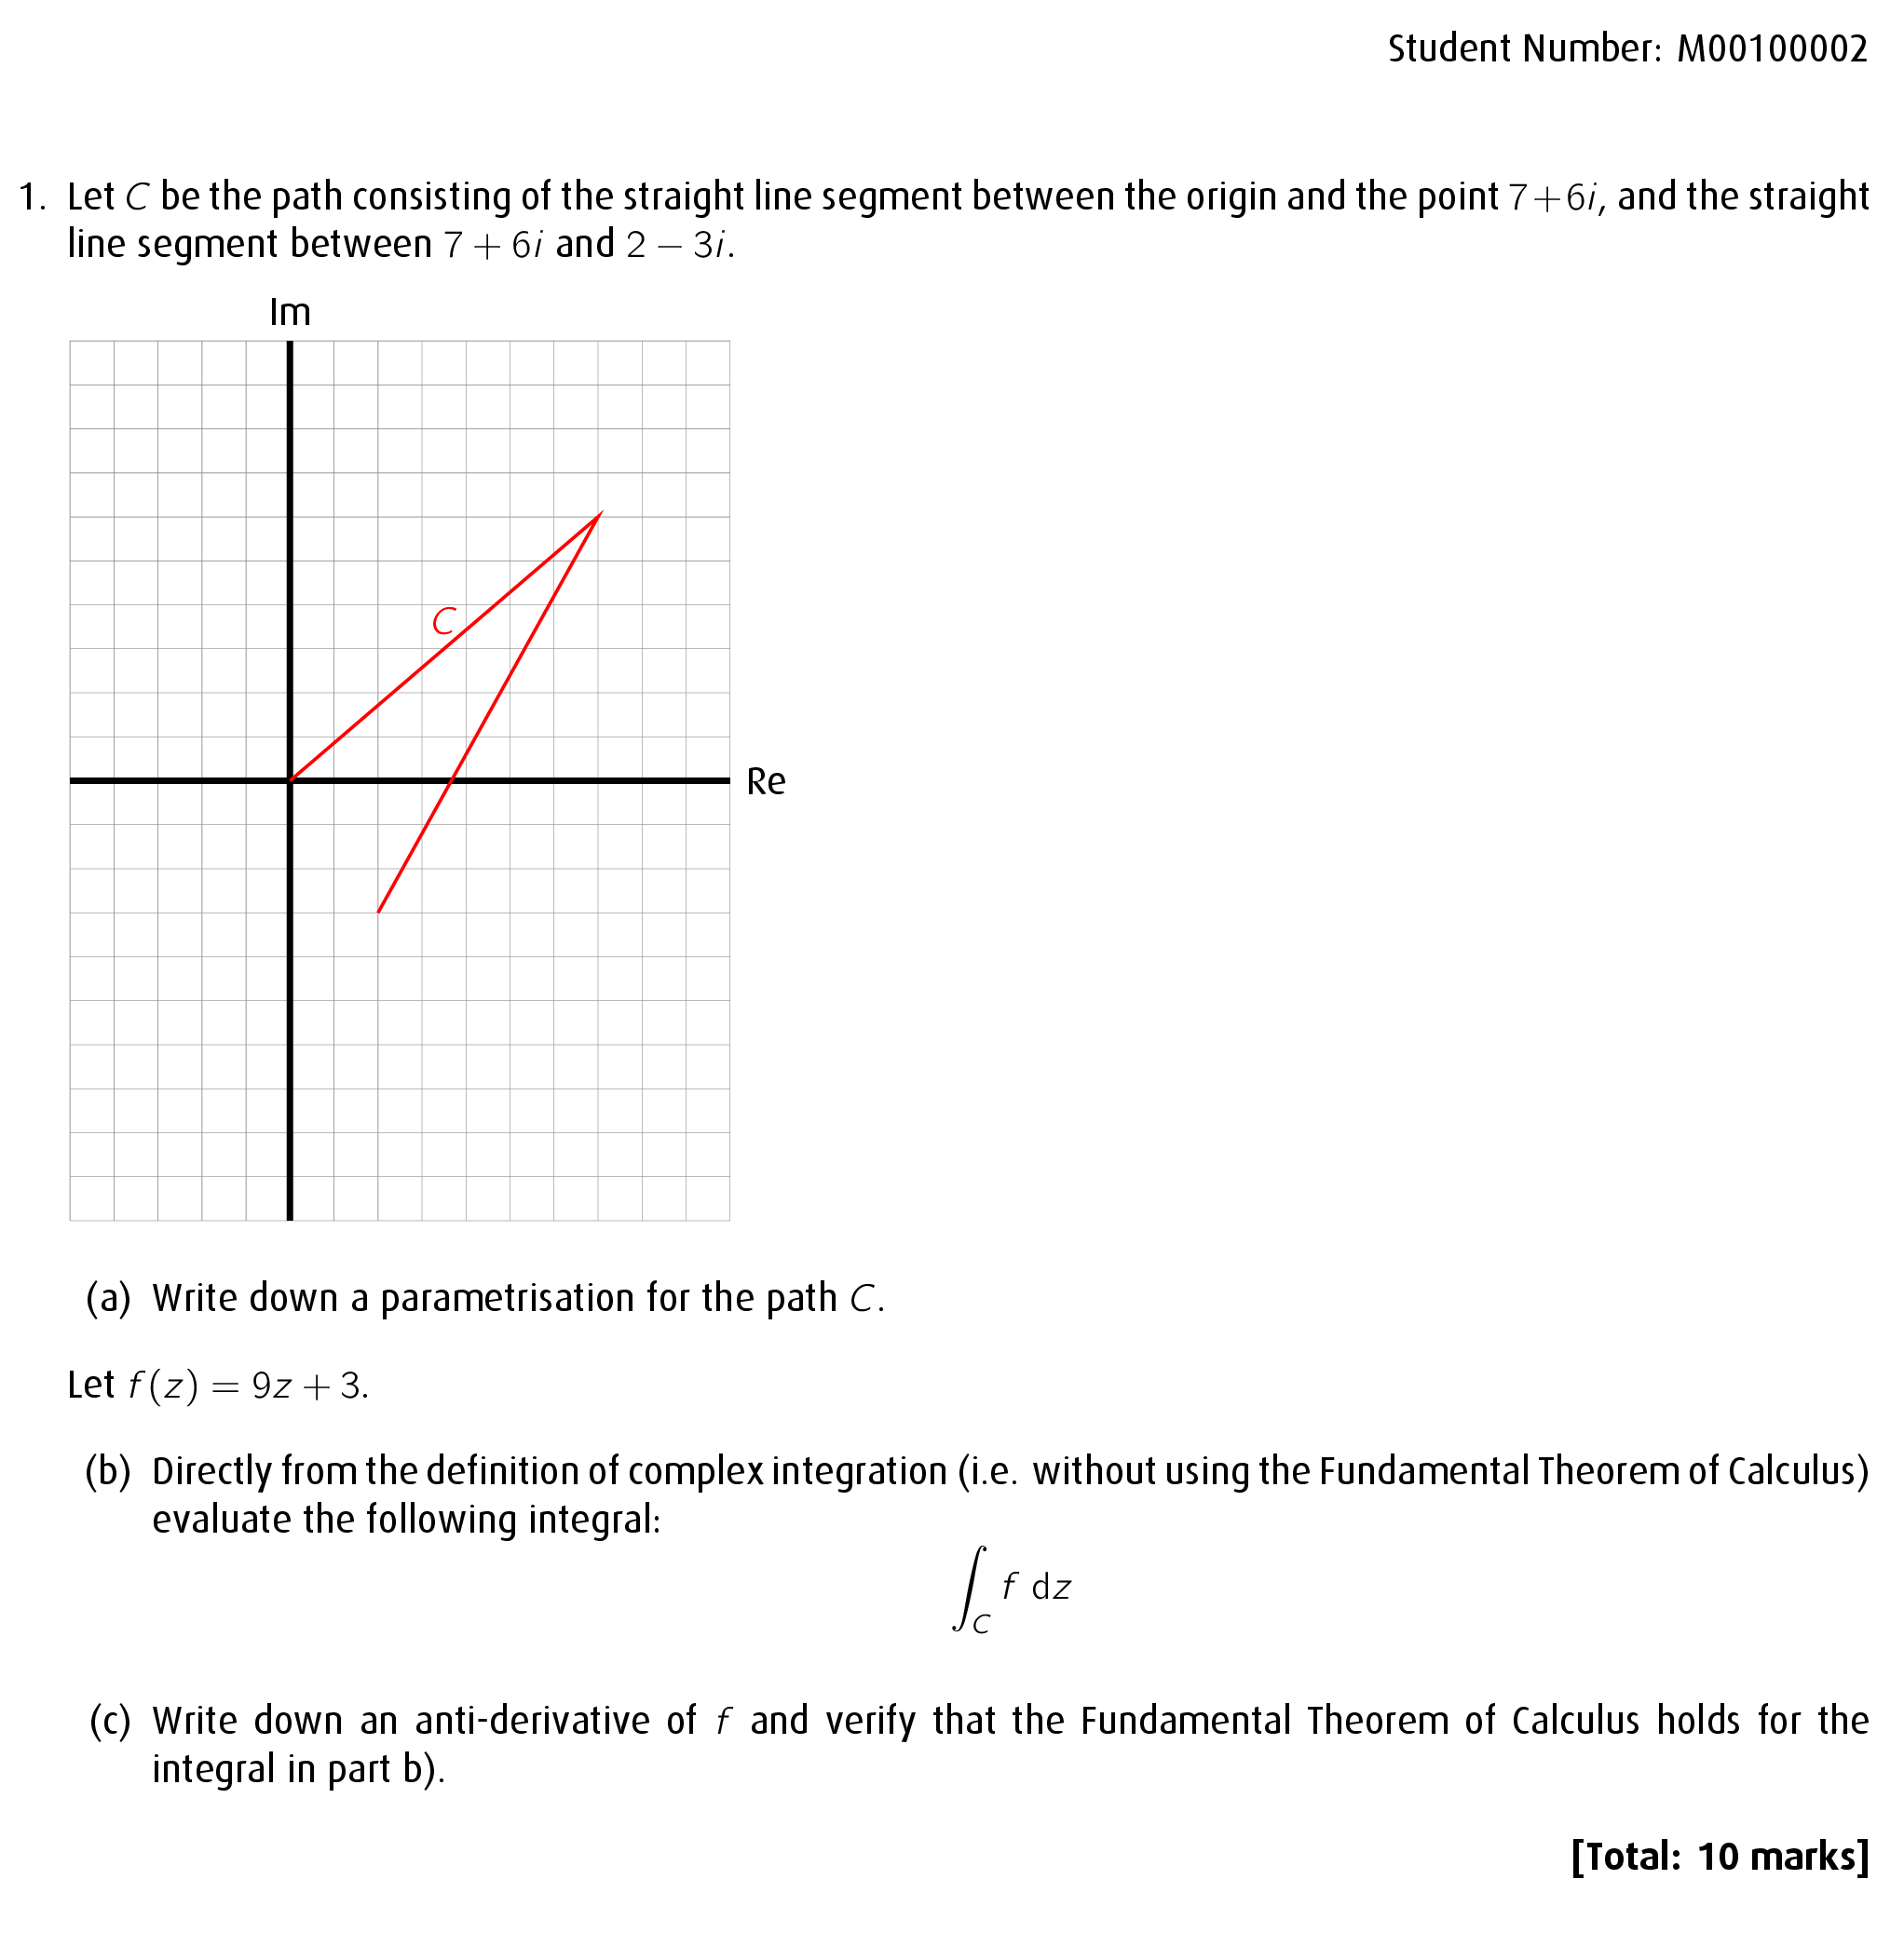
Pros:
Very powerful: great for generating images for questions.
Cons:
Syntax can be tricky.
Requires maintenance of multiple bits of software
No-Exam Mathematics

Slide 14
Technique 3: RMarKDOWN

Slide 15
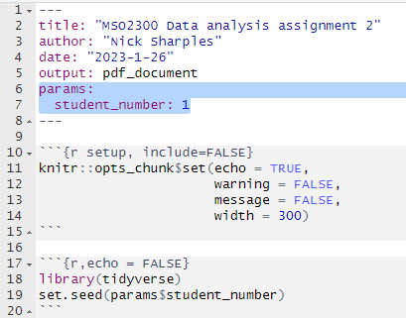
RMarkdown preamble
No-exam mathematics

Slide 16
Example question:
No-exam mathematics

Slide 17
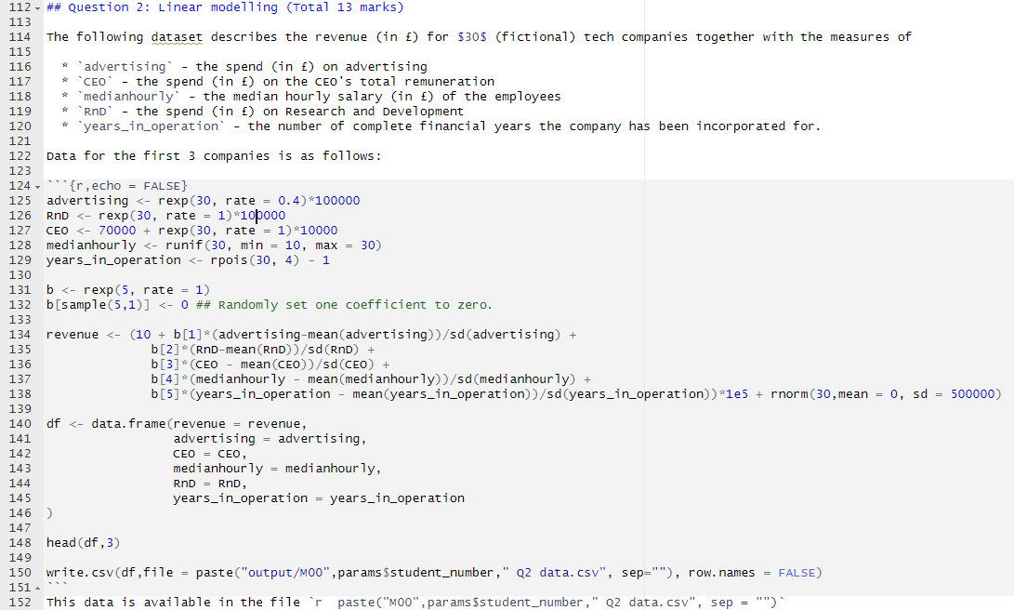
Example question:
No-exam mathematics

Slide 18
Example question:
No-exam mathematics

Slide 19
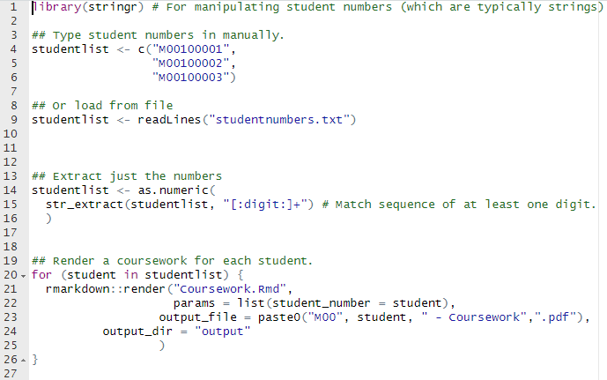
Generate the coursework
No-exam mathematics

Slide 20
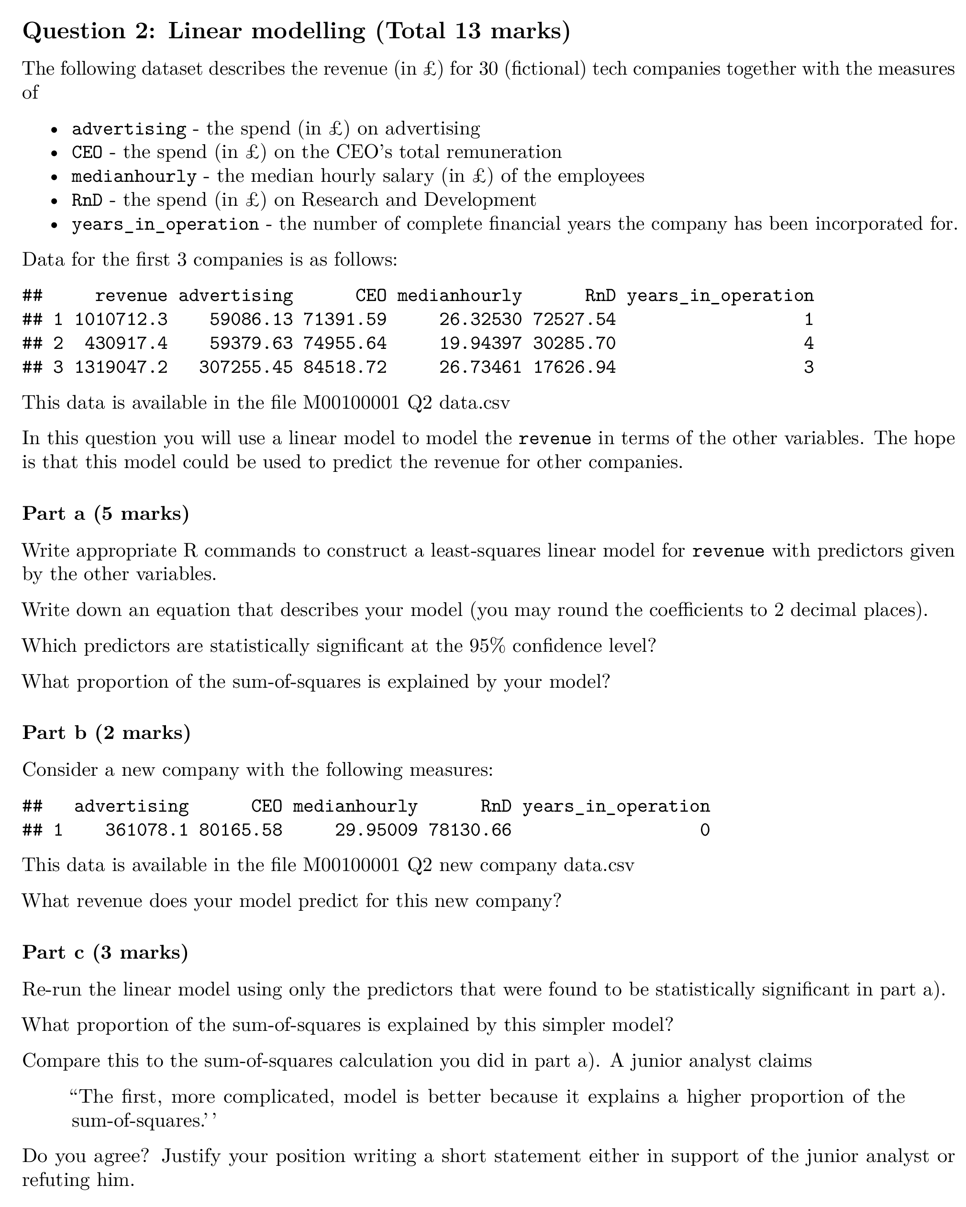
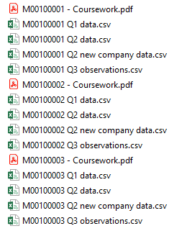
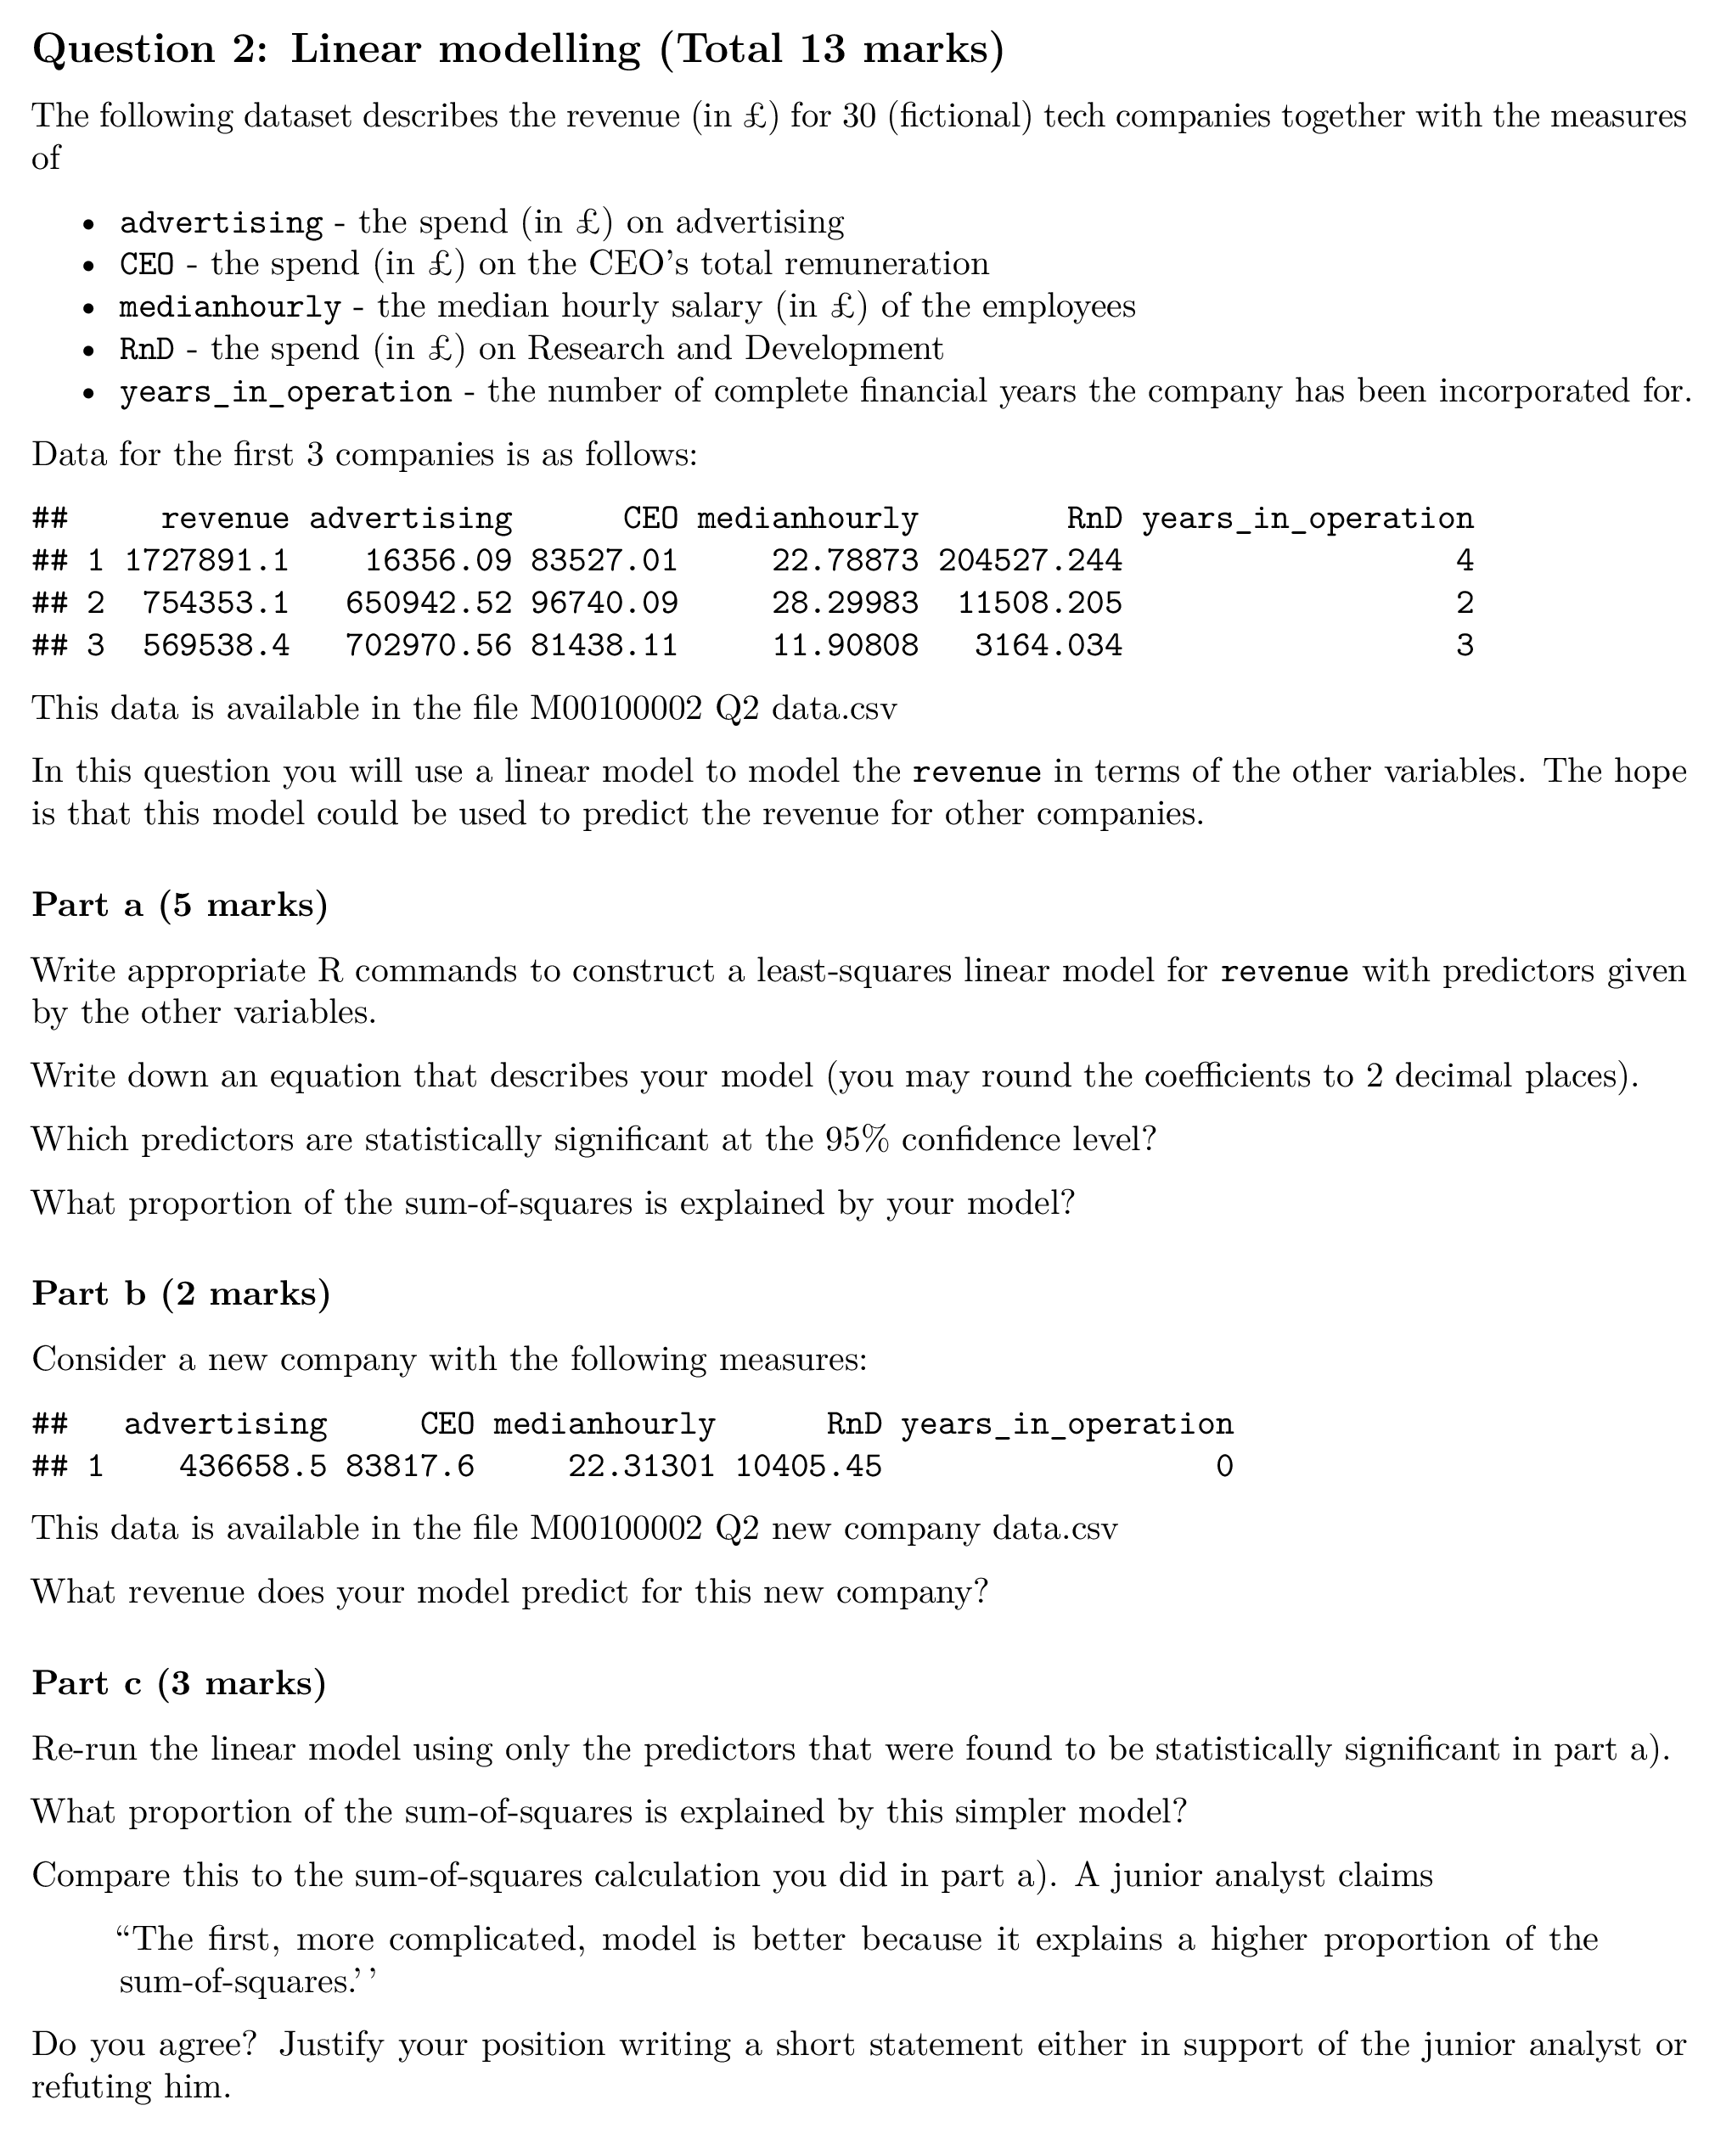
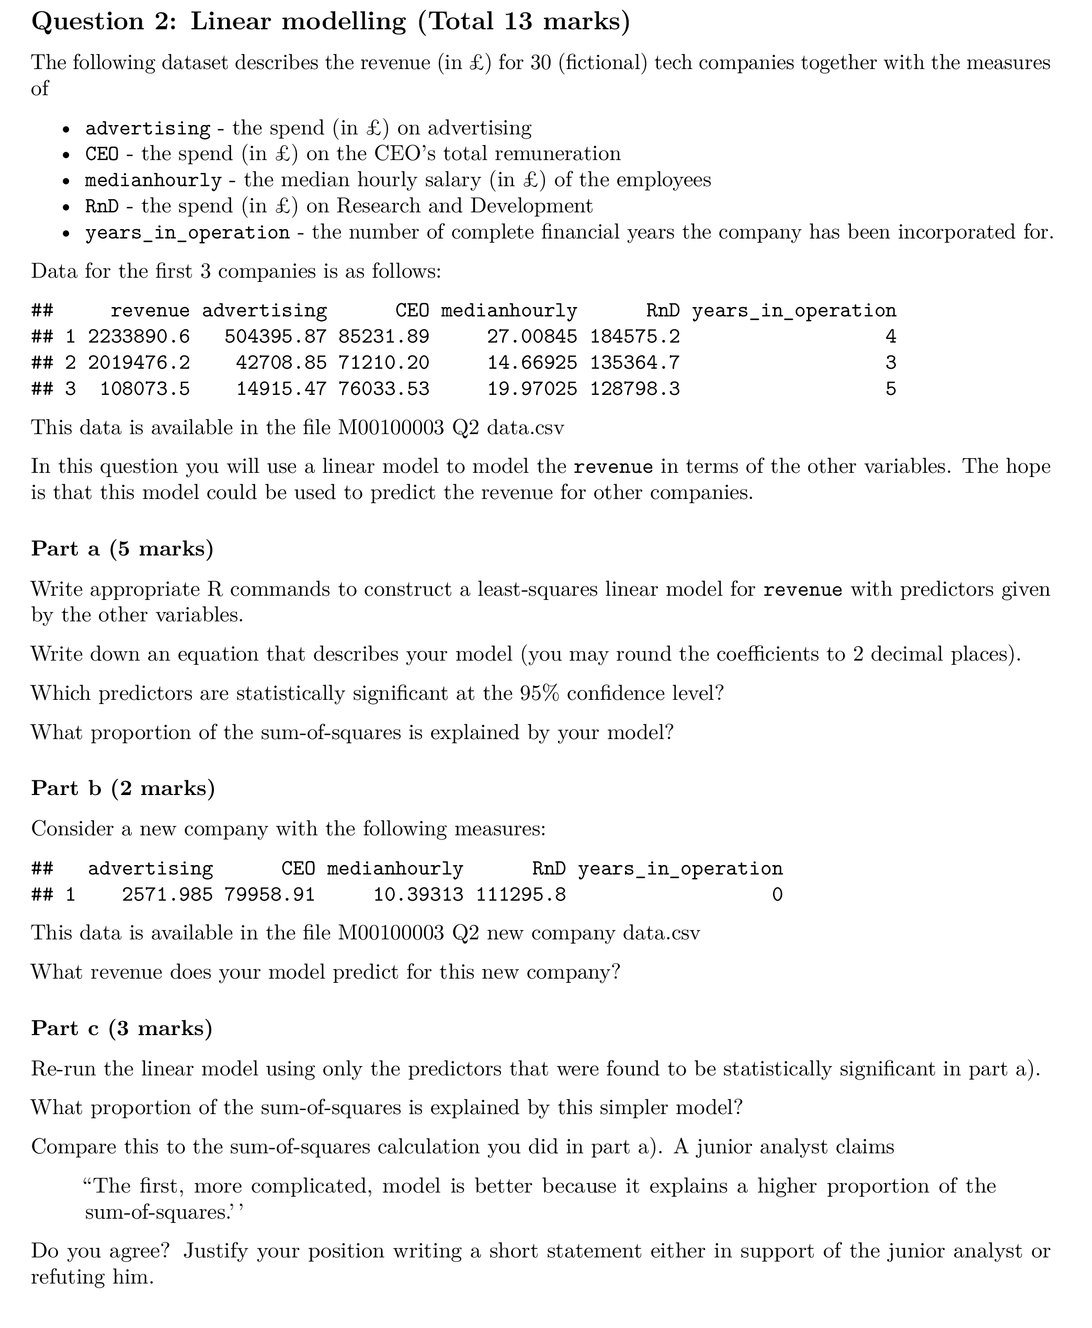
Generate the coursework
Pros:
Very powerful: great for generating datasets for questions.
One software suite (Rstudio).
Multiple output formats (e.g. html).
Straightforward syntax.
R skills generalise.
Cons:
Less familiar?
No-exam mathematics

Slide 21
Discussion

Slide 22
Tomorrow:
10:15 – 11:00 Workshop: Get your hands into Rmarkdown. Ahmed, Richard & Hodge
On Ai:
$Randomly generated questions⊂LLM/Ai solvable questions$ ?
10:40 – 11:00 Authenticity in Learning, Teaching and Assessment. Masterson & Sharples
Generated data sets are (perhaps) harder for LLMs to deal with.
Ai generated solutions have tell-tale conditionals:
if (F_stat > F_crit) {
cat("The variances are statistically significantly different at the 95% confidence level. \n")
} else {
cat("The variances are not statistically significantly different at the 95% confidence level. \n")
}
Kaggle datasets (for example) have too much sample code and discussion.
No-exam Mathematics

Slide 23
References
QAA Subject Benchmark Statement: Mathematics, Statistics and Operational Research March 2023
CBI report: Getting young people ‘work ready’. People and Skills. June 2019
Cook, A. (2001). Assessing the use of flexible assessment. Assessment & Evaluation in Higher Education, 26(6), 539-549.
Francis, R. A. (2008). An investigation into the receptivity of undergraduate students to assessment empowerment. Assessment & Evaluation in Higher Education, 33(5), 547-557.
Irwin, B., & Hepplestone, S. (2012). Examining increased flexibility in assessment formats. Assessment & Evaluation in Higher Education, 37(7), 773-785.
Pretorius, L., van Mourik, G.P., and Barratt, C. (2017). Student Choice and Higher-Order Thinking: Using a Novel Flexible Assessment Regime Combined With Critical Thinking Activities to Encourage the Development of Higher Order Thinking. International Journal of Teaching and Learning in Higher Education, 29 (2), 389-401.

Slide 24
Questions?
Link to templates: https://meshresearch.org/?p=15
MESH Research Group
Dr Alison Megeney a.megeney@mdx.ac.uk @DrAliMegs
Dr Nick Sharples n.sharples@mdx.ac.uk @nick_sharples
Dr Brendan Masterson b.masterson@mdx.ac.uk @BrendanMasters4
Dr Matthew Jones matthew.m.jones@ucl.ac.uk @doc_jones1
Dr Snezana Lawrence s.lawrence@mdx.ac.uk @snezanalawrence
Notes:
Order of speaking and other Mesh Members

