Slide 1
Authenticity in Learning, Teaching & Assessment
CETL-MSOR 2023
Cardiff
MESH Research Group
Dr Brendan Masterson
Dr Nick Sharples
Dr Matthew Jones
Dr Snezana Lawrence
Dr Alison Megeney

Slide 2
Signature pedagogies
Middlesex University's signature pedagogies place an emphasis on:
Active, practice-based learning;
The university has mandated the removal of all exams.
Exams are to be replaced with authentic assessment.
Inclusive learning through technology.

Slide 3
Signature Pedagogies in Maths
At the point of revalidation of our undergraduate maths programmes we removed exams.
Goal was to focus more on continuous authentic assessment and learning.
A greater emphasis placed on employability skills which maths students traditionally lack such as communication skills.
Technology platforms were also integrated into assessment and learning to help bridge the digital divide.

Slide 4
Our students
The demographics of the MDX students have particular difficulties:
60.6% of Full-Time Undergraduates are from IMD quintile 1 or 2 (latest 2021-22 OFS data)
41.2% were eligible for free school meals (latest 2021-22 OFS data)
Digital poverty presents a significant obstacle to success for our students.

Slide 5
The common platform
We loan our students with iPads and Apple pencils for the duration of their degrees.
The common platform is used by staff and students and fully integrated into classes.
Knowing each student has access to identical hardware and software has allowed us to innovate in assessment

Slide 6
What is a professional Mathematician?

Slide 7
Problem solving
Maths graduates have a reputation for excellent problem solving skills.
However, these skills are often developed through abstract but well defined problems.
Professional mathematicians are, on the other hand, are expected to use these problem solving skills to solve vague problems with real world data.
It is important to bridge this disconnect and present students with contextualised problems with no obvious solution.

Slide 8
Industry tools
An authentic approach to learning dictates that students should learn material in a way that replicates the way in which would allow them to become familiar with real world problems.
One way to facilitate this is to build in industry standard tools in to the curriculum.
On our undergraduate maths programmes we have decided to use RStudio Server throughout our probability and statistics modules.
Engaging with maths online

Slide 9
Authentic assessment and problems

Slide 10
Authentic Assessment
Is realistic;
Requires judgement and innovation;
Ask's students to 'do' the subject;
Replicates or simulates the contexts in which adults are 'tested' in the workplace;
Assesses the student's ability to efficiently and effectively use a repertoire of knowledge and skills to negotiate a complex task;
Allows opportunities to rehearse, practice, consult resources, and get feedback.

Slide 11
Authentic assessment
Across the maths programmes students are given options on the format in which they can submit their coursework.
These include:
Traditional written coursework;
Written discussion;
Multimedia presentations.
This flexibility reduces the need for reasonable adjustments.
It also allows students to enhance important employability skills such as creativity and communication.

Slide 12
Authentic Problems
An authentic problem is a problem which is a problem which is similar in format and context to the kind of task a student can expect in the workplace.
These types of problems are distinct from 'applied' problems.
Authentic problems are:
Often vaguely defined;
Allow students to use every tool at their disposal;
Encourages students to seek guidance from their lecturer.

Slide 13
Authentic Problem Examples

Slide 14
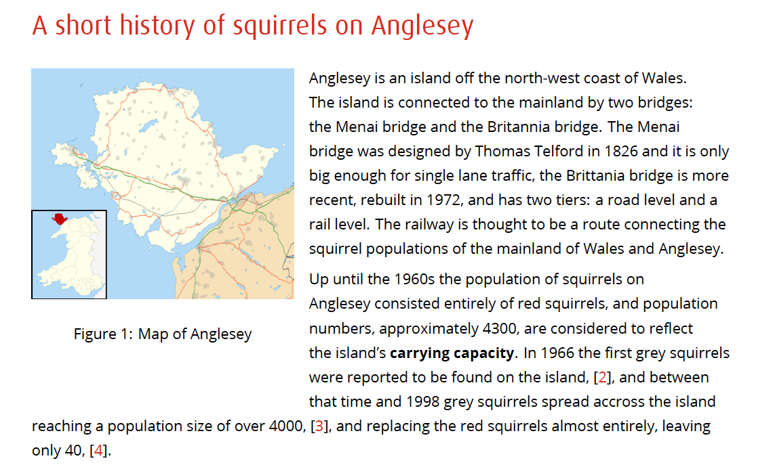
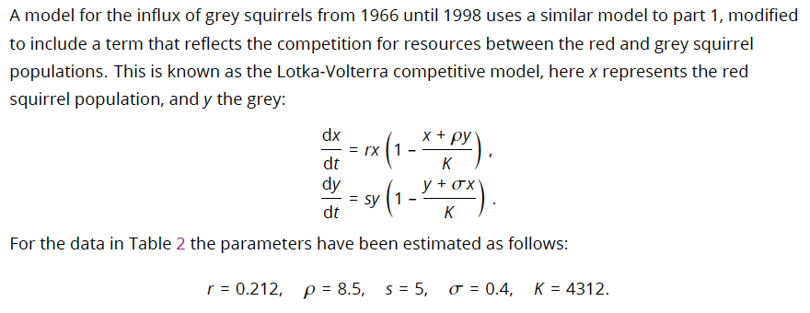
PROBLEM SOLVING 2020-21

Slide 15
What the students say
Being forced to think more creatively when trying to formulate a solution and becoming more patient when doing so has helped me not only in a professional setting but it has also helped me in a day to day basis also. The variety of complex topics I came across throughout the degree helped me become more adaptable when being introduced to new topics professionally.

Slide 16
PROBLEM SOLVING From 2022
Students choose one vague prompt.
Submission is report and presentation (worth 15 credits).
Worked on in timetabled workshops with guidance and support from lecturers.

Slide 17
Mathematical Statistics
Problem of interest to the student
Explicit human judgement
Open-ended brief, but
Guidance on expected content
Guidance on epistemic links
Refer to our shared body of theory (not ChatGPT’s!)
Multiple contact points while completing assignment
Bespoke follow-up question:
Authentic! Graduates will work with clients.
Avoid “solved” questions on e.g. Kaggle datasets
Compare with ChatGPT output.
Authentic! Interviewees will need to demonstrate what they can offer over Ai.

Slide 18
Multivariable Calculus
Problem of interest to the student
Explicit human judgement
Open-ended brief, but
Guidance on expected content
Multiple contact points while completing assignment

Slide 19
Multivariable Calculus
Let’s try a banana:
Bananas are curved. Let’s say the curve is a cubic.
Bananas can be sliced into circles.
Find the tangent plane to the curve.
Vary the radius of the circles.

Slide 20
Multivariable Calculus

Slide 21
Multivariable Calculus
Further questions relate to the student’s object of interest.
Guide students to trusted tools (WolframAlpha)
Bespoke follow-up question:
Authentic! Graduates will work with clients.
Compare with ChatGPT output.
Authentic! Interviewees will need to demonstrate what they can offer over Ai.

Slide 22
Larger Modules

Slide 23
LargeR modules
Exams are inauthentic but incredibly time-efficient!
Lecturers as “project managers” would require an investment of staff time.
Received wisdom: exams are 10 times faster to mark than to sit.
180 minute exam
120 minute exam + 6 minute viva
60 minute exam + 12 minute viva
3 times 6 minute vivas
18 minutes per student

Slide 24
Financial Data Analysis
Service module with 120 students
Previous assessment: 2 hour exam (12 minutes to mark!)
Section A
Section B
Closed, prescriptive questions. Little problem solving.
Our pitch for next year: hybrid (still with 12 minutes to mark!)
Section A: exam conditions/coursework. Closed questions.
Section B: 6 minute viva. Less prescriptive, problem solving questions.

Slide 25
Summary

Slide 26
Authentic LTA
Authentic assessment: uses formats typical of professional environment
Authentic problems: “real world”
Messy
Vague
Open-ended
Support by others (have multiple contact points during assessment)
Dynamic (use bespoke follow-up questions)
Not just “applied”
Guide students on
expected content (to satisfy LOs)
explicit links to theory (to avoid LLM reliance)
Actively compare results to LLMs – this is an authentic real-world problem!

Slide 27
References
Office for Students, Access and Participation Dashboard [accessed 24/08/23], https://www.officeforstudents.org.uk/data-and-analysis/access-and-participation-data-dashboard/data-dashboard/

Slide 28
Questions?
MESH Research Group
Dr Brendan Masterson b.masterson@mdx.ac.uk @BrendanMasters4
Dr Nick Sharples n.sharples@mdx.ac.uk @nick_sharples
Dr Matthew Jones matthew.m.jones@ucl.ac.uk @doc_jones1
Dr Snezana Lawrence s.lawrence@mdx.ac.uk @snezanalawrence
Dr Alison Megeney a.megeney@mdx.ac.uk @DrAliMegs
Notes:
Order of speaking and other Mesh Members

